Slide 1
Sustainability- Principles and Practices
Chapter 1
Introduction to Sustainability

Slide 2
LEARNING OBJECTIVES
Define sustainability.
Discuss the Conference of Parties meeting in Paris in 2015
Define the term Carbon War Room or CWR.
Describe the “1.5 to Stay Alive” initiative
Explain the six leading green economy investments.
Identify how sustainability can be introduced into schools and the STEM (Science, Technology, Engineering and Math) curriculum
List the programs that can prepare the future green workforce

Slide 3
SUSTAINABILITY 1.
Definition: What is Sustainability?
Sustain means "to maintain"
Means to "live, or maintain, within limits."
1987, Brundtland Commission defined Sustainability
Development that meets the needs of the present without compromising the needs of future generations to meet their own needs."
Sustainability terms include: “green,” “energy independence,” “eco-friendly,” “renewable energy” “zero carbon footprint”
What is Sustainability?: 9:43
Sustainability Explained: 4:01
Sustainability Explained through Animation: 2:00

Slide 4
SUSTAINABILITY 2.
Wetlands & Forests
Examples of sustainable biological systems.
Sustainability: strength of systems & processes
To be maintained to preserve environment
Create & maintain conditions under which
People & nature can exist together
To support present & future generations

Slide 5
SUSTAINABILITY 3.
Sustain Means To Maintain
Sustainable means to live, or maintain
Within certain government mandated limits
Technological growth, fueled by fossil fuels
Makes this true today.
To live up to sustainability challenge
Old habits have to be changed
New ways of thinking and doing must be developed
Pursuit of long-term efficiency in all our productive activities

Slide 6
QUESTION 1: ?
Which of these means to maintain certain government mandated limits?
a. Climate controls
b. Sustain
c. Environmentalism
d. Global warming?

Slide 7
ANSWER 1:
b. Sustain

Slide 8
STUDENT ACTIVITY 1.
Download WORD file: What is Sustainability?

Slide 9
HISTORY OF SUSTAINABILITY 1.
Sustainability Movement Grew Out Of Ideas From:
Henry David Thoreau
Theodore Roosevelt
John Muir

Slide 10
HISTORY OF SUSTAINABILITY 2.
Maximum Sustainable Yield (MSY)
Reach maximum amount of resource extraction
Not depleting resource from one harvest to next
Point when rate of resource extraction or harvest
Equals amount produced by the ecosystem
Metric looks at impact of a human society
Increasing or decreasing

Slide 11
HISTORY OF SUSTAINABILITY 3.
Ecological Footprint
Represents carrying capacity of earth
Total area of productive land and water
Required to produce what population consumes
& Wastes produced

Slide 12
HISTORY OF SUSTAINABILITY 4.
Precautionary Principle
Central to sustainability ethics
Great deal not known about specific impacts of
Human activities on natural resources
E.G. Californian sardine industry collapsed suddenly
In 1940s due to overfishing
Priority should lie with ecosystem preservation
Rather than industrial development & market growth

Slide 13
HISTORY OF SUSTAINABILITY 5.
FREQUENTLY ASKED QUESTION
Where Did Term Sustainability Come From?
In 1987, WCED (World Commission on Environment and Development) defined sustainability “…as an economic development activity that meets the needs of the present without compromising the ability of future generations to meet their own needs.”
Sustainability movement came from UN Agenda 21
Provision of UNCED (United Nations Conference on Environment and Development) held in Rio de Janerio, Brazil in 1992.

Slide 14
FIGURE 1-2 Rio Sustainability Conference Logo (Courtesy Of Https://Sustainabledevelopment.Un.Org/Rio20)

Slide 15
HISTORY OF SUSTAINABILITY 6.
Rio +20
United Nations Conference on Sustainable Development (Rio+20)
Rio de Janeiro, Brazil from June 20-22, 2012
resulted in a focused political outcome document,
Measures for implementing sustainable development
Non-binding, voluntarily plan of UN

Slide 16
QUESTION 2: ?
Where did the term sustainability come from?
a. EPA
b. United Nations
c. US Department of Energy
d. World Health Organization ?

Slide 17
ANSWER 2:
United Nations

Slide 18
BRUNDTLAND COMMISSION 1.
Brundtland Commission
World Commission on Environment & Development (WCED)
Rally countries to work and pursue sustainable
Development together as established by UN
Javier Pérez de Cuéllar, former Secretary General of UN
Appointed Gro Harlem Brundtland as chairperson
Gro Harlem Brundtland was former Prime Minister of Norway
Strong background in sciences and public health
Brundlant Report: 3:31

Slide 19
BRUNDTLAND COMMISSION 2.
Brundtland Commission
Proposed Long-Term Environmental Strategies:
Recommend ways in which concern for the environment may be translated into greater co-operation among developing countries and between countries
Consider ways and means by which international community can deal more effectively with environmental concerns
Help to define shared observations of long-term environmental issues and of appropriate efforts needed to deal successfully with problems of protecting and enhancing environment

Slide 20
BRUNDTLAND COMMISSION 3.
Report, Our Common Future
Called for international meeting, where
More actual initiatives & goals could be developed
Called Agenda 21, came out of the meeting
Actions to be taken globally, nationally, and locally
Make life on Earth more sustainable.
1992/2002 Earth Summits result of Brundtland Commission

Slide 21
FIGURE 1-2 CIRCLES OF SUSTAINABILITY indicating relationship between "3 pillars of sustainability", in which both economy and society are constrained by environmental limits the Brundtland Commission created the 3 main pillars of sustainable development: economic growth, environmental protection, and social equality. It is easy to agree that each of these three ideas contribute to the overall idea of sustainability. Yet, it is difficult to find evidence of equal levels of initiatives for the three pillars in countries' policies worldwide
3 Pillars are Interdependent
Cannot exist without others
Common ground for sustainability standards and certification systems
Brundtland Commission created theoretical framework that many nations agree with and want to try to make a difference with in their countries.

Slide 22
3 Pillars of Sustainability Animation

Slide 23
BRUNDTLAND COMMISSION 4.
Economic Growth
Brundtland Commission helped to change association
Between economic growth and resource withdrawal
Worldwide consumption of resources was projected to increase
Agenda 21 strengthened the importance of finding ways
To generate economic growth without causing harm to environment

Slide 24
BRUNDTLAND COMMISSION 5.
Environmental Protection
Become a big issue to government and businesses
2010, US & Europe added more power capacity
Renewable sources such as wind and solar
2011, 45 new wind energy projects 25 different US states
Eco-city development helped to develop water conservation
Smart grids with renewable energy sources
LED (light emitting diodes) street lights and energy.
Estimated consumption of about 80% of natural resources
Used each year is being consumed by about 20% of population.

Slide 25
BRUNDTLAND COMMISSION 6.
Net Zero
EPA Program to Conserve
Water, reduce energy use, and eliminating solid waste
EPA researchers developing and implementing
Net Zero strategies, approaches, and technologies
Net Zero means consuming only as much energy as produced
Achieving a sustainable balance between
Water availability and demand, eliminating solid waste sent to landfills

Slide 26
BRUNDTLAND COMMISSION 7.
Brundtland Commission
Dissolved in December 1987 after releasing
Brundtland Report or Our Common Future, in October 1987
Defined meaning of term "Sustainable Development“
Center for Our Common Future organization
Started in April of 1988 to take place of Brundtland Commission

Slide 27
BRUNDTLAND COMMISSION 8.
Four Pillars of Sustainability
Some sustainability experts have used 4 pillars
1. Economic
2. Ecological
3. Political
4. Cultural
In accord with UN Agenda 21, who
Specifies culture as 4th domain of sustainable development
Used by UN in several of its sustainability programs

Slide 28
BRUNDTLAND COMMISSION 9.
3 Es
Kent E. Portney of MIT Sustainability Book
Referred to 3 circles as “3 Es” which stand for:
Economy
Equity
Environment

Slide 29
QUESTION 3: ?
All of these are pillars of sustainable development, EXCEPT:
a. Economic growth
b. Environmental protection
c. Energy
d. Social equality

Slide 30
ANSWER 3:
Energy

Slide 31
CONFERENCE OF PARTIES (COP) 1.
2015 UN Climate Change Conference
COP (Conference of Parties) 21
Paris, France, from November 12-20, 2015
21st session of COP to 1992 UNFCCC
11th session of Meeting of Parties to 1997 Kyoto Protocol
Formal meeting of COP to assess progress
Dealing with climate change, beginning in the mid-1990s
Negotiate Kyoto Protocol for binding obligations
For developed countries TO reduce their greenhouse gas emissions
Climate Change: 1.5 to Stay Alive: 3:58

Slide 32
CONFERENCE OF PARTIES (COP) 2.
COP Negotiated Paris 2016 Agreement
Global agreement on reduction of climate change
Consensus of representatives of 196 parties attending
Agreement will take effect when joined by at
Least 55 countries representing 55% of global greenhouse emissions (Figure 1-3)
April 22, 2016 (Earth Day), 174 countries signed the agreement in New York at the UN building
Began adopting it within their own legal systems (through ratification, acceptance, approval, or accession).

Slide 33
FIGURE 1-3. The agreement will take effect when joined by at least 55 countries which together represent at least 55% of global greenhouse emissions that lead to Global Warming.

Slide 34
CONFERENCE OF PARTIES (COP) 3.
Expected Key Result
Set a goal of limiting global warming < 2° Celsius
Zero net man created greenhouse gas emissions
Reached during 2nd half of the 21st century
Adopted version of Paris Agreement
Pursue efforts to limit temperature increase to 1.5° C
Require 0 emissions sometime between 2030-2050

Slide 35
CONFERENCE OF PARTIES (COP) 4.
Prior to Conference
Intended Nationally Determined Contributions or INDC
Estimated to limit global warming to 2.7º Celsius by 2100
EU suggested INDC was a guarantee to reduce emissions
By 40% by 2030 as compared to 1990 standards
No detailed timetable or country-specific goals for emissions
Were incorporated into the Paris Agreement
As opposed to the previous Kyoto Protocol

Slide 36
CARBON WAR ROOM 1.
CWR (Carbon War Room)
International NGO (non-governmental organization)
Think tank working on issues
Market-based solutions to climate change
Founded by Virgin Group CEO Richard Branson
Merged with the Rocky Mountain Institute in 12/2014.
Carbon War Room explained: 2:08

Slide 37
CARBON WAR ROOM 2.
CWR Initiatives
Shipping Efficiency
Green Capital
Renewable Jet Fuels
Smart Island Economies
Focus of CWR includes these major environmental areas:
1. Agriculture
2. Energy Supply, Forestry, Industry
3. Buildings
4. Transport and Waste Management

Slide 38
ONE POINT FIVE TO STAY ALIVE INITIATIVE 1.
One Point Five to Stay Alive
Took place in the Caribbean with
AOSIS (Alliance of Small Island States)
Centered on adopting 1.5C as goal of climate negotiations
According to climate science, this tougher standard
Give AOSIS a better chance of surviving rising seas
Threaten to flood cities, drown crops, and fuel storm surges
Help AOSIS survive effects of climate change

Slide 39
ONE POINT FIVE TO STAY ALIVE INITIATIVE 2.
Beginning
1.5 to stay alive campaign
Gained momentum at NY meeting on climate change
Caribbean song, badges, t-shirts and stickers
Raise awareness of small islands and low lying states
Distributed at Copenhagen Climate Change meeting

Slide 40
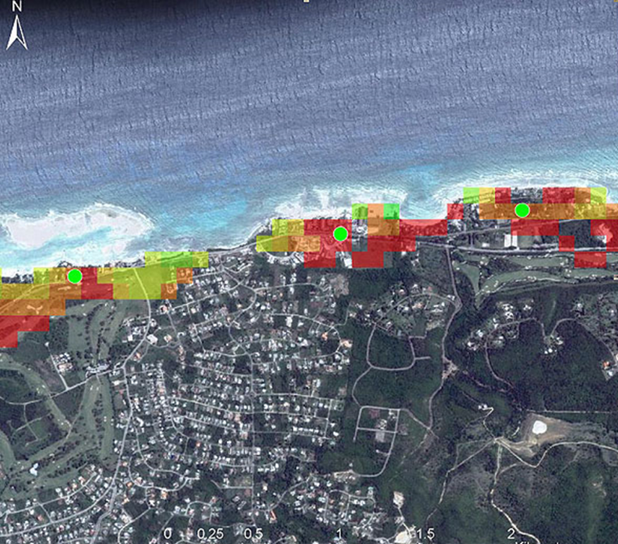
FIGURE 1-4 shows an example of high resolution sea level rise modelling now being undertaken in the Caribbean. The colors show the impact of different levels on infrastructure. Taken from ‘An overview of modelling climate change impacts in the Caribbean with contribution from the Pacific islands’

Slide 41
ONE POINT FIVE TO STAY ALIVE INITIATIVE 3.
CASE STUDY: Islands Could Disappear
Ronald Jumeau, UN ambassador for climate change stated: “It’s not just a question of islands slipping under. People think it’s a very simple story, but we would become a failed state. If these measures were enacted our economy would collapse,”
80% of Population & Economic activity is in coastal area
Airport would be lost
#1 industry tourism & #2 fishing port could be lost, PLUS:
capital
Power stations
Schools, which are on the coast
Hotels which are on the coast

Slide 42
QUESTION 4: ?
The “One Point Five to Stay Aline” initiative took place where?
a. United States
b. Eastern Europe
c. Western Europe
d. Caribbean Islands

Slide 43
ANSWER 4:
Caribbean Islands

Slide 44
STUDENT ACTIVITY 2.
Download WORD file: Sustainability Elevator Pitch

Slide 45
SIX LEADING GREEN ECONOMY INVESTMENTS 1.
Karl Burkart, Digital Communications Director for the GCCA, Global Call for Climate Action, defines Green Economy based on 6 main sectors:
Green Buildings
Sustainable Transport
Renewable Energy
Water Management
Waste Management
Land Management

Slide 46
SIX LEADING GREEN ECONOMY INVESTMENTS 2.
Green Buildings
Reduce a built environment's ecological footprint
Connected with construction/operation of
Built environment throughout its life cycle.
Building operations, construction, transportation, and energy use.
Solid waste, water, and construction materials
As they relate to energy use also factor into the analysis.
How to Build a Net Zero Energy House: 7:00

Slide 47
SIX LEADING GREEN ECONOMY INVESTMENTS 3.
Consider following issues in building:
Where do building materials originate, and what processes need to occur to produce them in their current state?
Where will those materials go after the use?
What are sources for water and energy that this building utilizes?
How do those energy and water sources alter the building's surroundings?
What transportation options will be available to users of this building

Slide 48
SIX LEADING GREEN ECONOMY INVESTMENTS 4.
Purchasing TV or microwave. Consider following issues with that purchase:
Where were materials that went into a product purchased?
What happens after product breaks or is no longer needed?
Will it be sent to landfill or back to manufacturer, or donate it?
Is product purchased energy and water efficient?

Slide 49
SIX LEADING GREEN ECONOMY INVESTMENTS 5.
Product Life Cycle (Figure 1-5)
Goal of green building is to create
Healthy, comfortable, and sustainable built environments
Reduce water and energy consumption
Solid waste generation, & greenhouse gas emissions
Reduces costs and liabilities
Increases overall monetary value
Collective impact of improving these facets of green building
Supports restoring and preserving economic prosperity, promoting human health, and protecting the environment

Slide 50
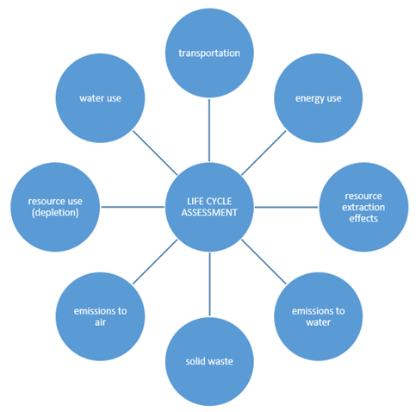
Figure 1-5 Life Cycle Assessment or Ecosystem

Slide 51
SIX LEADING GREEN ECONOMY INVESTMENTS 6.
US Green Building Council (USGBC)
Market transformation example
Leadership in Energy and Environmental Design (LEED)
Rating Systems: FIGURE 1-6 NEXT SLIDE
USGBC has made an impact in the green building industry
Created a movement and market transformation Results:
More than 12,200 national members
More than 150 countries and territories with LEED projects

Slide 52
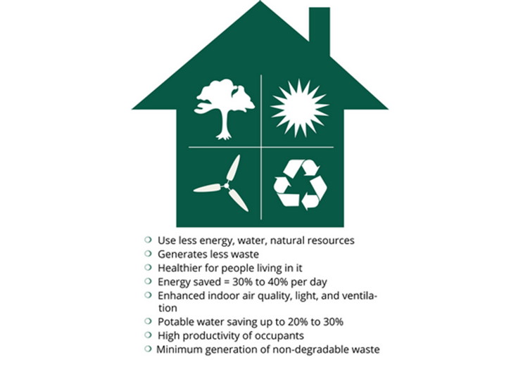
FIGURE 1-6. LEEDS Rating System

Slide 53
SIX LEADING GREEN ECONOMY INVESTMENTS 7.
Sustainable Transport
Transport sustainable in senses of social, environmental and climate impacts and ability to transport energy source indefinitely, include:
Particular vehicles used for road
Water or air transport
Source of energy
Infrastructure to accommodate transport (roads, railways, airways, waterways, canals and terminals)
Pipelines for transporting liquid or gas materials
Transport operations and logistics

Slide 54
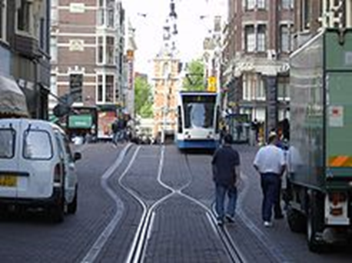
FIGURE 1-7. Sustainable transport systems make a positive contribution to the environmental, social and economic sustainability of the communities they serve. Transport systems exist to provide social and economic connections, allowing increased mobility. The advantages of increased mobility need to be weighed against the environmental, social and economic costs that transport systems pose.

Slide 55
SIX LEADING GREEN ECONOMY INVESTMENTS 8.
Renewable Energy: Wind Mill FARM Figure 1-8
Energy collected from resources
Naturally replenished on a human timescale
Sunlight, wind, rain, tides, waves, and geothermal heat
Renewable energy provides energy in 4 areas:
Electricity generation
Air and water heating/cooling
Transportation
Rural (off-grid) energy services.

Slide 56
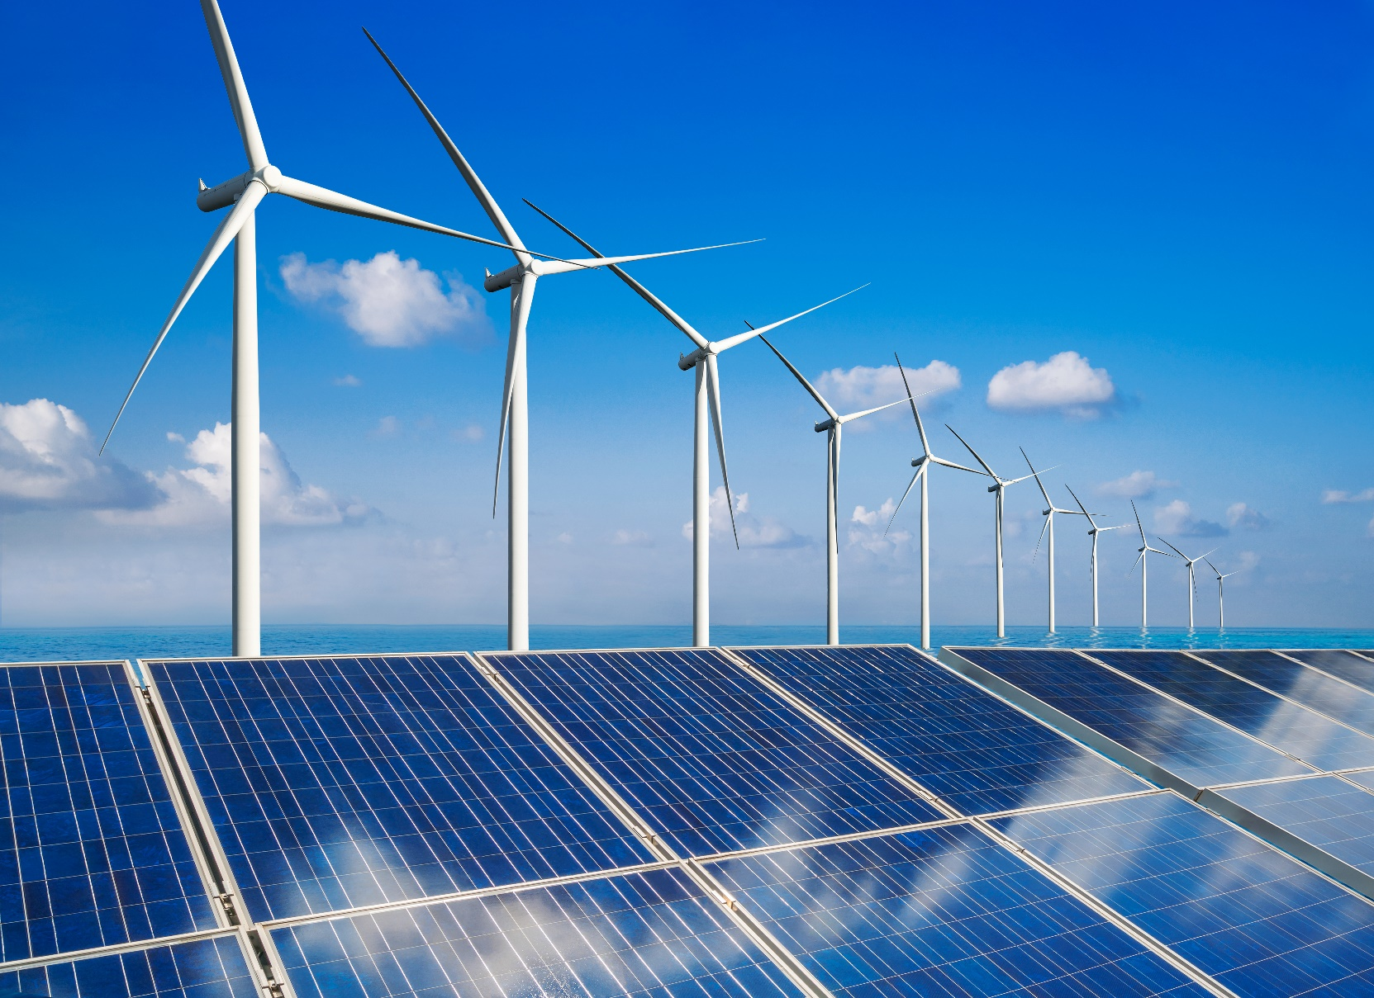
FIGURE 1-8. Renewable energy is generally defined as energy that is collected from resources which are naturally replenished on a human timescale, such as sunlight, wind, rain, tides, waves, and geothermal heat. Renewable energy provides energy in four important areas including: Electricity generation, Air and water heating/cooling, Transportation, and Rural (off-grid) energy services.

Slide 57
SIX LEADING GREEN ECONOMY INVESTMENTS 9.
Water Management
Activity of planning, developing, distributing
Managing optimum use of water resources
Part of water cycle management
Concerns all competing demands for water
Allocate water on an equitable basis to satisfy demands

Slide 58
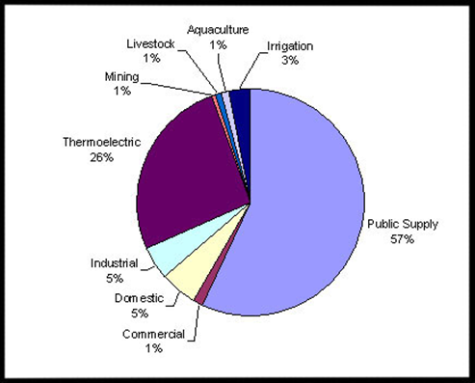
Figure 1-9 Water Distribution
Water
Essential resource
3% is fresh
2/3^{rds} is locked up in ice caps and glaciers
Remaining 1%, a fifth is in remote, inaccessible areas
Rainfall from floods that cannot easily be used
Water can become scarcer
0.08% of world’s fresh water supply is misused by mankind

Slide 59
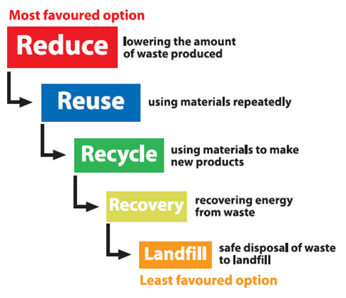
SIX LEADING GREEN ECONOMY INVESTMENTS 10.
Waste Management
Concerns all activities/actions to manage waste
From cradle to grave
Includes: collection, transport, treatment and disposal of waste together with monitoring and regulation
Actions include legal and regulatory framework
Related to waste management guidance on recycling etc.
Figure 1-10 Waste Hierarchy

Slide 60
SIX LEADING GREEN ECONOMY INVESTMENTS 11.
Land Management
Managing use and development
(Both urban and rural settings) of land resources
Land resources are used for a variety of purposes
Include organic agriculture, reforestation,
Water resource management and eco-tourism projects

Slide 61
SIX LEADING GREEN ECONOMY INVESTMENTS 12.
Land Management
Sustainable Land Management (SLM)
Use of land resources, including soils, water, animals and plants,
For the production of goods to meet changing human needs
SLM is merger of agriculture & environment: 2 objectives:
Maintaining long term productivity of the ecosystem functions (land, water, biodiversity)
Increasing productivity (quality, quantity and diversity) of goods and services, and particularly safe and healthy food.

Slide 62
TIP to REMEMBER
Over 225,000 more people on earth each day
Means a population growth of over 82,000,000
Additional people on earth each year
Means a lot more people need to be feed each year

Slide 63
QUESTION 5: ?
Which of these is defined as energy that is collected from resources which are naturally replenished
a. Natural
b. Renewable
c. Green
d. Earth

Slide 64
ANSWER 5:
Renewable

Slide 65
STUDENT ACTIVITY 3.
Download WORD file: Finding Academic Solutions for Sustainability

Slide 66
SUSTAINABILITY EDUCATION 1.
Maker Movement
Maker culture is a contemporary culture or subculture
Technology-based extension of DIY (Do-it-Yourself) culture
Creation of new devices as well as tinkering with existing ones
Supports open-source hardware
Engineering-oriented pursuits: sustainability, electronics, robotics,
3-D printing, & use of computerized manufacturing tools
Strong focus on using and learning practical skills and applying them
Maker culture emphasizes learning-through-doing (active learning)
Maker Movement (TedEx): 15:04
Defining the Maker Movement: 3:32
Sustainability for All (TedEx talk): 19:02

Slide 67
CASE STUDY
TechShop
Chain of member-based workshops
People of all skill levels come in and use industrial tools and equipment to build their own projects
Offer safety and basic usage training on all the tools and equipment
Membership is available yearly, monthly, or daily
TechShop was founded by Jim Newton and Ridge McGhee
Newton, science adviser to the TV show Mythbusters
Motivated by his students' frustration with lack of access to equipment
Figure 1-11 TechShop

Slide 68
SUSTAINABILITY EDUCATION 2.
STEM Curriculum
Maker culture has attracted interest of educators
Concerned about’ disengagement from STEM subjects
(Science, Technology, Engineering & Mathematics)
Maker culture has potential to contribute to a more
Participatory approach and create new pathways
Making them more alive
Causes learners to be more interested in STEM activities.
Techshop connects sustainability and the maker movement
Sustainability and STEM: 5:02

Slide 69
QUESTION 6: ?
What the acronym STEM stand for?
a. science, technology, engineering and mathematics
b. Super technology for engineering and math
c. Science controlled the environment and mother earth
d. Super technology engineering and mathematics

Slide 70
ANSWER 6:
Science, Technology, Engineering and Mathematics

Slide 71
PROGRAMS FOR GREEN WORKFORCE 1.
Typical Programs
Environmental term: GREEN
Loosely applied to
Any effort, product, or initiative proposes to benefit environment
Term not scientific WITH little consensus
What activities can/cannot qualify as "GREEN."
Sustainability strategies usually parallel activities
Referred to as "Green Activities or programs“
"Green Activities" do not reflect all ideas behind sustainability

Slide 72
PROGRAMS FOR GREEN WORKFORCE 2.
Green Programs & Jobs
Help protect ecosystems and biodiversity
They include:
Environmental Engineers
Design ecologically solutions to problems
Water Conservationists
Develop solutions for soil erosion
Environmental Design: Design Renewable Technology
Naturalists: Protect and preserve geographical areas

Slide 73
CASE STUDY
Green Street-Green Jobs-Green Towns
EPA & Chesapeake Bay Trust Exit Funder
Support for urban green stormwater infrastructure projects
Help implement sustainability plans reduce stormwater runoff,
Improve local water quality, and enhance a community's quality of life
Enhance green spaces in communities
Implementing urban green stormwater practices
Increasing urban green spaces
Replacing impervious surfaces with more permeable materials
Green Workforce: 9:34

Slide 74
QUESTION 7: ?
What term been loosely applied to any effort, product, or initiative that proposes to benefit the environment and used in many areas of business?
a. Sustainability
b. Control
c. Green
d. Blue

Slide 75
ANSWER 7:
Green

Slide 76
STUDENT ACTIVITY 4.
Download WORD file: Sustainability Around the World

Slide 77
Summary (1 of 3)
Sustainability: property of various biological systems to remain different and productive forever. Comes from the term sustain and the ability to sustain our ecological or environmental systems.
From UN Agenda 21, which was a provision of UN
Brundtland Commission; (WCED) World Commission on Environment and Development. Rally countries to work and pursue sustainable development.
3 main pillars of sustainable development: economic growth, environmental protection, and social equality

Slide 78
Summary (2 of 3)
Carbon War Room & “One Point Five to Stay Aline initiative” specific components of Sustainability movement
6 green economy sectors are: Green buildings, Sustainable transport, Renewable energy, Water management, Waste management, &Land management
TechShop is a chain of member-based workshops that lets people of all skill levels come in and use industrial tools and equipment to build their own projects
Techshop connects sustainability and the maker movement

Slide 79
Summary (3 of 3)
Maker culture attracted interest of educators and gotten students interested in STEM subjects (science, technology, engineering and mathematics) in formal educational settings
Term "green" has been applied to any effort, product, or initiative that proposes to benefit the environment in many areas of business. Not scientific, little consensus about what activities can or cannot qualify as "green." Sustainability strategies usually parallel activities commonly referred to as "green activities or programs", but "green activities" do not reflect all ideas behind sustainability.

