Slide 1
Sustainability- Principles and Practices
Chapter 10
Hydroelectric & Geothermal Electric Generation

Slide 2
LEARNING OBJECTIVES
Define sustainability.
Discuss the Conference of Parties meeting in Paris in 2015
Define the term Carbon War Room or CWR.
Describe the “1.5 to Stay Alive” initiative
Explain the six leading green economy investments.
Identify how sustainability can be introduced into schools and the STEM (Science, Technology, Engineering and Math) curriculum
List the programs that can prepare the future green workforce

Slide 3
HYDROELECTRICITY 1.
Hydroelectricity
Converting flowing water energy
Into mechanical energy of a turbine
AC hydroelectric generator to generate electricity
China largest producer of hydroelectricity
Hydropower in a Pipe: 1:54
How to Make Electricity with Water: 3:52

Slide 4
FIGURE 10-1 hydroelectric plant using a dam for the water supply.

Slide 5
HYDROELECTRICITY
NO ANIMATION IN FOLDER

Slide 6
HYDROELECTRICITY 2.
Economic Impact
Cheap to produce, very competitive source
Does not consume or use any water or fossil fuels
>10 megawatts costs about is 3-5 cents per kilowatt-hour
Dam is a barrier that impounds water or underground streams
Reservoirs created by dams not only suppress floods
Provide a water supply for hydroelectricity
Produces no waste, and lower level of greenhouse gases

Slide 7
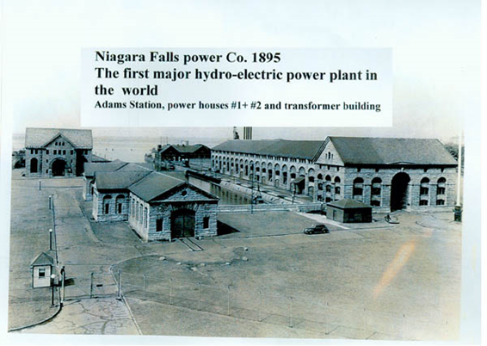
HYDROELECTRICITY 3.
History of Hydroelectricity
Schoelkopf Power Station produce electricity in 1881
1st Edison hydroelectric power plant was the Vulcan Street Plant, in September 30, 1882, 12.5 kilowatts
40% of power produced in US by 1920 was hydroelectric
Figure 10-2 first major hydro-electric power plant in the world in Niagara Falls

Slide 8
HYDROELECTRICITY 4.
Federal Power Act passed into law
Created Federal Power Commission
Regulate hydroelectric power stations
Federal funding became necessary for large-scale development
TVA (Tennessee Valley Authority) in 1933
Bonneville Power Administration (1937)
Hoover Dam's 1,345 MW power station
World's largest hydroelectric power station in 1936
Surpassed by 6,809 MW Grand Coulee Dam in 1942

Slide 9
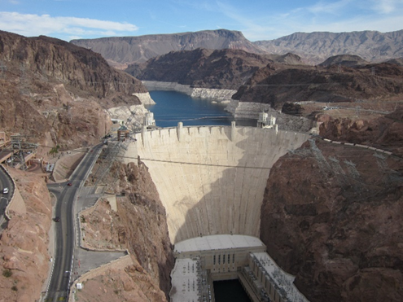
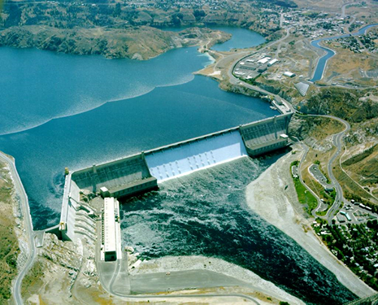
FIGURE 10-3 view A: Hoover Dam, View B: Grand Coulee Dam
View B:
View A:

Slide 10
QUESTION 1:
Which of these is defined as converting the energy of flowing water into mechanical energy to turn an AC hydroelectric generator to generate electricity?
a. Photovoltaic energy
b. Hydroelectricity
c. Energy of water
d. Water energy

Slide 11
ANSWER 1:
Hydroelectricity

Slide 12
CONVENTIONAL HYDROELECTRIC DAM 1.
Head of Water
Most hydroelectric power comes from potential energy
Dammed water driving a water turbine & generator
Power extracted depends on flow volume
From head of water or difference in height
Between source and water's outflow
Large pipe or penstock delivers water from
Reservoir to turbine

Slide 13
FIGURE 10-4 conventional hydroelectric dam

Slide 14
CONVENTIONAL HYDROELECTRIC DAM 2.
Hydroelectric Advantages
Flexibility: output can be ramped up and down
Low Power Costs: no fossil fuels
Suitability:
Reduced CO2 Emissions: do not burn fossil fuels
Reservoir Use: Reservoirs provide other uses

Slide 15
CONVENTIONAL HYDROELECTRIC DAM 3.
Disadvantages
Ecosystem damage and loss of land
Siltation and flow shortage
Methane Emissions (from reservoirs)
Relocation: need to relocate people
Failure risks: Dam & hydroelectric power station failures.

Slide 16
QUESTION 2:
What is defined as the difference in height between the source and the water's outflow?
a. Pondage
b. Water pressure
c. Height of water
d. Head of Water

Slide 17
ANSWER 2:
Head of Water

Slide 18
PUMPED-STORAGE HYDROELECTRIC DAM 1.
Produces Electricity
Moving water between reservoirs at different elevations
Low demand, excess generation capacity used
Pump water into upper reservoir
High demand water is released back into lower-level r
Provide most important means of large-scale grid energy
Improve daily capacity factor
SEE FIGURE 10-5 NEXT SLIDE

Slide 19
FIGURE 5 pumped-storage hydroelectric system

Slide 20
QUESTION 3:
What type of hydroelectricity production produces electricity by moving water between reservoirs at different elevations for peak demands?
a. Standard
b. Run of the river
c. Pumped-storage
d. Dumped storage

Slide 21
ANSWER 3:
Pumped-storage

Slide 22
STUDENT ACTIVITY 1.
Download WORD file: Building a Hydroelectric Generator

Slide 23
RUN OF THE RIVER 1.
Run-of-the-River (ROR) Hydroelectricity
Little or no water storage is used
Referred to as pondage
No pondage has no water storage
Subject to seasonal river flows
Intermittent energy source
Plant with pondage can regulate the water flow
At all times and serve as peaking power plant

Slide 24
FIGURE 10-6 Run-of-the-river hydroelectricity

Slide 25
FIGURE 10-7 Run-of-the-river plant with a small dam built to create a headpond or headgate to make sure there is enough water entering penstock pipes that lead to turbines which are at a lower elevation.

Slide 26
RUN OF THE RIVER 2.
Run-of-the-River Advantages
Create sustainable energy
Cleaner power, fewer greenhouse gases
Less flooding/reservoirs:
substantial flooding of upper part of river is not required
Large reservoir is not required
People do not need to be relocated

Slide 27
RUN OF THE RIVER 3.
Run-of-the-River Disadvantages
Little or no capacity for energy storage
Generates much more power during times
When seasonal river flows are high but not low flow
Create a reservoir hundreds of miles (kilometers) long
Environmental impacts:
Large projects have more environmental concerns

Slide 28
QUESTION 4: ?
What is a hydroelectricity plant where little or no water storage is used?
a. Conventional
b. Run of the river
c. Pumped-storage
d. Dumped storage

Slide 29
ANSWER 4:
Run of the river

Slide 30
MICRO-HYDRO SYSTEMS 1.
Micro-Hydro Systems
Produces from 5 kilowatts (kW) to 100 kilowatts
Using natural flow of water
Provide power to an isolated home or small community
Connected to electric power grids
Developing nations
Accomplished with Pelton wheel for high head
Low flow water supply. SEE FIGURE 10-9

Slide 31
FIGURE 10-8 Micro-hydro hydroelectric power system

Slide 32
FIGURE 10-9 The Pelton wheel is an impulse type water turbine that was invented by Lester Allan Pelton in the 1870s. The installation is often just a small dammed pool, at the top of a waterfall, with several hundred feet of pipe leading to a small generator housing, SEE FIGURE 10-8

Slide 33
MICRO-HYDRO SYSTEMS 2.
Micro-Hydro Power Advantages
Uses Natural flow of water to create the power
No direct emissions resulting from this conversion
ROR system meaning water diverted from river
Redirected back into the same watercourse
Adds to potential economic benefits of efficiency
An Introduction to Micro Hydro System: 7:14

Slide 34
MICRO-HYDRO SYSTEMS 3.
Micro-Hydro Power Disadvantages
Limited mainly by site characteristics
Direct limitation comes from small sources
With microscopic flow.
Water flow can fluctuate seasonally in some areas.
Distance from power source to site in need of energy

Slide 35
PICO-HYDRO SYSTEMS 1.
Pico Hydro System
Less than 5 kilowatts
Remote communities require only a small amount
Smaller turbines of 200 to 300 watts may power
Single home in a developing country
ROR system meaning water diverted from river
Redirected back into the same watercourse
Pico Hydro for Science: 8:30

Slide 36
FIGURE 10-10 Pico-hydro installation

Slide 37
GRID ENERGY STORAGE 1.
Grid Energy Storage
Methods used to store electrical energy
Within an electrical power grid
2016, biggest form of grid energy storage
Dammed hydroelectricity
Alternatives to grid storage includes
Peaking power plants to fill in
Feeds power to grids consumption exceeds production

Slide 38
FIGURE 10-11 hydroelectricity power grid system

Slide 39
STUDENT ACTIVITY 2.
Download WORD file: PICO-HYDRO Systems Project

Slide 40
GRID ENERGY STORAGE 2.
Grid Storage Advantages:
Electricity generated by intermittent sources
Stored and used later instead of being wasted
Peak generating capacity can be reduced
Increased stable pricing
Emergency preparedness where the needs can be met
How Grid Storage Works (Animated): 1:38

Slide 41
HYDROELECTRICITY EROEI (ENERGY RETURNED ON ENERGY INVESTED) EROEI 1.
EPBT (Energy Payback Time)
Time requisite to generate as much energy
As is consumed during production/lifetime of system
Plant with an 8 kilowatt system might achieve
Full potential 50% of year
Produce 35,040 kilowatt hours per year
Enough energy for five semi-detached homes
Payback period of approximately 7years

Slide 42
HYDROELECTRICITY EROEI (ENERGY RETURNED ON ENERGY INVESTED) EROEI 2.
EROEI uses Formula:
$EROEI= \frac{Electricity Generated }{Energy required to build and maintain the equipment}$
Energy Transfer and Efficiency: 21:22
Returns on Renewable Energy Investments: 1:16:33

Slide 43
GEOTHERMAL ENERGY 1.
Geothermal Energy
Energy derived from heat of earth
Core is distance of 4,000 miles and is so hot
Temperatures at least 5,000 degrees centigrade
Thermal energy determines matter temperature
Well drilled and earth’s core heats water into steam
Drives turbine to drive AC generator produce electricity
Energy 101: Geothermal Energy: 3:48

Slide 44
FIGURE 10-12 geothermal power plant schematic.

Slide 45
GEO-THERMAL ELECTRICITY

Slide 46
GEOTHERMAL BINARY CYCLE
NO ANIMATION IN FOLDER

Slide 47
FREQUENTLY ASKED QUESTION?
Where does geothermal energy come from?
The geothermal energy of the Earth's crust originates from the original formation of the planet and from radioactive decay of materials. The geothermal gradient, which is the difference in temperature between the core of the planet and its surface, drives a continuous conduction of thermal energy in the form of heat from the core to the surface.

Slide 48
FIGURE 10-13 We used geothermal energy from hot springs for therapeutic baths and space heating since ancient Roman times, however it is now better known for electricity generation

Slide 49
GEOTHERMAL ENERGY 2.
Earth's Geothermal Resources
Theoretically more than adequate to supply needs
Very small fraction may be profitably exploited
Drilling and exploration for deep resources expensive.
Forecasts for the future of geothermal power
Depend on assumptions about technology
Energy prices, subsidies, and interest rates

Slide 50
FIGURE 10-14 For industrial project, you need to drill well into hot aquifer. Aquifer is an underground layer of water-bearing permeable rock, rock fractures or unconsolidated materials (gravel, sand, or silt) from which groundwater can be extracted using a water well. If no adequate aquifer is available, artificial one may be built by injecting water to hydraulically fracture bedrock

Slide 51
GEOTHERMAL ENERGY 3.
Geothermal Power
Renewable because heat extraction is small
Compared to the Earth's heat content
Earth has an internal heat content of 1,031 joules
100 billion times current worldwide 2010 energy consumption
Extraction of earth core heat taps a very small fraction
Natural core outflow, without accelerating flow
Geothermal power is sustainable

Slide 52
QUESTION 5:
What is energy derived from the heat of the earth?
a. Hydropower
b. Geothermal
c. Thermal
d. Core

Slide 53
ANSWER 5:
Geothermal

Slide 54
STUDENT ACTIVITY 3.
Download WORD file: Hydroelectric vs. Coal Powered Electricity

Slide 55
STUDENT ACTIVITY 4.
Download WORD file: Building a Model Geothermal Plant

Slide 56
Summary (1 of 3)
Hydroelectricity is defined as converting the energy of flowing water into mechanical energy to turn an AC hydroelectric generator to generate electricity.
The hydroelectric plant produces no direct waste, and has a lower output level of greenhouse gases than fossil fuel powered electricity plants.
The power extracted from the water depends on the flow volume coming from the head of water or the difference in height between the source and the water's outflow.
A large pipe or penstock delivers water from the reservoir to the turbine.
Hydroelectric advantages are flexibility, low power costs, elimination of the cost of fuel, sustainability, reduced CO2 emissions, and reservoir use.

Slide 57
Summary (2 of 3)
Hydroelectric disadvantages are ecosystem damage and loss of land, siltation and flow shortage, methane emission, relocation, and failure risks.
The pumped-storage hydroelectricity production process plant produces electricity by moving water between reservoirs at different elevations for peak demands.
Run-of-the-river (ROR) hydroelectricity is a hydroelectricity plant with little or no water storage and is subject to seasonal river flows.
Micro-hydro is hydroelectric power that produces from 5 kilowatts (kW) to 100 kilowatts of electricity using the natural flow of water. Installations that are less than 5 kilowatts are called Pico-hydro systems.
Grid energy storage is a group of methods used to store electrical energy on a large scale within an electrical power grid. As of 2016, the biggest form of grid energy storage is dammed hydroelectricity.

Slide 58
Summary (3 of 3)
Hydroelectric dams with large reservoirs can be used to provide peak generation at times of peak demand.
The EPBT (Energy Payback Time) of a power generating system is the time requisite to generate as much energy as is consumed during the production and lifetime operation of the energy system.
EROEI (Energy Returned on Energy Invested) is the ratio of electricity generated divided by the energy required to build and maintain the equipment, which is an economic measure, closely related to the energy payback time.
Geothermal energy is energy derived from the heat of the earth core
A well is drilled to the core and heat from the earth’s core heats water into steam that drives a turbine to drive an AC generator to produce electricity.

