Slide 1
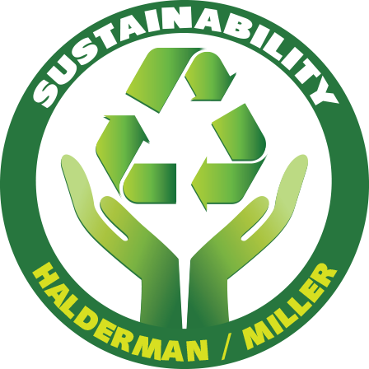
Sustainability- Principles and Practices
Chapter 11
Construction Industry to Sustainability

Slide 2
LEARNING OBJECTIVES
Explain the levels of LEED certification
Discuss how using LEED standards will lower the ecological footprint
Describe the LEED credit weighting process
Describe how a green roof saves energy
Discuss the meaning of a passive house
Discuss the advantages of using recycled and local materials
Describe why thermal controls are needed
Explain how using natural light and LED lighting helps sustainability
Discuss how using CMMS (Computerized Maintenance Management Systems) helps control costs

Slide 3
INTRODUCTION
Opportunities In Construction
Apply principles of sustainability
End waste/abuse improve carbon footprint
Through conservation and reuse
USGBC, US Green Building Council
Developed
LEED (LEADERSHIP IN ENERGY & ENVIRONMENTAL DESIGN)
Rating systems: design, construction, operation, maintenance
Green buildings, homes, & neighborhoods

Slide 4
LEED (LEADERSHIP IN ENERGY & ENVIRONMENTAL DESIGN) 1.
LEED (LEADERSHIP IN ENERGY & ENVIRONMENTAL DESIGN)
Worldwide green building certification program
USGBC or U.S. Green Building Council
Rating systems
501(c) 3 non-profit membership based organization
Promotes sustainability
What is LEED: 5:50
LEED Credits for Energy Modelers: 1:12

Slide 5
FIGURE 11-1 tower PNC building in Pittsburg that is LEED certified

Slide 6
LEED (LEADERSHIP IN ENERGY & ENVIRONMENTAL DESIGN) 2.
LEED Progress
Grew from a single building standard
To all-inclusive system of interrelated standards
Cover all phases from design to maintenance & operation

Slide 7
LEED GREEN BUILDING RATING SYSTEM 1.
LEED Versions:
LEED NC version 2.0,
LEED NC version 2.2 in 2005
LEED 2009 (previously named LEED Version 3)
LEED version 4, 11/2013 to 10/2016
Choose between LEED 2009 and LEED Version 4
Projects registering after October 31, 2016
Must use LEED Version 4

Slide 8
LEED GREEN BUILDING RATING SYSTEM 2.
5 Predominant Categories
LEED professional construction program:
Green Building Design & Construction
Green Interior Design & Construction
Green Building Operations & Maintenance
Green Neighborhood Development
Green Home Design and Construction

Slide 9
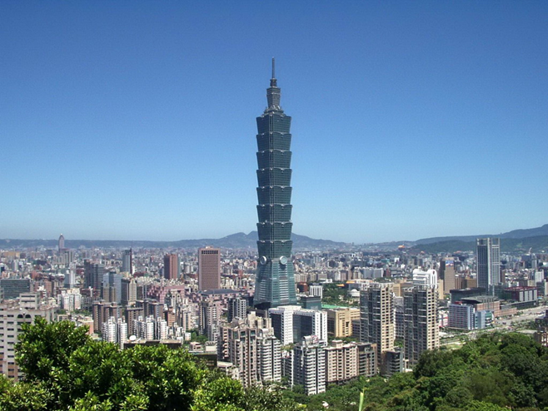
FIGURE 11-2 Taipei 101, tallest and largest green building of LEED Platinum certification in world since 2011

Slide 10
LEED GREEN BUILDING RATING SYSTEM 3.
LEED 2009
100 possible base points distributed
Across 6 credit categories
Sustainable Sites, Water Efficiency, Energy, Atmosphere, Materials and Resources, Indoor Environmental Quality, & Innovation in Design
10 additional points may be earned
4 additional points for Regional Priority Credits
6 additional points for Innovation in design

Slide 11
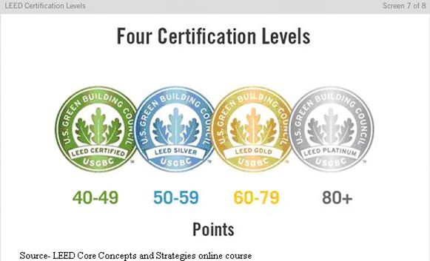
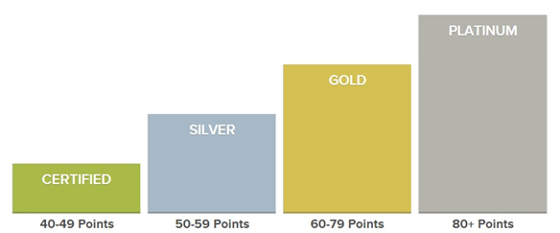
LEED GREEN BUILDING RATING SYSTEM 4.
Certification Level
4 Different LEED Certification Levels:
Certified: 40–49 points
Silver: 50–59 points
Gold: 60–79 points
Platinum: 80 points & above
How to get LEED Certified: 2:22
Figure 11-3 LEED Certification Levels

Slide 12
LEED GREEN BUILDING RATING SYSTEM 5.
LEED 2009 Performance Credit System
Assign points based on environmental impacts
Human benefits of each credit
EPA's Tools Reduction and Assessment of Chemical and Other Environmental Impacts (TRACI)
Developed by National Institute of Standards & Technology (NIST).

Slide 13
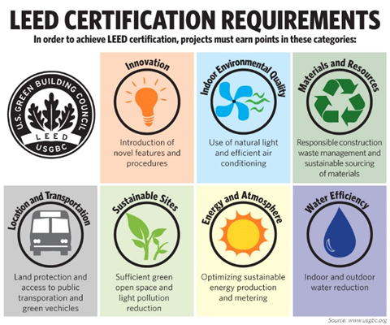
LEED GREEN BUILDING RATING SYSTEM 6.
Figure 11-4 Requirements
To participate in LEED 2009
Building must comply with environmental laws and regulations, occupancy scenarios, building permanence and pre-rating completion, site boundaries and area-to-site ratios

Slide 14
LEED GREEN BUILDING RATING SYSTEM 7.
Number of Points Project Earns
Determines its level of LEED certification categories:
Innovation in Design
Indoor Environmental Quality
Sustainable Sites
Water Efficiency
Energy & Atmosphere
Materials and Resources
Regional Priority

Slide 15
LEED GREEN BUILDING RATING SYSTEM 8.
LEEDS Credit Weighting Process
Following 3 steps:
Collection of reference buildings are used to determine environmental impacts of any building seeking LEED certification
National Institute of Standards and Technology weightings are used to judge importance of these impacts in each category
Data regarding actual impacts on environmental and human health used to assign points to individual categories &metrics

Slide 16
LEED GREEN BUILDING RATING SYSTEM 9.
LEEDS Environmental Impact
Use same source energy
Produce equal greenhouse gas emissions
As non-LEED-certified buildings
However, use between 11% and 39% less site energy
Than non-LEED buildings
Reduces ecological footprint

Slide 17
FIGURE 11-5 Green Building Information Gateway (GBIG) is a web-based tool, search engine and data platform for exploring and comparing the green dimensions of the built environment

Slide 18
LEED GREEN BUILDING RATING SYSTEM 10.
GBIG Categories Available With Tool:
Activities
Buildings
Places
Strategies
Collections

Slide 19
QUESTION 1:
LEED (Leadership in Energy & Environmental Design) is a worldwide green building certification program that was developed by?
a. EPA (environmental Protection Agency)
b. USGBC (US Green Building Council
c. DOE (US Department of Energy)
d. The UN (United Nations)

Slide 20
ANSWER 1:
USGBC (US Green Building Council

Slide 21
QUESTION 2:
How many points or credit are need for LEED Gold certification?
a. 40–49 points
b. 50–59 points
c. 60–79 points
d. 80 points and above

Slide 22
ANSWER 2:
60–79 points

Slide 23
STUDENT ACTIVITY 1.
Download WORD file: LEED (Leadership in Energy & Environmental Design) Certification

Slide 24
BREEAM 1.
BREEAM (Building Research Establishment Environmental Assessment Method)
Longest established method of assessing, rating
Certifying sustainability of buildings
Raise awareness among builders and owners
Benefits of taking a sustainability approach

Slide 25
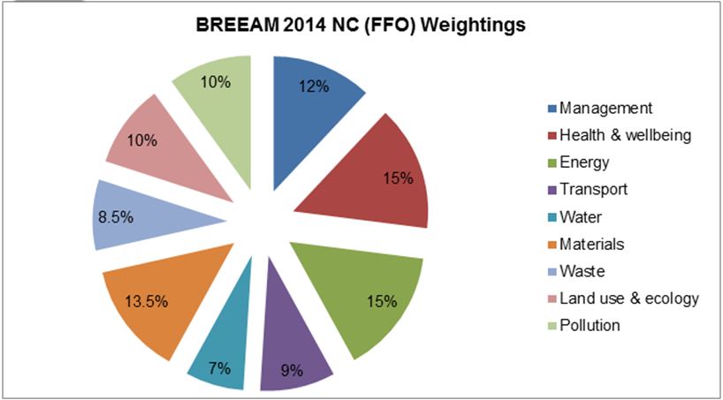
BREEAM 2.
BREEAM Assesses
energy and water use, health, pollution, transportation, materials, waste, ecology and management processes
Figure 11-6 BREEAM Weightings

Slide 26
GREEN (LEED) CONSTRUCTION 1.
Green Roof (Figure 11-7)
Living building roof
Partially or completely covered with vegetation
Growing medium, planted over waterproofing membrane
Root barrier and drainage and irrigation systems
They serve several purposes including:
absorbing rainwater
providing insulation
creating a habitat for wildlife
Aesthetically pleasing landscape
Lower urban air temperatures

Slide 27
FIGURE 11-7 Green Roof

Slide 28
GREEN (LEED) CONSTRUCTION 2.
Green Roof
Serve several purposes including:
Absorbing rainwater
Providing insulation
Creating a habitat for wildlife
More aesthetically pleasing landscape
Helping to lower urban air temperatures
Mitigate heat island effect
Green Roofs Save Energy (Speaker): 6:22

Slide 29
GREEN (LEED) CONSTRUCTION 3.
Green Roof Advantages
Reducing Energy use
Reducing heating & cooling by 50-90%
Extend lifespan of a roof by over 200%
Waterproofing membrane with growing medium
Lifespan of roof 3 times after greening roof
Increase real estate value by about 7%.
Stormwater tax reduction, grants, or rebates.
Reduce Carbon Dioxide (CO2) emissions

Slide 30
GREEN (LEED) CONSTRUCTION 4.
Green Roof Disadvantages
Initial cost of installing a green roof can be double
Large strain on the structural support of a building
More maintenance and maintenance energy
Compared to a standard roof

Slide 31
FREQUENTLY ASKED QUESTION?
How Does Green Roof Reduce NOx, Particulate Matter & CO₂ emissions?
Nitrogen-oxides (NOx) and particulate matter (PM) is produced in combustion and creates smog and acid rain. Plants remove these pollutants from the air through their pores, or stomates. Thicker growth medium or growth medium on a green roof that includes expanded clays and shales can allow a roof to remove or absorb large amounts of carbon dioxide. Plants like large perennials can also increase a roof’s ability to absorb carbon, while the application of fertilizer, composition of growth medium and irrigation can also have an effect

Slide 32
QUESTION 3:
Which of these is a living building top that is partially or completely covered with vegetation and a growing medium, planted over a waterproofing membrane?
a. Solar panel roof
b. Green roof
c. Passive house
d. Geothermal roof

Slide 33
ANSWER 3:
Green roof

Slide 34
STUDENT ACTIVITY 4.
Download WORD file: Green Building Best Practices

Slide 35
PASSIVE HOUSE 1.
Passive House
Voluntary standard for energy efficiency
Reducing its ecological footprint
MINERGIE-P, is used in Switzerland Standard
Not confined to residential properties
Design process integrated with architectural design
Applied to new buildings & renovation projects
Passive House Explained in 90 Seconds: 1:35

Slide 36
FIGURE 11-8 Passive House

Slide 37
PASSIVE HOUSE 2.
Passive House Standard
Annual heating and cooling demand
Not more than 4,755 BTU/square foot per year
Peak heat load of 10 watts per square meter
Total primary energy
Not be more than 38,040 BTU/ square foot per year.
Not leak more air than 0.6 times
House volume per hour as tested by a blower door
Leakage rate must be < 0.05 cubic feet per minute

Slide 38
PASSIVE HOUSE 3.
Recycled and Local Construction Materials
Recyclables remanufactured for reuse
Include many kinds of construction materials
Demolition materials are materials left over:
Concrete
Wood
Drywall
Asphalt shingles
Asphalt pavement
Metal
Recycled Glass: 4:24

Slide 39
ENERGY EFFICIENT HOUSE

Slide 40
HOME AIR LEAKAGE
NO ANIMATION IN FOLDER

Slide 41
THERMAL CONTROLS 1.
Thermal Control
Used in almost all buildings to achieve comfort
Useful for assessing energy use
Requires insulation layers
Few thermal bridges
Effective air barrier system
Good control of radiation
Management of interior heat generation
Forms of renewable green energy

Slide 42
FIGURE 11-9 Controls for thermal comfort are sensors and controllers, such as thermostats, humidistats, mechanized blinds, mechanized windows or ventilation openings, and other building automation systems like energy management dashboard, which keeps the environment within comfortable temperature and humidity values.

Slide 43
THERMAL CONTROLS 2.
Basic and Advanced Systems
Climate control systems
Individual controllers for different products
System that connects all sensors and controllers
Unified systems can incorporate controls for
Lighting, indoor air quality, and water

Slide 44
Figure 11-10 Heat pump thermal storage system

Slide 45
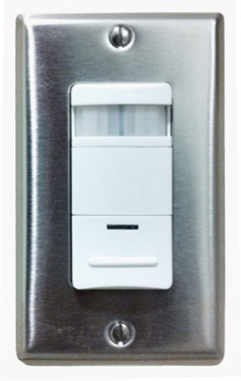
THERMAL CONTROLS 3.
Predicting People Comfort Needs
Predictable occupancy and activity schedules
Use advanced artificial intelligence to predict needs
Figure 11-11 motion sensor
When occupancy is less predictable, motion sensors can be used to determine whether someone is in the room.

Slide 46
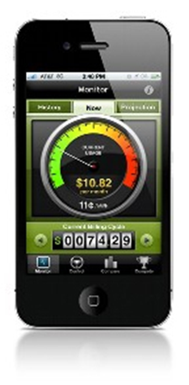
THERMAL CONTROLS 4.
Smart Phone Control
Anticipated occupancy is not possible
Remote mobile apps for a smart phone
Web-based controls can be used
Figure 11-12 smart phone mobile app for HVAC

Slide 47
THERMAL CONTROLS 5.
Sustainability and Lighting
Using daylight in design of building
Justified for a number of reasons
Increases in productivity
Regulates melatonin production in the pineal gland
Which regulates sleep
Daylight used in appropriate quantities to light interior spaces
Will reduce dependence on electric lighting

Slide 48
FIGURE 11-13 A light shelf is a daylight delivery system that is used to reflect daylight to the ceiling and decrease daylight levels adjacent to a window.

Slide 49
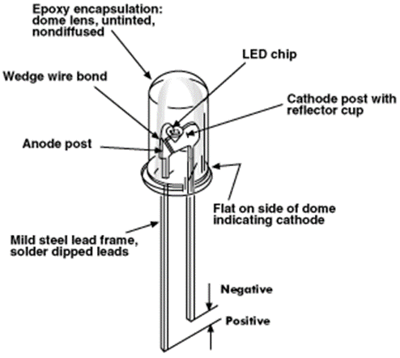
THERMAL CONTROLS 6.
Sustainability Lights
LED (Light Emitting Diode)
Voltage applied to leads, electrons recombine with electron holes within solid-state device releasing energy in form of photons
Electroluminescence
Light COLOR determined by energy band gap of semiconductor
FIGURE 11-14 LED is a two-lead semiconductor light source. It is a PN junction diode that emits light when triggered

Slide 50
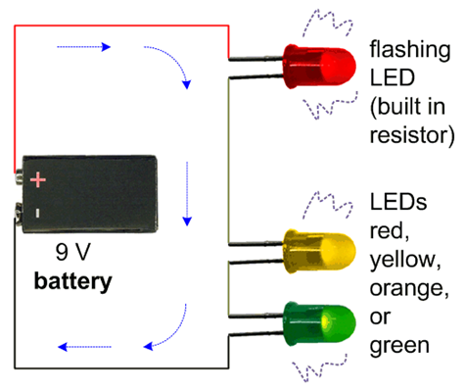
THERMAL CONTROLS 7.
LED Lighting Different
Than incandescent & fluorescent
Produces light very efficiently
Electrical current passes through semiconductor
Illuminates LED, heat absorbed into heat sink
Common LED colors include:
Amber
Red
Green
FIGURE 11-14 LED colors

Slide 51
Figure 11-15 LED Bulbs: The useful life of LED lighting products is much higher than other light sources

Slide 52
THERMAL CONTROLS 8.
LED Lighting Lifetime
LED lights do not “burn out” or fail
Lumen depreciation, where amount of light produced
Decreases and light color appearance can change
Useful life of LED product
Based on prediction of when output decreases to 30%
Sustainability and LED Lighting (Ted Talk): 5:58
Light & Sustainability a Revolution: 58:41

Slide 53
THERMAL CONTROLS 9.
Fluorescent Lamps
Creates light by using an electric current in a gas
Contains mercury plus other gases
Electric current excites mercury vapor
Causes a phosphor coating on inside of lamp to glow
Straight and range in length from 3.9” to 8 feet
Some tubes are bent into a circle or a U-shape
Must use ballast to control current through lamp

Slide 54
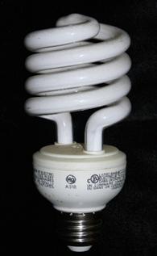
THERMAL CONTROLS 10.
CFL (Compact Fluorescent Lamp)
Fluorescent lamp replaces incandescent lamp
Tube which is curved or folded to fit into space
Of incandescent bulb
Compact electronic ballast in base of lamp
Figure 11-16 CFL bulb

Slide 55
QUESTION 4:
On-Demand-Control ventilation by itself can save about how much HVAC energy?
a. 15%
b. 20%
c. 30%
d. 10%

Slide 56
ANSWER 4:
15%

Slide 57
CASE STUDY
Reducing Energy Costs through Lighting Changes
Large university reduced electrical usage by changing lighting:
Replaced conventional T8 linear fluorescent 32 watt, either 4 feet or 8 feet long tubes with 25 watt units. Saved 7 watts per bulb for a savings of about 30%.
Standard ballasts were replaced at the same time with high-efficiency ballasts.
Energy-efficient magnetic ballast uses copper wire coils, and the iron cores are larger. The copper has lower resistance and the larger iron core generates less heat inside the ballast.
Some people in offices and classrooms noticed the slight decrease in the brightness of the light. The original bulbs were warm white with a light temperature of 2,800 degrees Kelvin (K) (a method used to describe the “whiteness” of the light). By using a whiter 3,500 degree lamp, the light appeared to be brighter.
Fluorescent tubes used in tunnels in underground campus were changed to 5,000 degrees K in an effort to make these closed spaces appear to be brightly illuminated.
These changes along amounted to a huge savings in the electrical usage

Slide 58
STUDENT ACTIVITY 2.
Download WORD file: Sustainable Lighting Benefits

Slide 59
STUDENT ACTIVITY 3.
Download WORD file: Sustainability and Lighting

Slide 60
ASSET MANAGEMENT 1.
Computerized Maintenance Management System (CMMS)
Software maintains a computer database of information
CMMIS (Computerized Maintenance Management Information System)
Help maintenance workers be more efficient
Verify regulatory compliance
Maintenance Assistance CMMS: 2:11

Slide 61
ASSET MANAGEMENT 2.
Deferred Maintenance
Postponing maintenance activities
Save costs, meet budget funding levels
Failure to perform needed repairs could lead to impairment.
May result in higher costs, asset failure, affect sustainability
E.G.
Putting off HVAC (Heating Ventilation and Air Conditioning System) yearly furnace cleaning
Result in more energy consumption
Increase building’s carbon footprint and affect sustainability

Slide 62
ASSET MANAGEMENT 3.
Construction Operations Building Information Exchange (COBie)
Standard relating to managed asset information
Associated with BIM (building information modeling)
Devised by US Army Corps of Engineers
Capture and record important project data at point of origin
Support operations, maintenance and asset management

Slide 63
ASSET MANAGEMENT 4.
Reliability-Centered Maintenance (RCM)
Process to make sure that systems
Continue to do what their users require
Achieve improvements in minimum levels of maintenance
Lead to increase in cost effectiveness & reliability
Defined by SAE (Society of Automotive Engineers)
Standard SAE JA1011, Evaluation Criteria for RCM Processes.

Slide 64
INTERNATIONAL FACILITY MANAGEMENT ASSOCIATION (IFMA) 1.
IFMA
Guide and develop facility management professionals
Providing services, products, resources, Founded as
National Facility Management Association (NFMA)
Not-for-profit incorporated association and
Certifies facility managers & conducts research
Provides educational programs
Recognizes facility management degrees

Slide 65
INTERNATIONAL FACILITY MANAGEMENT ASSOCIATION (IFMA) 2.
Credentialing Programs
IFMA has 3 credentialing programs:
Certified Facility Manager (CFM)
Facility Management Professional (FMP)
Sustainability Facility Professional (SFP)

Slide 66
INTERNATIONAL FACILITY MANAGEMENT ASSOCIATION (IFMA) 3.
Operations and Maintenance (O&M) Program
Plan of training, cleaning, work practices, and surveillance
To Maintain asbestos-containing materials (ACM)
Minimize exposure of all building occupants to asbestos
EPA recommends that an O&M program include work practices to:
Maintain ACM in good condition
Ensure proper cleanup of asbestos fibers previously released
Prevent further releases of asbestos fibers
Monitor the condition of ACM

Slide 67
INTERNATIONAL FACILITY MANAGEMENT ASSOCIATION (IFMA) 4.
LEED Maintenance Spectrum
(LEED-EBOM [Existing Building Operations & Maintenance]) system, offers:
Streamlined reporting
Fewer prerequisites
Emphasis on operations, maintenance, and upgrades
Ease of scale for use in greening existing buildings
High number of rewards for measured environmental performance
Green cleaning incentives
Strong commitment to performance
New water efficiency credits

Slide 68
INTERNATIONAL FACILITY MANAGEMENT ASSOCIATION (IFMA) 5.
Best Practices
Ways to reduce operating costs and carbon emissions
Improve energy & water performance for green buildings
Defined as a policy, systems and procedures
Regarded by peers as practice
Delivers optimal outcome
They are worthy of using

Slide 69
INTERNATIONAL FACILITY MANAGEMENT ASSOCIATION (IFMA) 6.
Other IFMA Considerations
Site Preparation
Building Design
Sustainable Materials
Sound Construction Methods
Environmentally Sensitive Landscaping
Waste Management

Slide 70
QUESTION 5:
What describes a policy, systems and procedures that, at any given time that delivers optimal outcome, such that they are worthy of using?
a. Six Sigma
b. Best practices
c. Controlled maintenance
d. Smart Budgeting

Slide 71
ANSWER 5:
Best practices

Slide 72
REAL PROPERTY INVENTORY (RPI) 1.
Record Of Real Property Asset
Package for collecting/maintaining real property inventory
Data to manage assets &meet record/reporting
Provides data necessary to frame facility budgets
Make decisions on facility replacement, organize repair and penalty costs, and improve the management of investments in property assets
RPAM program can help to plan, program, and budget
Real property inventory
RPI & RPAM are functional level of a organization

Slide 73
Summary (1 of 3)
LEED is a worldwide green building certification program developed by the USGBC or U.S. Green Building Council. USGBC developed LEED to include a set of rating systems for the design, construction, operation, and maintenance of green buildings, homes, and neighborhoods.
Buildings can qualify for 4 LEED certification levels:
Certified: 40–49 points
Silver: 50–59 points
Gold: 60–79 points
Platinum: 80 points and above
LEED-certified buildings use between 11 and 39% less site energy than non-LEED buildings, which reduces their ecological footprint, which is the impact of a person or community on the environment, expressed as the amount of land required to sustain their use of natural resources.

Slide 74
Summary (2 of 3)
The LEEDs credit weighting process has the following 3 steps:
Collection of reference buildings are used to determine environmental impacts of any building seeking LEED certification
National Institute of Standards and Technology weightings are used to judge the importance of these impacts in each category.
Data regarding actual impacts on environmental and human health are used to assign points to individual categories and metrics.
This LEEDs credit weighting process results in an average for each rating scheme based upon actual impacts and the importance of those impacts to health and environmental quality.
A green roof is a living building roof that is partially or completely covered with vegetation and a growing medium, planted over a waterproofing membrane. It may also include additional layers such as a root barrier and drainage and irrigation systems.
A passive house is a rigorous, voluntary standard for energy efficiency in a building, reducing its ecological footprint, which can result in ultra-low energy buildings that require little energy for space heating or cooling.

Slide 75
Summary (3 of 3)
Construction and demolition materials are materials left over at a construction, renovation or demolition site, like concrete, wood, drywall, asphalt shingles, asphalt pavement, and metal, which can be reused or recycled to promote sustainability.
Thermal control is used in almost all buildings to achieve this comfort level and environmental control.
Daylighting and sustainable electric lighting are important elements of sustainable design. The incorporation of daylight in the design of a building provides non-energetic benefits. Daylighting increases in productivity and reduces dependence on fossil fuels. Sustainable lighting like LED and CFL can reduce the consumption of electricity
CMMS (Computerized Maintenance Management System) or computerized maintenance management information system (CMMS) is a software package that maintains a computer database of information about maintenance operations known as CMMIS (Computerized Maintenance Management Information System) used to verify regulatory compliance.

