Slide 1
Sustainability- Principles and Practices
Chapter 12
Product Design For Environment (DFE)

Slide 2
LEARNING OBJECTIVES
Discuss design for the environment
Define Eco-Efficiency
Describe design for energy efficiency
Explain design for disposal or reuse
Describe design for environmental processing and manufacturing

Slide 3
INTRODUCTION
Manufactured Goods
From 4 major systems or spheres:
Atmosphere, biosphere, hydrosphere, and lithosphere
70% of its material from the lithosphere
Fossil fuels, stone products, and metals
Materials are mixed and combined with other materials
Become toxic to the atmosphere
New concept: Cradle-to-Cradle
Opposed to cradle-to-grave

Slide 4
DESIGN FOR THE ENVIRONMENT (DFE) 1.
Design for the Environment or DFE
Designing products and processes
Make products in a responsible way
Causes no harm to environment.
Design for Environmental Health (Ted Talk): 18:17
Design for Manufacturing: 25:24

Slide 5
Figure 12-1 shows a typical DFE cycle. DFE is design for environmental processing and manufacturing, with its goal to protect environmental systems from harm, protect human health, and enhance sustainability of natural resources for the entire product lifecycle.

Slide 6
DESIGN FOR THE ENVIRONMENT (DFE) 2.
DFE is Also Known As
Eco-Design
Lifecycle Design
Design for Eco-Efficiency
ECO Efficient Modern Energy Solutions: 4:33

Slide 7
DESIGN FOR THE ENVIRONMENT (DFE) 3.
EPA
Research and technical support
Partnership with industry and academia
Through its DFE program (Figure 2)
WBCSD (World Business Council for Sustainable Development) was driving force behind this process
200 major corporations
Figure 12-2 EPA DFE logo

Slide 8
DESIGN FOR THE ENVIRONMENT (DFE) 4.
DFE Has Choices To Select:
Change Process
Make Product But In A Different Way
Change Product
How to Design an Energy Efficient Home: 17:08

Slide 9
QUESTION 1:
Which of these is the overall process of designing products and processes to manufacture products in a responsible way that causes no harm to the environment?
a. DFR (Design for Reuse)
b. DFE (Design for the Environment)
c. DFD (Design for Disassembly)
d. DFSP (Design for sustainable packaging)

Slide 10
ANSWER 1:
DFE (Design for the Environment)

Slide 11
DESIGN FOR THE ENVIRONMENT (DFE) 5.
Industrial Ecology
Biosphere provides a model
Cycling of resources
Nature is a closed-loop system
Circulates matter
Waste from one organism is food for another

Slide 12
FIGURE 12-3 identifies an industrial system that is contained within a natural system rather than separating it from the industrial mechanism. Near end cycle, industrial mechanism would interact with natural world in a sustainable way.

Slide 13
QUESTION 2:
The ________________provides a model for the cycling of resources.
a. Ionosphere
b. Biosphere
c. Hydrosphere
d. Lithosphere

Slide 14
ANSWER 2:
biosphere

Slide 15
DESIGN FOR THE ENVIRONMENT (DFE) 6.
DFE Product Design
Goal of DFE product design
Design not just products but product lifecycles
Use DFE principles to influence
Impacts of product from sourcing and delivery
Of raw materials to production
To eventual disposal of product

Slide 16
ECO-EFFICIENCY or DFE 1.
Eco-Efficiency
Used to promote a transformation
From unsustainable development to sustainable development
Based on concept of creating more goods and services
Using fewer resources and creating less waste
Design and Reuse: 28:49

Slide 17
FIGURE 12-4 shows Eco-Efficiency diagram from Nissan on driving to conserve energy. Efficiency with environment means generating more value in more product usefulness and more financial benefit with less energy and resource consumption, which delivers less harm to environment.

Slide 18
ECO-EFFICIENCY or DFE 2.
Eco-Efficiency
Ratio between added value of what has been produced
& environment impact of that product or service
Main tools used to promote a transformation
From unsustainable development to one of
Sustainable development

Slide 19
ECO-EFFICIENCY or DFE 3.
National Ambient Air Quality Standards (NAAQS)
Established by EPA from Clean Air Act
Protect human health, with an adequate margin of safety
Sensitive populations such as children, elderly, etc.
Secondary standards designed to protect public welfare

Slide 20
ECO-EFFICIENCY or DFE 4.
Eco-Efficiency History
WBCSD (World Business Council for Sustainable Development)
Created term eco-efficiency
Eco-Efficiency
Delivery of competitive priced goods and services
Satisfy human needs and bring quality of life
Reducing environmental impacts
Eco efficiency is a key part of solution for sustainability

Slide 21
ECO-EFFICIENCY or DFE 5.
Eco-Efficiency Metrics
WBCSD developed 4 ratios as a metric
Measure Eco-Efficiency:
Environmental productivity and its inverse
Environmental intensity of production
Refers to kingdom of production
Environmental improvement cost and its inverse
Environmental cost-effectiveness.

Slide 22
ECO-EFFICIENCY or DFE 6.
3 Methods
Achieve eco-efficiency at micro-level:
1st Micro Method: effects of total value of a product system or sector and its total concomitant environmental effects.
2nd Micro Method: ‘’win-win’’, which “gives a comparison between a historical reference situation and potentially new situations based on the use of new technologies
3rd Micro Method: is difference eco-efficiency, which is similar to the win-win method, but removes all irrelevant alternatives to heighten potential for optimal technologies while comparing two alternatives.

Slide 23
ECO-EFFICIENCY or DFE 7.
Goals/Objectives of Eco-efficiency:
Reduction in material intensity of goods or services
Reduction in energy intensity of goods or services
Reduced dispersion of toxic materials
Improved recyclability
Maximum use of renewable resources
Greater durability of products
Increased service intensity of goods and services.

Slide 24
ECO-EFFICIENCY or DFE 8.
Eco-Efficiency Examples
Useful tool to use because it’s adaptable and flexible
Used by different sized companies
Remaining relevant in the bigger scale
Government and national policies

Slide 25
ECO-EFFICIENCY or DFE 7.
EPA Safer Choice
Safer Choice is a term created to help
Find products that perform well and are safer
For human health and the environment
EPA developed this label to find
Products safer for family, and environment
Figure 12-5 EPA Safer Choice Label

Slide 26
INDUSTRIAL ECOLOGY PROCESS

Slide 27
STUDENT ACTIVITY 4.
Download WORD file: EPA (Environmental Protection Agency) Safer Choice

Slide 28
ECO-EFFICIENCY or DFE 7.
DFE Processes
Suggests following processes
For environmental processing and manufacturing:
Design for Energy Efficiency
Design for Reuse (Revalorization)
Design for Disassembly
Design for Dematerialization
Design for Sustainable Packaging

Slide 29
ECO-EFFICIENCY or DFE 8.
Designs for Energy Efficiency (DEE)
1 of 12 principles of GREEN Chemistry
Minimize energy requirements of chemical processes
Perform synthesis at ambient temperatures
Manufacture of products using less energy

Slide 30
FIGURE 12-6 Design for Energy Efficiency House

Slide 31
ECO-EFFICIENCY or DFE 9.
Design for Energy Efficiency 12 principles of green chemistry
Prevention
Atom Economy: design synthetic methods to generate less toxic substances
Less Hazardous chemicals synthesis
Designing Safer Chemicals
Safer Solvents
Design for Energy Efficiency
Using Renewable Raw Material
Reduce derivatives which require and generate waste
Catalysis: Catalytic reagents are superior to stoichiometric reagents
Design for Degradation
Real-Time Analysis for Pollution Prevention
Safer Chemistry for Accident Prevention

Slide 32
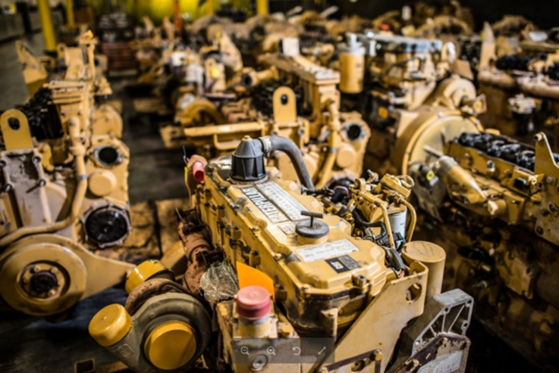
ECO-EFFICIENCY or DFE 10 .
DFR (Design for Reuse [Revalorization])
Looks for opportunities to recover spent materials
Use them again
Process of reuse or revalue
Caterpillar uses this strategy to disassemble and reused tractors and engines
Figure 12-7 Caterpillar Remanufactured Engine stockpile

Slide 33
FIGURE 12-8 Some Silicone valley manufactures remake solid state components in what is called a takeback program. Most computer and cell phone companies have takeback programs. Used electronic components are still functional so they are refurbished and sent to charitable organizations.

Slide 34
ECO-EFFICIENCY or DFE 11.
DFD (Design for Disassembly
Process to easily disassemble products for reuse
Recycle materials from product assemblies
Major area of research and development within DFE
Create obvious access and disassembly points
Products can be disassembled using common tools
Fastening technology is important in DFD

Slide 35
FIGURE 12-9 Design for Disassembly Athletic Shoe

Slide 36
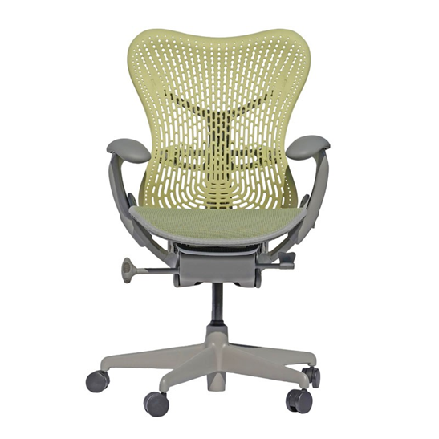
ECO-EFFICIENCY or DFE 12.
MIRRA Chair (Herman Miller)
Designed to be easily disassembled
Returned to factory and can be disassembled
< 15 minutes
96% of chair recyclable
Fabric turned into compost
Plastic & molded plastic seat back recycled
Remolded into backs 25 times
Figure 12-10 MIRRA Chair by Herman Miller

Slide 37
STUDENT ACTIVITY 2.
Download WORD file: DFD (Design for Disassembly)

Slide 38
QUESTION 3: ?
The corn-based calm positive fabric chair is called the.
a. The Eco-Chair
b. The Environmental Chair
c. The MIRRA Chair
d. The Ruse Chair

Slide 39
ANSWER 3:
The MIRRA Chair

Slide 40
ECO-EFFICIENCY or DFE 13.
DFD (Design for Dematerialization)
Reduces amount of material required make product
Results in lower energy use
Means less material is used to deliver same level
Material and energy reductions can be obtained
Through straightforward design changes
Minimize the material or packaging required

Slide 41
QUESTION 4:
Which of these is a strategy that reduces the amount of material required to make a product, which usually results in lower energy use?
a. DFR (Design for Reuse)
b. DFE (Design for the Environment)
c. DFD (Design for Disassembly)
d. DFDM (Design for Dematerialization)

Slide 42
ANSWER 4:
DFDM (Design for Dematerialization)

Slide 43
STUDENT ACTIVITY 3.
Download WORD file: DFD (Design for Dematerialization)

Slide 44
ECO-EFFICIENCY or DFE 14.
Design for Sustainable Packaging
Creating and using packaging
Improves environmental sustainability
life cycle inventory (LCI) and life cycle assessment (LCA)
Guide packaging which reduces
Environmental impact and ecological footprint
Looks at whole supply chain

Slide 45
STUDENT ACTIVITY 1.
Download WORD file: Design for Sustainable Packaging

Slide 46
FREQUENTLY ASKED QUESTION?
What is Life-Cycle Assessment (LCA)?
Environmental impact of a product over its entire life cycle
Requires an analysis called a life-cycle assessment (LCA)
Steps involved include (See Figure 12-11):
Step #1-Prepare proposed design options.
Step #2- Identify what happens during the life of the product including recycling and disposal.
Step #3- Identify all materials and energy sources used to create and dispose of the product.
Step #4- Identify all outputs and waste streams
Thoroughly determine life-cycle of product requires
Specialized LCA software and training:
SimaPro
GaBi
Open LCA
Sustainable Minds

Slide 47
FIGURE 12-11 Lifecycle Management

Slide 48
Summary (1 of 4)
Design for the Environment or DFE is the process designing products and processes to manufacture products in a responsible way that causes no harm to the environment.
DFE practice focuses on reducing the use of hazardous substances, minimizing consumption of energy, reducing waste, and expanding the lifecycle of products through the process of recycling and reuse. DFE is also known as Eco-Design, Lifecycle Design, and Design for Eco-Efficiency
Eco-Efficiency is one of the main tools used to promote a transformation from unsustainable development to one of sustainable development.
Eco-Efficiency is based on the concept of creating more goods and services while using fewer resources and creating less waste and pollution. It is the ratio between the added value of what has been produced and the environment impact of that product or service.

Slide 49
Summary (2 of 4)
Eco-Efficiency also takes into consideration the NAAQS standards established by the EPA under authority of the Clean Air Act. Primary standards are designed to protect human health, with an adequate margin of safety, including sensitive populations such as children, the elderly, and individuals suffering from respiratory diseases.
DFE or Eco-Efficiency suggests following processes:
Design for Energy Efficiency
Design for Reuse (Revalorization)
Design for Disassembly
Design for Dematerialization
Design for Sustainable Packaging
EPA Safer Choice is a term created to help consumers, businesses, and purchasers find products that perform well and are safer for human health and the environment.

Slide 50
Summary (3 of 4)
Design for Energy Efficiency is one of 12 principles of GREEN Chemistry and is defined as minimize the energy requirements of chemical processes and perform synthesis at ambient temperatures and pressure if possible. It’s the manufacture of products using less energy.
Design for Reuse or Revalorization is a DFE process that looks for opportunities to recover spent materials components reprocess them and use them again. It is a process of reuse or revalue
DFD (Design for Disassembly) is the process to easily disassemble products for reuse and recycle materials from product assemblies after they've been disassembled.
Design for Dematerialization is a DFE strategy that reduces the amount of material required to make a product, which usually results in lower energy use. The dematerialization of a product means less material is used to deliver the same level of functionality to the user.

Slide 51
Summary (3 of 4)
Design for sustainable or environmental packaging design is creating and using packaging that improves environmental sustainability. This process involves increased use of life cycle inventory (LCI) and life cycle assessment (LCA) to help guide the use of packaging which reduces the environmental impact and ecological footprint.

