Slide 1
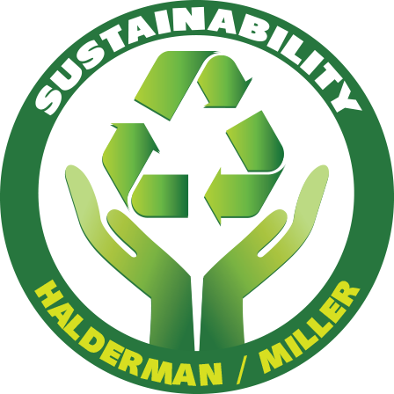
Sustainability- Principles and Practices
Chapter 2
Planet, People and Profits

Slide 2
LEARNING OBJECTIVES
Describe the “Circles of Sustainability”.
Explain “triple bottom line”
Discuss how sustainability affects the social structure, environmental and financial institutions
Describe the Global Reporting Initiative (GRI).
Explain the concept of planning for “Cradle to Grave”.
Discuss eco-capitalism.
Explain return on investment (ROI)

Slide 3
INTRODUCTION 1.
Sustainability Actions
Affect business bottom line or profit.
Triple Bottom Line (TBL) accounting framework
Contains social, environmental, & financial components.
TBL framework evaluates an organization’s performance
To create greater business value

Slide 4
INTRODUCTION 2.
Normal Accounting Usage, Bottom Line
Refers to either the profit (black) or loss (red)
Recorded at very bottom line of business balance sheet
Expenses on one side and income on other side.
Environmentalists and social justice advocates
Fought to create a broader definition of bottom line
By introducing sustainability for businesses
To include environmental concerns as part of business plan

Slide 5
CIRCLES OF SUSTAINABILITY 1.
Circles of Sustainability
Explain 4 pillars in more detail
Understand and assess sustainability process
Manage projects directed towards sustainable outcomes
Handle inflexible problems from opposing parties.
Often used for cities and urban areas

Slide 6
CIRCLES OF SUSTAINABILITY 2.
Figure 2-1: 4 Pillars of Sustainability
Chp 1, explained 3 Pillars of Sustainability:
Economic Growth
Environmental Protection
Social Equality
4th Pillar is Cultural Sustainability
Circles of Sustainability: 13:03

Slide 7
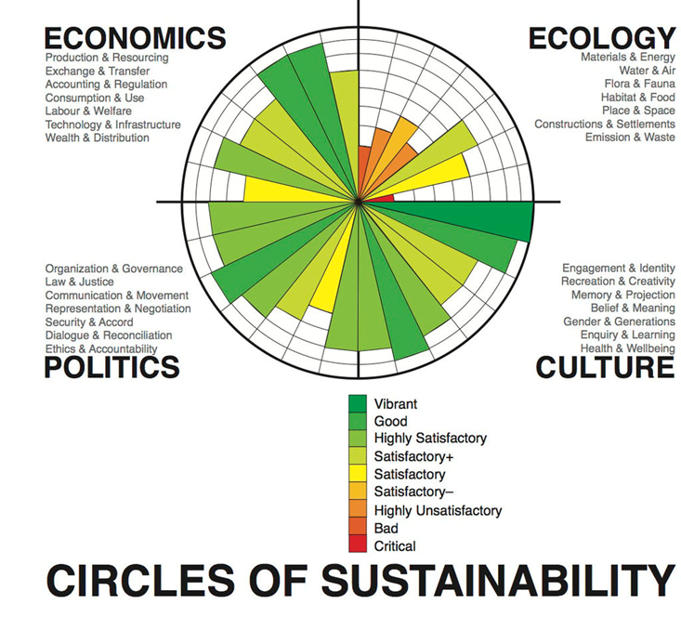
FIGURE 2-1 the circle of sustainability representation for Melbourne, Australia in 2011, which provides details around 4 pillars: Economics, Ecology, Politics, and Culture with a color coded indicators of success

Slide 8
CIRCLES OF SUSTAINABILITY 2.
Circle of Sustainability Domains/Subdomains
The 4-domain models of
Economics
Ecology
Politics
Culture
Each contains 7 subdomains:

Slide 9
CIRCLES OF SUSTAINABILITY 3.
Economics Domain
Practices & meanings associated with
Production, use, and management of resources:
Production and resourcing
Exchange and transfer
Accounting and regulation
Consumption and use
Labor and welfare
Technology and infrastructure
Wealth and distribution

Slide 10
CIRCLES OF SUSTAINABILITY 4.
Ecology Domain
Practices and meanings
Between society & nature. The subdomains are:
Materials and energy
Water and air
Flora and fauna
Habitat and settlements
Built-form and transport
Embodiment (visible or tangible) and sustenance (food, nutrition)
Emission and waste

Slide 11
CIRCLES OF SUSTAINABILITY 5.
Politics Domain
Practices & meanings associated with
Social power, organization, authorization, legitimation and regulation
Area extend beyond the conventional sense of politics
Include social relations in general. The subdomains are:
Organization and governance (act of governing)
Law and justice
Communication and critique
Representation and negotiation
Security and accord
Dialogue and reconciliation
Ethics and accountability

Slide 12
CIRCLES OF SUSTAINABILITY 6.
Culture Domain
Practices, discourses, and material expressions
Determine social meaning and interaction, subdomains are:
Identity and engagement
Creativity and recreation
Memory and projection
Belief and ideas
Gender and generations
Enquiry and learning
Wellbeing and health

Slide 13
FIGURE 2-2 UN Global Compact Cities Program
UN Global Compact Cities Program
More than eighty participating cities
Some have influenced the development
Of Circles of Sustainability method
Through their management of major projects

Slide 14
CIRCLES OF SUSTAINABILITY 7.
Circles of Sustainability Use
UN Global Compact Cities Program
World Association of Major Metropolises
World Vision to support their appointment in cities
Cities across the world have used it in different ways
Manage major projects & provide feedback on sustainability profiles
Johannesburg, Melbourne, New Delhi, and São Paulo

Slide 15
CIRCLES OF SUSTAINABILITY 8.
UN Global Compact Cities Program Examples:
Vila Chocolatao Project:
Resettlement of approximately 1,000 residents of the inner-city Vila Chocolatao slum in Porto Alegre, Brazil in 2011
Milwaukee, Wisconsin water project

Slide 16
CIRCLES OF SUSTAINABILITY 9.
World Association of Major Metropolises
120 member cities to manage urban growth
Published on web, used by member cities as a guide
Map sustainability of their cities as part of developing
Urban-regional plans
Cities Program and Metropolis have worked together
To Refine Circles of Sustainability method
Further development of model delegated to a Metropolis Taskforce

Slide 17
QUESTION 1: ?
Which of these is used to understand and assess the sustainability process and manage projects directed towards sustainable outcomes?
Pillars of Sustainability
Circles of Sustainability
People, Planet, and Profit
Eco-capitalism

Slide 18
ANSWER 1:
Circles of Sustainability

Slide 19
TRIPLE BOTTOM LINE (TBL) 1.
Triple Bottom Line (TBL) (Figure 2-3)
Accounting framework that contains
Social, environmental, and financial components
Evaluates an organization’s performance to create
Greater business value, created by John Elkington in 1994
Bottom line refers to either the profit or loss
Recorded at very bottom line of business balance sheet
Triple Bottom Line as it Pertains to Sustainability: 1:55

Slide 20
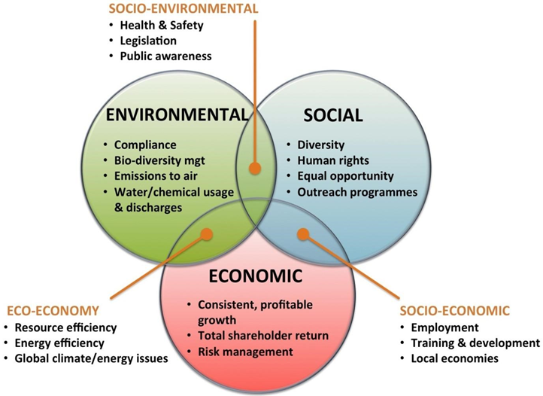
Figure 2-3 Triple bottom line is an accounting framework that contains social, environmental, and financial components.

Slide 21
VENN DIAGRAM ANIMATION

Slide 22
TRIPLE BOTTOM LINE (TBL) 2.
S TBL (Sustainability-The Bottom Line)
Environmentalists and social justice advocates
Fought to create a broader definition of bottom line
Introducing full cost accounting toward sustainability
If a corporation shows a profit
Their operation causes deaths, pollution
Government spends taxpayer money on
Health care & river clean-up
Cost benefit analysis needs to be done to recover these costs
Triple Bottom Line, Pillars of Sustainability: 1:46

Slide 23
TRIPLE BOTTOM LINE (TBL) 3.
UNICLEI (International Council for Local Environmental Initiatives)
TBL standard for urban and community accounting
Dominant approach to public sector full cost accounting
S-TBL added two more bottom lines:
1. Social concerns
2. Environmental (ecological) concerns
UN standards apply to natural capital and human capital measurement to assist in measurements required by TBL
EcoBudget® standard for reporting ecological footprint

Slide 24
TRIPLE BOTTOM LINE (TBL) 4.
EcoBudget®
Implement municipal environmental budgeting worldwide.
EcoBudget® works along lines of local financial budgeting,
Budget approved by political decision-making body
Includes a periodic and systematic process of creating a budget
For natural resources and environmental quality
Approved by the authorizing council
Results are fed back to political decision makers
Indicators informs elected officials of how their decisions
Impact natural resources capital.

Slide 25
TRIPLE BOTTOM LINE (TBL) 5.
S-TBL Development
Defined by Brundtland Commission
S-TBL (Sustainability Triple Bottom Line)
Expands traditional reporting framework
Takes into account social & environmental performance
Show commitment to CSR (Corporate Social Responsibility) using:
Top-level involvement (CEO)
Policy Investments
Programs
Signatories to voluntary standards
Principles (UN Global Compact-Ceres Principles)
Reporting (Global Reporting Initiative)

Slide 26
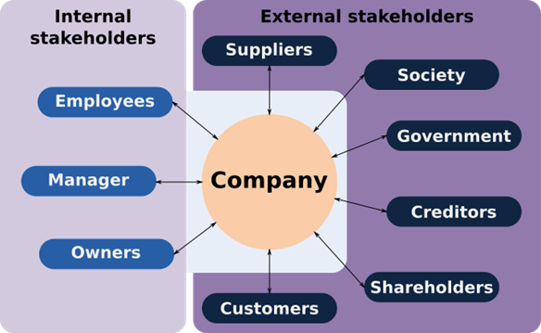
TRIPLE BOTTOM LINE (TBL) 6.
Stakeholders
Directly/Indirectly affected by organization
Businesses should coordinate stakeholder interests
Instead of maximizing shareholder profit
Growing number of financial institutions incorporating TBL
Figure 2-4 stakeholders

Slide 27
QUESTION 2: ?
What term applies to anyone who is influenced, either directly or indirectly, by the actions of the company or organization?
a. Shareholder
b. Stakeholder
c. Consumer
d. Worker

Slide 28
ANSWER 2:
Stakeholder X

Slide 29
STUDENT ACTIVITY 1.
Download WORD file:
Triple Bottom Line Versus Sustainability

Slide 30
STUDENT ACTIVITY 3.
Download WORD file:
Stakeholders

Slide 31
FIGURE 2-5 People, planet and profit describes TBL bottom line business and consists of social equity, economic, and environmental factors. People, planet and profit describes TBL business within the goal of sustainability. It consists of social, economic, and environmental factors.
People
Planet
Profit

Slide 32
PEOPLE, PLANET, PROFIT (3P) SUSTAINABILITY 1.
People
Refers to fair and useful business practices toward labor and community
Areas corporation does business in an effort to create new jobs
TBL business comprehends a common social structure
Well-being of corporate, labor and stakeholder interests are interdependent.
TBL business would monitor all contracted companies for
Child labor exploitation
Pay fair salaries
Maintain safe work environment
Offer reasonable working hours, not abuse a community

Slide 33
PEOPLE, PLANET, PROFIT (3P) SUSTAINABILITY 2.
Planet
Refers to sustainable environmental practices.
Reduce demand for natural resources and energy
TBL model benefits natural order or do no harm
Reduce ecological footprint by:
Managing its consumption of energy and non-renewables
Reducing manufacturing waste & legally disposing of it.

Slide 34
PEOPLE, PLANET, PROFIT (3P) SUSTAINABILITY 3.
Cradle to Grave
Life cycle assessment of products to determine
True environmental cost from growth & harvesting of raw materials
To manufacture, distribution, & eventual end user disposal
Assesses environmental impacts with all stages of a product's life
From raw material extraction through materials processing to
Manufacture, distribution, use, repair, maintenance, & recycling
Cradle to Cradle Explained: 4:33
Cradle to Grave Explained (Animated): :43

Slide 35
PEOPLE, PLANET, PROFIT (3P) SUSTAINABILITY 4.
Profit
Economic value created by a business after
Deducting all costs, including capital investments
Different from traditional accounting definitions of profit which is
Financial gain resulting from employment of capital in any transaction
In a sustainability framework, profit aspect is a real economic benefit
Real economic impact organization has on its economic environment
Profit represents eco-bottom line or what is called eco-capitalism

Slide 36
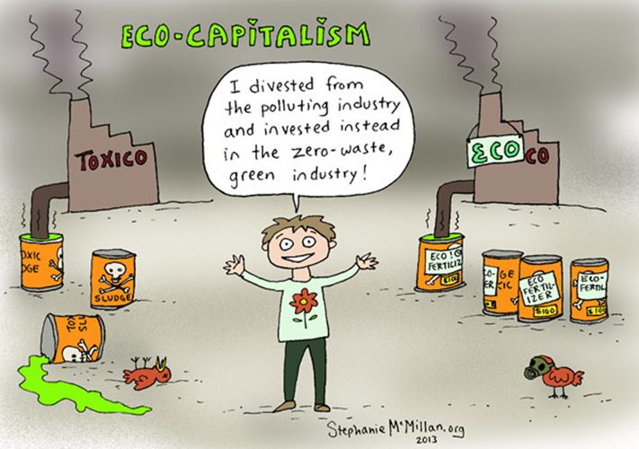
Figure 2-6 Eco-capitalism also known as environmental capitalism or green capitalism, is the view that capital exists in nature as natural capital

Slide 37
PEOPLE, PLANET, PROFIT (3P) SUSTAINABILITY 5.
TBL Supporting Arguments
Business-based arguments support TBL concept:
Reaching untapped market potential:
TBL companies can find financially profitable places; such as:
Adding ecotourism or geotourism to rich tourism market
Developing profitable methods to assist existing nongovernment groups
Missions: fundraising, reaching clients, networking
Providing products or services which benefit underserved populations

Slide 38
PEOPLE, PLANET, PROFIT (3P) SUSTAINABILITY 6.
Criticism of UN TBL (The Bottom Line)
Disagreement with TBL:
Does not have ability to be applied in practical world
Problem of achieving global agreement
Alternative approaches, like Circles of Sustainability
More appropriate for understanding institutions and major cities
TBL disregards ecological sustainability
Low enforcement by regulatory agencies, like FTC
Does not specifically address time

Slide 39
QUESTION 3: ?
Which of these refers to sustainable environmental practices?
a. People
b. Eco-budgeting
c. Profit
d. Natural Capital

Slide 40
ANSWER 3:
Natural Capital or Planet

Slide 41
GLOBAL REPORTING INITIATIVE (GRI) 1.
Global Reporting Initiative (GRI)
International independent standards organization
Helps businesses, governments
Understands and communicates what has been done regarding climate change, human rights & corruption
Figure 2-7 GRI Logo
Global Reporting Initiative as it Pertains to Sustainability: 4:28

Slide 42
GLOBAL REPORTING INITIATIVE (GRI) 2.
GRI Guidelines
GRI Framework purposes to empower third parties
Measure environmental impact from company activities
GRI Indicator Protocol Set contains:
Standardized reporting guidelines
Performance Indicators (PI), which includes:
Criteria on energy, biodiversity and emissions
30 environmental indicators ranging from:
EN1 to EN30

Slide 43
GLOBAL REPORTING INITIATIVE (GRI) 3.
GRI Measurements (Metrics)
GRI standards were created according
To international labor practices & environmental impact by
Conducting an independent audit
ISO14010, ISO14011, ISO14012 and ISO26000
Set out a standard for assessing the environmental impact
OHSA 18001 is a health and safety risk MGMT system
Introducing the GRI Standards: 20:59
Morocco: World Leader in Renewable Energy: :46

Slide 44
QUESTION 4: ?
Which of these is an international independent standards organization that helps businesses, governments and other organizations understand and communicate what they have done regarding climate change, human rights and corruption?
a. EPA (Environmental Protection Agency)
b. DOE (Department of Energy)
c. Global Reporting Initiative (GRI)
d. UN (United Nations)

Slide 45
ANSWER 4:
Global Reporting Initiative (GRI

Slide 46
STUDENT ACTIVITY 2.
Download WORD file:
Global Reporting Initiative

Slide 47
SUSTAINABILITY RETURN ON INVESTMENT (S-ROI) 1.
Terminology
ROI or Return on Investment is:
Return benefit to investor from the results of a financial investment
High ROI means investment gains compare favorably to cost
Performance Metric
Used to evaluate efficiency of an investment
Compare the efficiency of a number of different investments
ROI is a way of considering profits in relation to capital invested
ROI of Eco Capitalism: 8:47

Slide 48
SUSTAINABILITY RETURN ON INVESTMENT (S-ROI) 2.
Sustainability Analysis Techniques
LIKE Life Cycle Assessment (LCA), provide insights
Into environmental impacts of products and factories
Guiding product and process design
Like development of cold-water laundry detergents

Slide 49
SUSTAINABILITY RETURN ON INVESTMENT (S-ROI) 3.
Sustainability Return on Investment (S-ROI)
Process of:
Systematically identifying possible future events
Might affect an investment’s payback
Considering likelihood that future events will occur
Assessing consequences of future events
Corporate Sustainability Strategies (ROI): 3:32

Slide 50
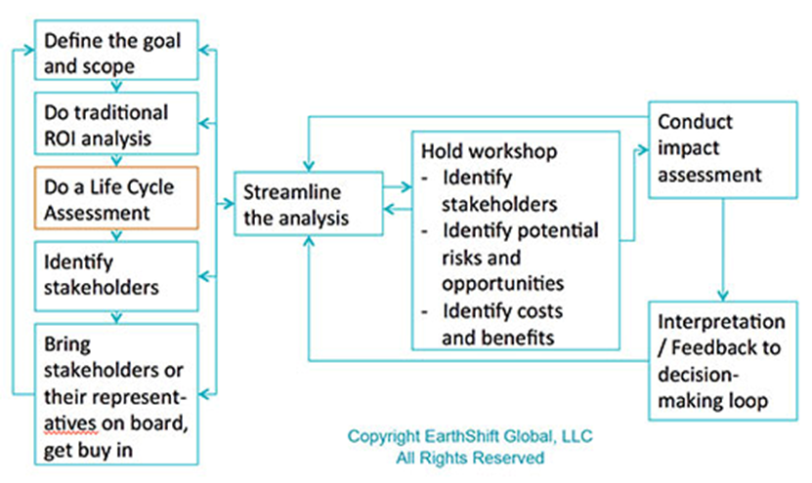
SUSTAINABILITY RETURN ON INVESTMENT (S-ROI) 4.
Figure 2-8 shows a typical S-ROI Analysis

Slide 51
SUSTAINABILITY RETURN ON INVESTMENT (S-ROI) 5.
Figure 2-8 Details 6 S-ROI Steps
Define project goal, scope, and alternatives, and conduct traditional ROI analysis as a baseline
Do Life Cycle Assessment (LCA), along with environmental and hazard risk assessments as needed
Identify stakeholders
Create scenarios and assign a range of probabilities to each
Do a financial analysis for each stakeholder of interest with best case, worst case and most-probable case
Review impact assessment with stakeholders to ensure completeness and agreement

Slide 52
QUESTION 5: ?
What is defined as the return benefit to an investor resulting from the results of a financial investment?
a. STBL (Sustainability-The Bottom Line)
b. ROI or Return on Investment
c. Sustainability Return on Investment (S-ROI)
d. Smart Budgeting

Slide 53
ANSWER 5:
ROI or Return on Investment

Slide 54
STUDENT ACTIVITY 4.
Download WORD file:
Return on Investment Analysis

Slide 55
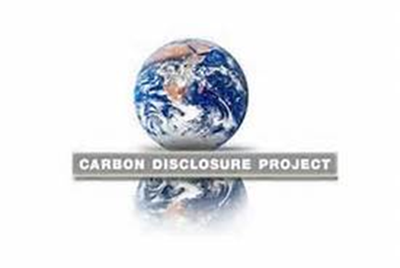
CDP (CARBON DISCLOSURE PROJECT) 1.
CDP (Carbon Disclosure Project)
UK organization
Disclose greenhouse gas emissions of major corporations
CDP's report DATA is questionable
CDP recognizes companies with high-quality disclosure as top scoring companies in CDLI
Figure 2-9 CDP Project
Global Companies that are Doing the Most to Combat Climate Change: 3:15

Slide 56
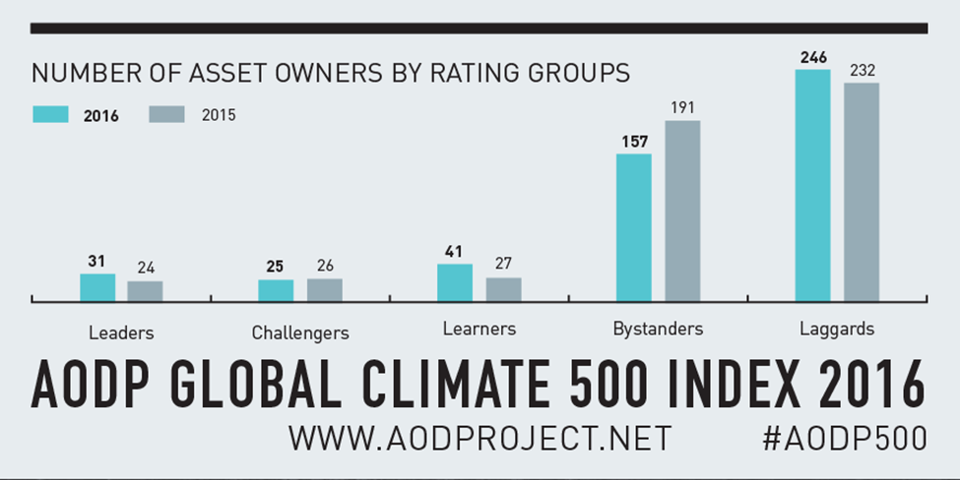
FIGURE 2-10: Climate Change Performance Index (CCPI) is a mechanism designed to enhance transparency in international climate politics. Its goal is to encourage political and social pressure on those who have failed to take actions on climate change and spotlight countries with best-practice climate change policies

Slide 57
QUESTION 6: ?
What country created the CDP (Carbon Disclosure Project) ?
a. United Kingdom (UK)
b. United States (US)
c. Canada
d. France

Slide 58
ANSWER 6:
United Kingdom (UK)

Slide 59
Summary (1 of 5)
Circles of Sustainability explains 4 pillars of sustainability and are used to understand and assess the sustainability process and manage projects directed towards sustainable outcomes.
Four sustainability domain models of economics, ecology, politics and culture each contains 7 subdomains.
Triple bottom line (TBL) is an accounting framework that contains social, environmental, and financial components
UN ratified the ICLEI (International Council for Local Environmental Initiatives) TBL standard for urban and community. It became the dominant approach to public sector full cost accounting called Sustainability Triple Bottom Line (S-TBL)

Slide 60
Summary (2 of 5)
EcoBudget® works along lines of local financial budgeting, adopting idea of an annual budget as a spending outline with the budget approved by political decision-making body.
Sustainability TBL accounting expands traditional reporting framework to take into account social and environmental performance in addition to the financial performance.
TBL stresses that a company's responsibility lies with stakeholders and not the shareholders. Stakeholders means anyone who is influenced, either directly or indirectly, by the actions of the company or organization.
S-TBL accounting expands the traditional reporting framework to take into account social and environmental performance in addition to the financial performance.

Slide 61
Summary (3 of 5)
People, Planet and Profit describes the Triple Bottom Line business within the goal of sustainability.
People refers to fair and useful business practices
Planet or natural capital refers to sustainable environmental practices.
Profit is defined as the economic value created by a business after deducting the cost of all inputs, including the cost of the capital invested in the business. Profit represents the eco-bottom line or what is called eco-capitalism.
Eco-capitalism or green capitalism, is view that capital exists in nature as natural capital (ecosystems W/ecological yield) on which all wealth depends, and therefore, market-based government policy instruments should be used to resolve environmental problems.

Slide 62
Summary (4 of 5)
Global Reporting Initiative (GRI) is an international independent standards organization that helps businesses, governments and other organizations understand and communicate what they have done regarding climate change, human rights and corruption.
Sustainability Return on Investment (S-ROI) is a process of:
Systematically identifying possible future events that might affect an investment’s payback
Considering the likelihood that future events will occur
Assessing the consequences of future events
CDP (formerly Carbon Disclosure Project) is a UK (United Kingdom) based organization that works with shareholders and corporations to disclose the greenhouse gas emissions of major corporations.

Slide 63
Summary (5of 5)
CDP recognizes companies with high-quality disclosure as top scoring companies in the Climate Disclosure Leadership Index (CDLI), which are scores calculated according to a standardized methodology which measures how well, a company responds to each question.
Climate Change Performance Indices (CCPI) is a mechanism designed to enhance transparency in international climate politics. Its goal is to encourage political and social pressure on those countries which have failed to take ambitious actions on climate change and spotlight countries with the best-practice climate change policies.

