Slide 1
Sustainability- Principles and Practices
Chapter 5
Energy and Power

Slide 2
LEARNING OBJECTIVES
Explain the difference between energy and power
Explain the units of energy and power
List the forms of energy
Describe the difference between kinetic energy and potential energy
Describe mechanical power
Explain electrical power
Discuss the difference between work and powe

Slide 3
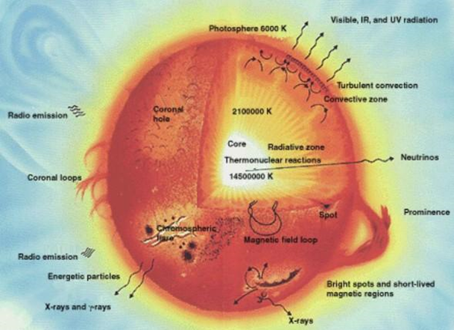
ENERGY 1.
Energy
Ability to do work
Sun is source of energy for life on Earth
Releases: thermal energy, heat energy &radiant (light) energy.
Figure 5-1 Sun as the source of all energy on earth

Slide 4
ENERGY 2.
Physics Defines Energy
Property of objects which can be transferred
To other objects or converted into different forms
Ability of a system to perform work is another definition
Energy is not necessarily available to do work
Energy can be converted from one form to another

Slide 5
ENERGY 3.
First Law of Thermodynamics
Matter and energy can neither be created nor destroyed
It can only change from one state to another

Slide 6
ENERGY 4.
Types of Energy (Figure 5-2)
Mix of both potential and kinetic energy
Thermal or heat energy is internal energy
Present in a system
Due to its temperature
Heat is transfer of energy
Thermal energy is energy of microscopic pieces of matter
Include both kinetic and potential energy

Slide 7
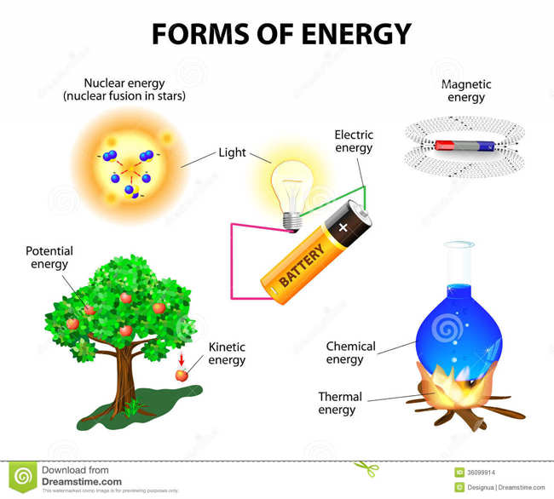
FIGURE 5-2 Forms of Energy

Slide 8
ENERGY 3.
Laws of Thermodynamics
Internal Combustion Engine (ICE)
Uses theory of thermodynamics to generate power
First Law of Thermodynamics
Energy cannot be created or destroyed
Internal energy in a system is a direct result of the heat
Transferred into that system and work done

Slide 9
ENERGY 4.
Second Law of Thermodynamics
Concerns thermodynamic cycle
In a perfect heat engine, all of heat produced
Would be completely converted to mechanical work
Nicolas Leonard Sadi Camot, French Scientist
Proved that this ideal cycle could not exist
Best engine loses heat and work because
Burned gases must be exhausted
Exhaust removes a great deal of heat

Slide 10
ENERGY 5.
Gasoline BTUs
ICE use gasoline rated at about 110,000 BTU per gallon
BTUs used to measure heat-producing capabilities
Burning vaporized gasoline in combustion chamber
Results in high heat and rapid expansion of gases
Rapid heating and expansion of gases
Creates high force that pushes pistons, produces power
Energy of expanding gas transmitted against piston
Rotates crankshaft, producing torque, a form of work

Slide 11
ENERGY 6.
Energy Units
In SI units (International System of Units
Energy is measured in joules
1 joule is defined "mechanically, being energy
Transferred to an object by mechanical work of moving it
Distance of 1 meter against a force of 1 newton
1 Nm (Newton-Meter) = 1 Joule
MKS (Meter Kilogram Second) measuring system
Joule is equivalent to the dyne centimeter

Slide 12
FREQUENTLY ASKED QUESTION?
Who discovered and defined energy unit Joule?
In 1843 James Prescott Joule independently discovered the mechanical equivalent of energy in a series of experiments. The most famous of them used the Joule apparatus: a descending weight, attached to a string, caused rotation of a paddle immersed in water, practically insulated from heat transfer. Figure 5-3 NEXT SLIDE
Energy and Power Difference: 2:56

Slide 13
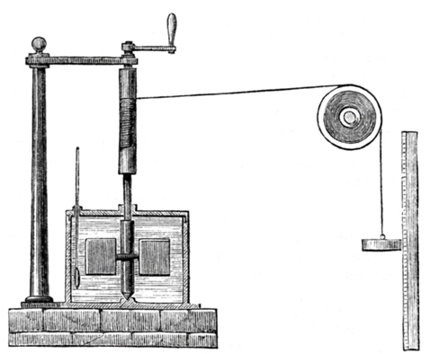
FIGURE 5-3 Showed that gravitational Potential energy lost by the weight in descending was equal to internal energy gained by the water through friction with the paddle.
Internal energy gained by the water through friction with the paddle

Slide 14
Energy In & Out Animation

Slide 15
QUESTION 1:
What is defined as the ability to do work?
a. Energy
b. Power
c. Horsepower
d. Wattage

Slide 16
ANSWER 1:
Energy

Slide 17
STUDENT ACTIVITY 1.
Download WORD file: Exercise Bicycle Efficiency

Slide 18
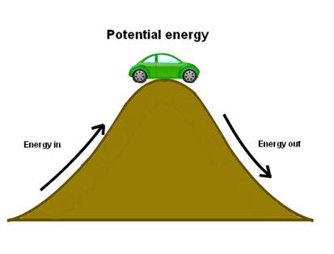
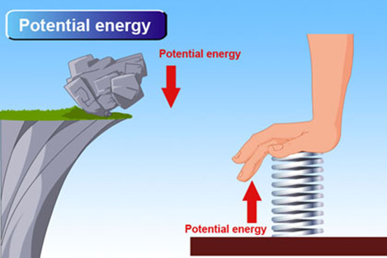
POTENTIAL ENERGY & KINETIC ENERGY 1.
Figure 5-4 Potential Energy
Potential Energy
Capacity to perform work
Energy at rest
Common types
Vehicle at top of hill
Rock ready to fall
Compressed spring

Slide 19
Potential Energy Animation

Slide 20
Potential and Kinetic Energy Animation

Slide 21
POTENTIAL ENERGY & KINETIC ENERGY 2.
Formula for Potential Energy:
Potential Energy = mg x h
h = Height or distance of body for potential motion
m = Mass or weight of potential energy body
g = Acceleration due to gravity or G force (9.8 meters/second)
Acceleration factor or “a”
F = Force can be substituted for mg
(F = ma [mass times acceleration, Newton’s 2nd Law of Motion])

Slide 22
POTENTIAL ENERGY & KINETIC ENERGY 3.
Kinetic Energy
Energy of motion
Work needed to accelerate a body
Of a given mass from rest to its stated velocity
Gained energy during acceleration
To maintain kinetic energy unless speed changes
Physics, Power and Energy: 2:36:49

Slide 23
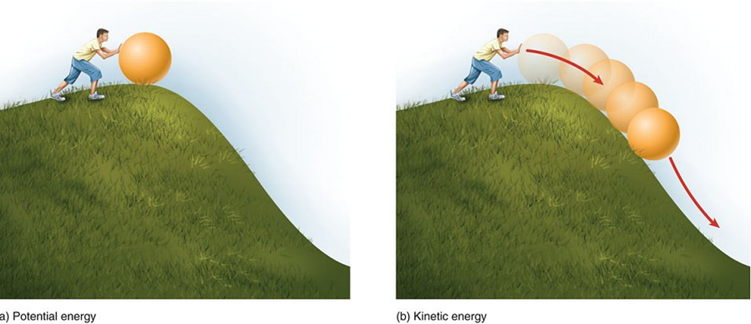
FIGURE 5-5 same amount of work is done by the body in decelerating from its current speed to a state of rest. In classical mechanics, kinetic energy of a non-rotating object of mass “m” traveling at a speed “v is solved using one of the kinematic formulas.
Kinetic Energy = ½ mv²
M = Mass or weight
v = Velocity: rate of change of position of object
Once a ball is in motion, it will stay in motion
Unless another force stops it
Figure 5-5 Kinetic Energy

Slide 24
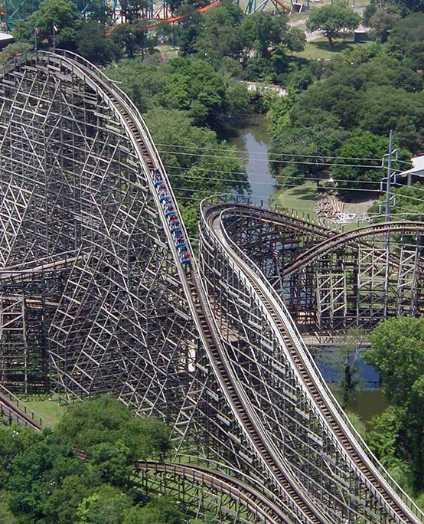
POTENTIAL ENERGY & KINETIC ENERGY 4.
Roller Coaster Cars
Reach maximum kinetic energy
At bottom of their path
Cars start rising
Kinetic energy converted to potential energy
Figure 5-6 Kinetic Energy of a Roller Coaster

Slide 25
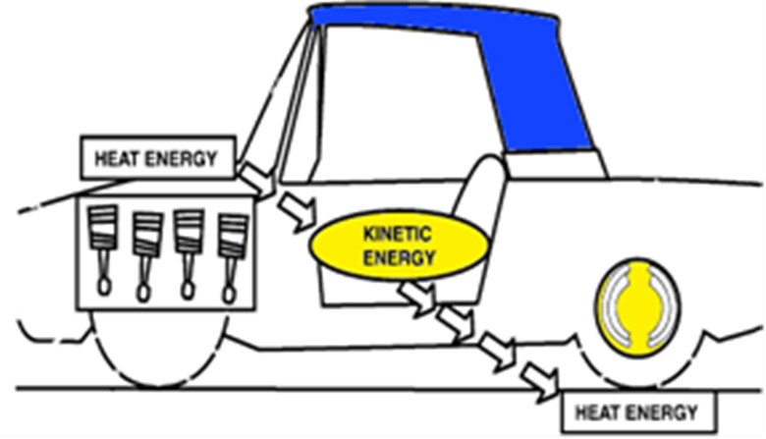
FIGURE 5-7 To move an automobile powered by an internal combustion engine requires use of energies. Energy is never lost, it just changes states. Gasoline in a car contains potential energy. Potential Energy is capacity to perform work, or energy at rest. When gasoline is injected into engine and ignited, potential energy of liquid gasoline changes states and becomes heat energy. The engine converts this heat energy into motion or kinetic energy.

Slide 26
Energy At Work Animation

Slide 27
QUESTION 2:
Which of these is the capacity to perform work?
a. Kinetic energy
b. Work
c. Potential Energy
d. Torque

Slide 28
ANSWER 2:
Potential Energy

Slide 29
STUDENT ACTIVITY 3.
Download WORD file: Kinetic Energy Observed Using Ramps

Slide 30
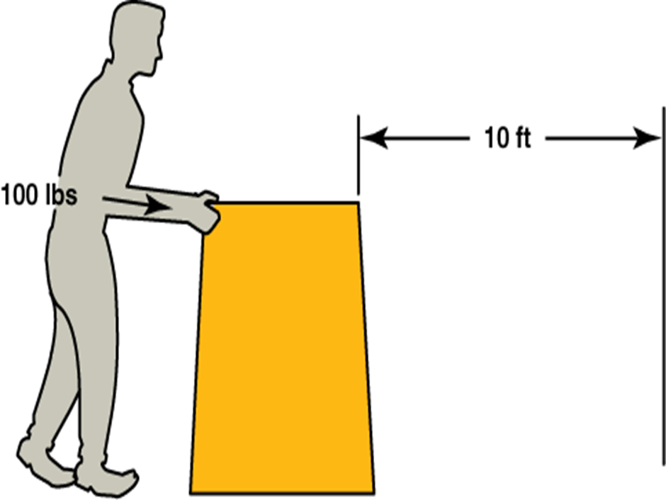
WORK & POWER 1.
Work
Product of force & distance
Through which force acts
Work is force (Pounds-Newton) times distance
Foot-pound or Newton-meter
Figure 5-8 Work

Slide 31
WORK & POWER 2.
Formula used for Work
Work = 2 πFRN
Work, Energy and Power: 3:17

Slide 32
FREQUENTLY ASKED QUESTION?
Who Introduced the Term “Work” in Physics?
Term work was introduced in 1826 by the French mathematician Gaspard-Gustave Coriolis as "weight lifted through a height", which is based on the use of early steam engines to lift buckets of water out of flooded ore mines.

Slide 33
WORK & POWER 3.
Torque
Form of Work
Force that tries to turn or twist something around
Product of a force and perpendicular distance
Between line of action of force and
Axis of rotation
Torque = Force x Length
Math Formula, lb ft to lb in – Torque

Slide 34
FIGURE 5-9 Torque is a twisting force equal to the distance from the pivot point times force applied expressed in units called pound-feet (lb-ft) or Newton-meters (Nm). Using a wrench to twist a nut is an example of torque as shown in Figure 9. Turning a nut is easier if using a wrench with a longer handle

Slide 35
WORK & POWER 4.
Torque Expressed Mathematically
T = FR
T = torque, in foot-pounds or Newton-meters
F= force, in pounds or Newtons
R= radius, or torque-arm distance, in feet or meters

Slide 36
WORK & POWER 5.
Power
Rate of doing work
Rate at which work is being done
SI system, unit of power is joule per second
Watt unit of power used in electricity
Horsepower (comparing to the power of a horse)
Metric unit for automotive horsepower is kilowatt
1 kilowatt is equal to 1,000 watts
Work, Energy and Power: 3:17

Slide 37
WORK & POWER 6.
One Horsepower = 33,000 ft-lbs of Work
Done in one minute
If weight of 550 pounds lifted 60 feet
Work done is 550 x 60 = 33,000 lbft
Done in one minute, 1 horsepower is consumed
Metric system, in Kilowatts
0.746 Kilowatts = 1 horsepower
1.341 horsepower = 1 kilowatt

Slide 38
FREQUENTLY ASKED QUESTION?
Where Did The Term Horsepower Come From?
Horsepower came from act of a horse pulling or lifting a weight of 200 pounds for a distance of 165 feet: Figure 5-10. 200 X 165 = 33,000 pounds in one minute. Brake or shaft horsepower is power delivered at shaft of engine. The term brake horsepower comes from method of testing early engines. This consisted of putting a mechanical brake on engine and measuring force required to hold the brake from turning. The energy produced was dissipated as heat. Water or air was used to cool the friction surfaces of the brake. Brakes of this type, called Prony brakes, were an early type of an absorption dynamometer.

Slide 39
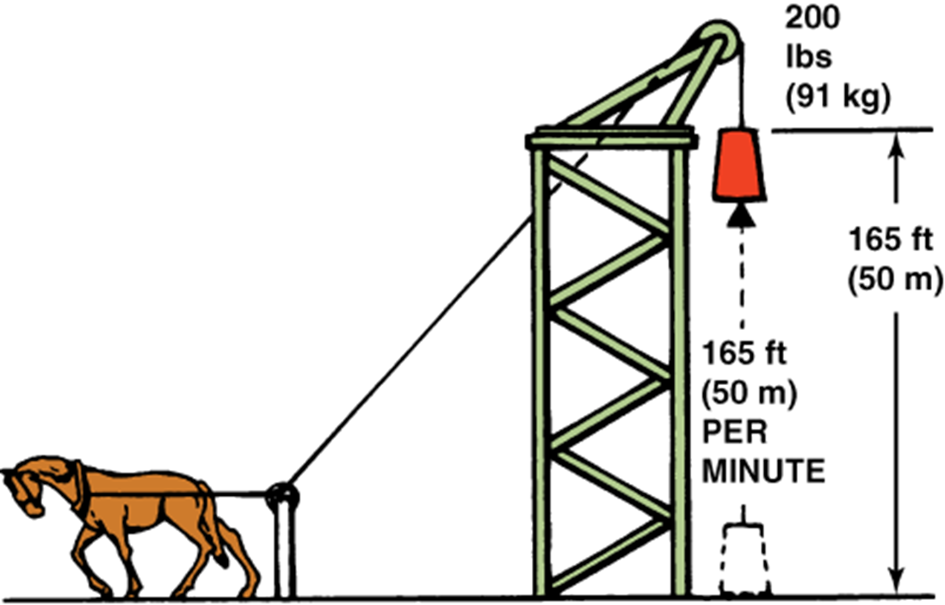
FIGURE 5-10 Horsepower Measurement
Horsepower
Measured by a dynamometer is expressed by formula:
Hp | horsepower
F | dynamometer load, in pounds
R | radius arm of dynamometer, in feet
33,000 | foot-pounds per minuter
N | engine speed, in revolutions per minute (rpm)
Π | 3.1416, a constant
Math Formula Horse Power

Slide 40
QUESTION 3: ?
Which of these is defined as the product of a force and the distance through which the force acts?
a. Kinetic energy
b. Potential Energy
c. Torque
d. Work

Slide 41
ANSWER 3:
Work

Slide 42
STUDENT ACTIVITY 2.
Download WORD file: Walking Work and Power Calculated

Slide 43
MECHANICAL POWER 1.
Mechanical Power
Measure of force amplification
Using tool, mechanical device
Lever or wedge or machine system
Law of the lever
Perfect mechanism transmits power without
Adding to or subtracting from it

Slide 44
MECHANICAL POWER 2.
Law of Levers
Movable bar that pivots on a fulcrum
Attached to or positioned on or across fixed point
Lever consists of beam pivoted at a fixed fulcrum
Capable of rotating on a point on itself
Lever operates by applying forces at different distances
From fulcrum or pivot
3 types of levers used in mechanics include:

Slide 45
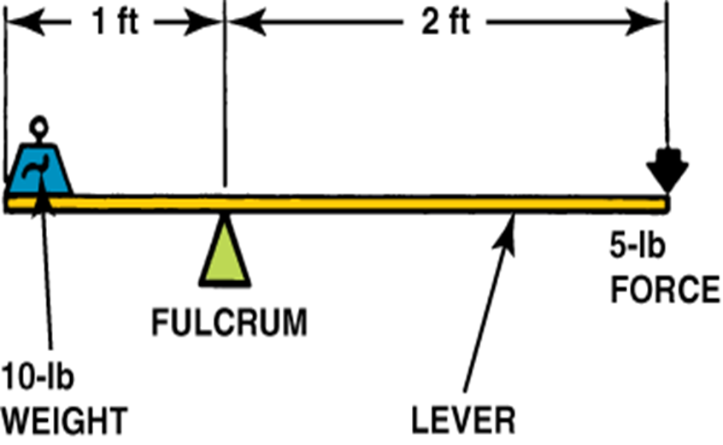
Figure 5-11 first-class lever increases force and changes direction of force. Fulcrum in the middle: the effort is applied on one side of the fulcrum and the resistance (load) on the other side, examples are” seesaw, crowbar or scissors. Mechanical advantage may be greater than, less than, or equal to 1
A Level Physics: Mechanical Power: 2:19

Slide 46
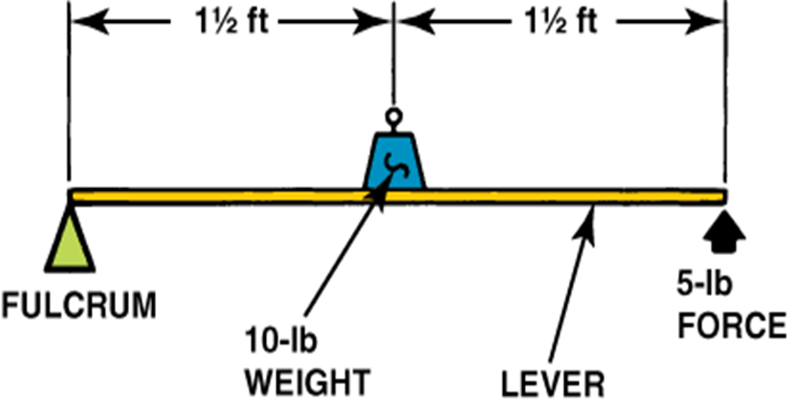
Figure 5-12 second-class lever increases force in same direction as it is applied: Resistance (load) in the middle: effort is applied on one side of resistance and fulcrum is located on other side, examples are wheelbarrow, nutcracker, bottle opener or automotive brake pedal. Mechanical advantage is always greater than 1.

Slide 47
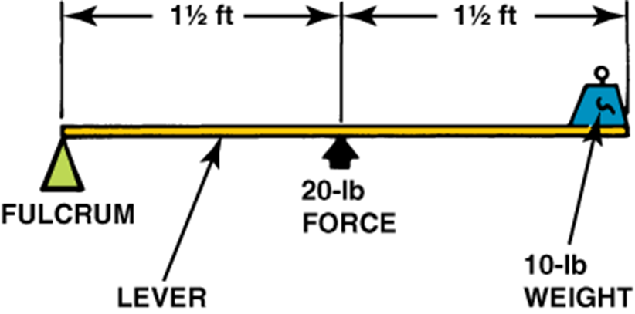
Figure 5-13 third-class lever reduces force but increases the speed and travel of the resulting work: Effort in middle: resistance (load) is on one side of effort and fulcrum is located on the other side, examples are tweezers or human hands. Mechanical advantage is always less than 1.

Slide 48
QUESTION 4: ?
Which of these is an example of a first class lever?
a. Crowbar
b. Wheelbarrow
c. Nutcracker
d. Tweezers

Slide 49
ANSWER 4:
Crowbar

Slide 50
ELECTRICAL POWER 1.
Greeks Discovered Electricity
Found when they took amber
Rubbed it against other materials
Became charged with an unseen force
With ability to attract lightweight objects
Like feathers in same way magnet picks up metal

Slide 51
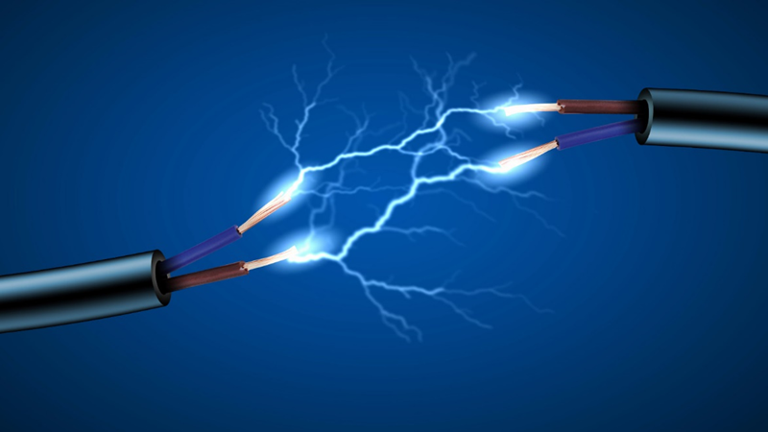
Figure 5-14 Electricity. William Gilbert discovered that other materials shared the ability to attract, such as sulfur and glass. He also used the Latin word electricus, which means “amber,” and the word electrical for the effect. Sir Thomas Browne used the word electricity during the early 1600s

Slide 52
ELECTRICAL POWER 2.
Electrical Power
Energy measure of amount of fuel within something
Used by something over a specific time period
kWh (Kilowatt hour) is a unit of energy
kW (Kilowatt) is a measure of power

Slide 53
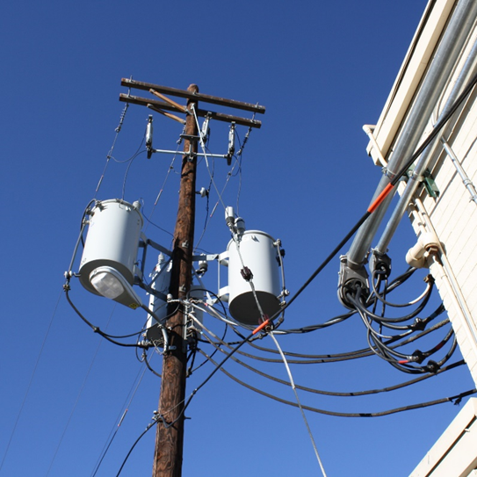
ELECTRICAL POWER 3.
Electric Power
Rate at which electrical energy transferred
SI unit of power is watt (one joule per second)
AC (Alternating Current) from generators
DC (Direct Current) supplied by batteries or solar cells
Supplied to businesses/homes by the electric power industry
Thru an electric power grid
Figure 5-15 Electric Power

Slide 54
ELECTRICAL POWER 4.
Electric Power
Sold by the kilowatt hour
Product of power in kilowatts
Multiplied by running time in hours
Watt-hour is a unit of energy
Equal to a power of one watt operating for one hour

Slide 55
ELECTRICAL POWER 5.
1 Watt-hour Equals 3600 Joules
kilowatt hour is a unit of energy
Equal to 1,000 watt-hours, or 3.6 megajoules
If energy used at a constant rate (power)
Over period of time, total energy is in kilowatt-hours
Product of power in kilowatts and time in hours
Electric utilities measure power using a meter

Slide 56
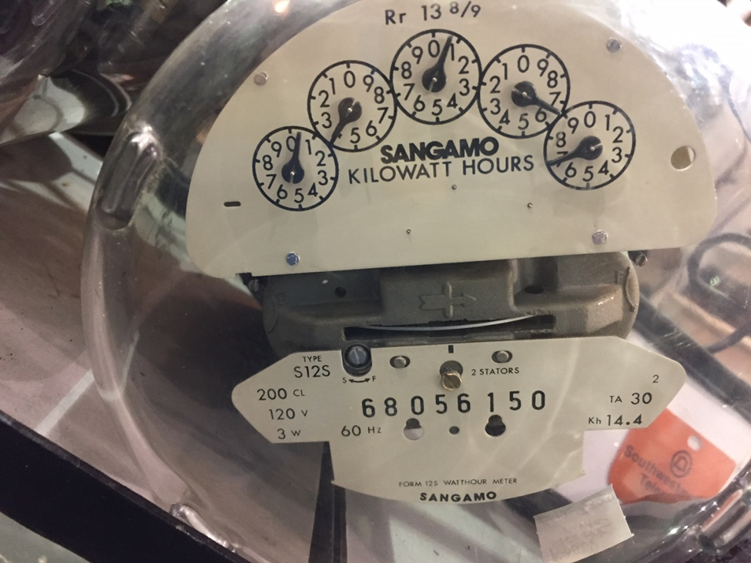
Figure 5-16 one megawatt is equal to the electrical needs for 1,000 homes.

Slide 57
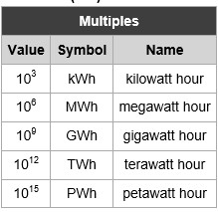
ELECTRICAL POWER 6.
Figure 5-17 power consumption values chart
TWh (Terawatt hours)
PWh (Petawatt hours)
Distribution or use of electrical power
Kilowatt (kWh) hours household electrical
Megawatt (MWh) hours city wide power generation
Terawatt (TWh) hours & Petawatt (PWh) hours
Larger producers of electrical power
Wind farms, large solar arrays
Physics: Electrical Power Simplified: 6:17

Slide 58
ELECTRICAL POWER 7.
Watt
Basic unit of power
Power is rate at which electrical energy delivered to circuit
Watts/horsepower both measures of power
Watt’s Law
Relationship between power (P), voltage (E), and current (I)
Formula P = I x E and its derivatives P/E=I and P/I=E
60 watt light bulb uses 0.5 amps of current
At 120 volts (60/120 = 0.5)

Slide 59
Fuels Used For Electricity Animation

Slide 60
QUESTION 5: ?
Which of these is the SI unit of power is the _____?
a. Joule
b. Ampere
c. Watt
d. Volt

Slide 61
ANSWER 5:
Watt

Slide 62
STUDENT ACTIVITY 4.
Download WORD file: Building an HEV Battery Pack

Slide 63
Summary (1 of 4)
Energy is defined as the ability to do work. The Sun is the source of energy for life on Earth. It releases the following: thermal energy, heat energy and radiant (light) energy.
Physics defines energy as a property of objects which can be transferred to other objects or converted into different forms.
Mechanical energy which is the sum of kinetic and potential energy in a system.
Elastic energy in materials is also dependent upon electrical potential energy (among atoms and molecules), as is chemical energy, which is stored and released from a reservoir of electrical potential energy between electrons, and the molecules or atomic nuclei that attract them. The list is also not necessarily complete.
Thermal or heat energy is internal energy present in a system due to its temperature.

Slide 64
Summary (2 of 4)
The first law of thermodynamics is a law of energy conservation: energy cannot be created or destroyed.
In SI units (International System of Units (French: Système international d'unités, or SI) is the modern form of the metric system, energy is measured in joules, and one joule is defined "mechanically", being the energy transferred to an object by the mechanical work of moving it a distance of 1 meter against a force of 1 newton. 1 Nm (Newton-Meter) = 1 Joule.
In the MKS (Meter Kilogram Second) measuring system the Joule is equivalent to the dyne centimeter in the CGS (Centimeter Gram Second) measuring system the Joule is equivalent to the erg.
Potential Energy is the capacity to perform work, or energy at rest. It is energy possessed by a body by virtue of its position relative to others, stresses within itself, electric charge, and other factors.

Slide 65
Summary (3 of 4)
Kinetic energy is the energy of motion. It is the work needed to accelerate a body of a given mass from rest to its stated velocity.
Work is defined as the product of a force and the distance through which the force acts. Simply expressed, work is force (pounds-Newton) times distance (the foot-meter); hence, the foot-pound or Newton-meter.
Power is defined as the rate of doing work or the rate at which work is being done. It is the amount of energy consumed per unit time.
Mechanical advantage or power is a measure of the force amplification achieved by using a tool, mechanical device like a lever or wedge or machine system. .

Slide 66
Summary (4 of 4)
Electric power is the rate at which electrical energy is transferred by an electric circuit.

