Slide 1

Sustainability- Principles and Practices
Chapter 6
Alternative Fuels

Slide 2
LEARNING OBJECTIVES
Describe how oxygenated fuels help reduce exhaust emissions.
List the types of oxygenated fuels.
Discuss how ethanol is made using grains or cellulose.
Explain phase separation.
Discuss safety precautions when working with methanol.
Discuss the advantages and disadvantages of propane as a vehicle fuel.
Discuss the advantages and disadvantages of CNG as a vehicle fuel.
List the safety precautions that need to be adhered to when working with alternative fuels.

Slide 3
INTRODUCTION
Gasoline Fuel of Choice for >100 Years
  Main Fuel for the foreseeable future
  Complex mixture of various hydrocarbons
  Refined from crude petroleum oil
  Gasoline and air burns in cylinder
  Produces heat and pressure from cylinders to crankshaft
  Powers drive wheels of a vehicle
  CO₂ & H₂O produced if of air & fuel are consumed

Slide 4

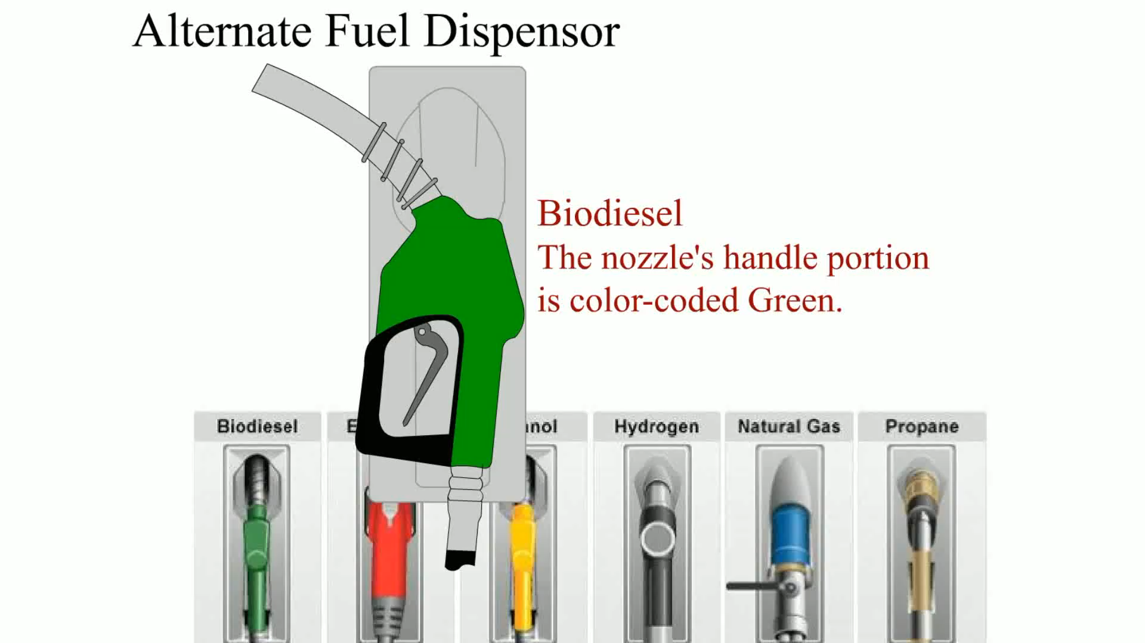
ANIMATION

Slide 5

OXYGENATED FUELS
Oxygenated Fuels
  Contain an oxygen atom in fuel molecule itself
  Improves fuel combustion & reduces exhaust emissions
  Reduces nonrenewable fossil fuels consumed
  Increases gasoline octane
  Clean Air Act (CAA) requires use of oxygenated gasoline
    CO levels exceed federal air quality standards
  Winter oxygenated gasoline programs implemented by states
How to Lower Car Emissions: 2:47
Clean Air Gas from all Gasoline Cars: 10:12

Slide 6
ETHANOL
Ethanol Terminology
  Ethanol also called ethyl alcohol or grain alcohol
  Usually made from grain
  Found in beer, wine, distilled spirits
  Composed of 2 carbon atoms
  6 hydrogen atoms, 1 added oxygen atom

Slide 7
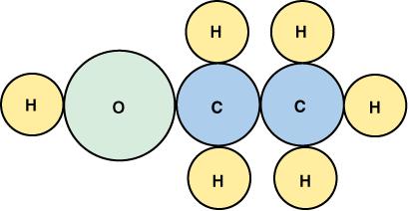
FIGURE 6–1 The ethanol molecule showing two carbon atoms, six hydrogen atoms, and one oxygen atom.

Slide 8

FREQUENTLY ASKED QUESTION?
What Is “Phase Separation”?
  All alcohols absorb water, and alcohol–water mixture can separate from the gasoline and sink to bottom of fuel tank. This process is called phase separation. To help avoid engine performance problems, try to keep at least a ¼ tank of fuel at all times, especially during seasons when there is a wide temperature span between daytime highs and nighttime lows. These conditions can cause moisture to accumulate in fuel tank as a result of condensation of moisture in air. SEE FIGURE 6–2.

Slide 9
FIGURE 6–2 A container with gasoline containing alcohol. Notice separation line where alcohol–water mixture separated from the gasoline and sank to the bottom.

Slide 10


STUDENT ACTIVITY 2.
Download WORD file: Phase Separation

Slide 11
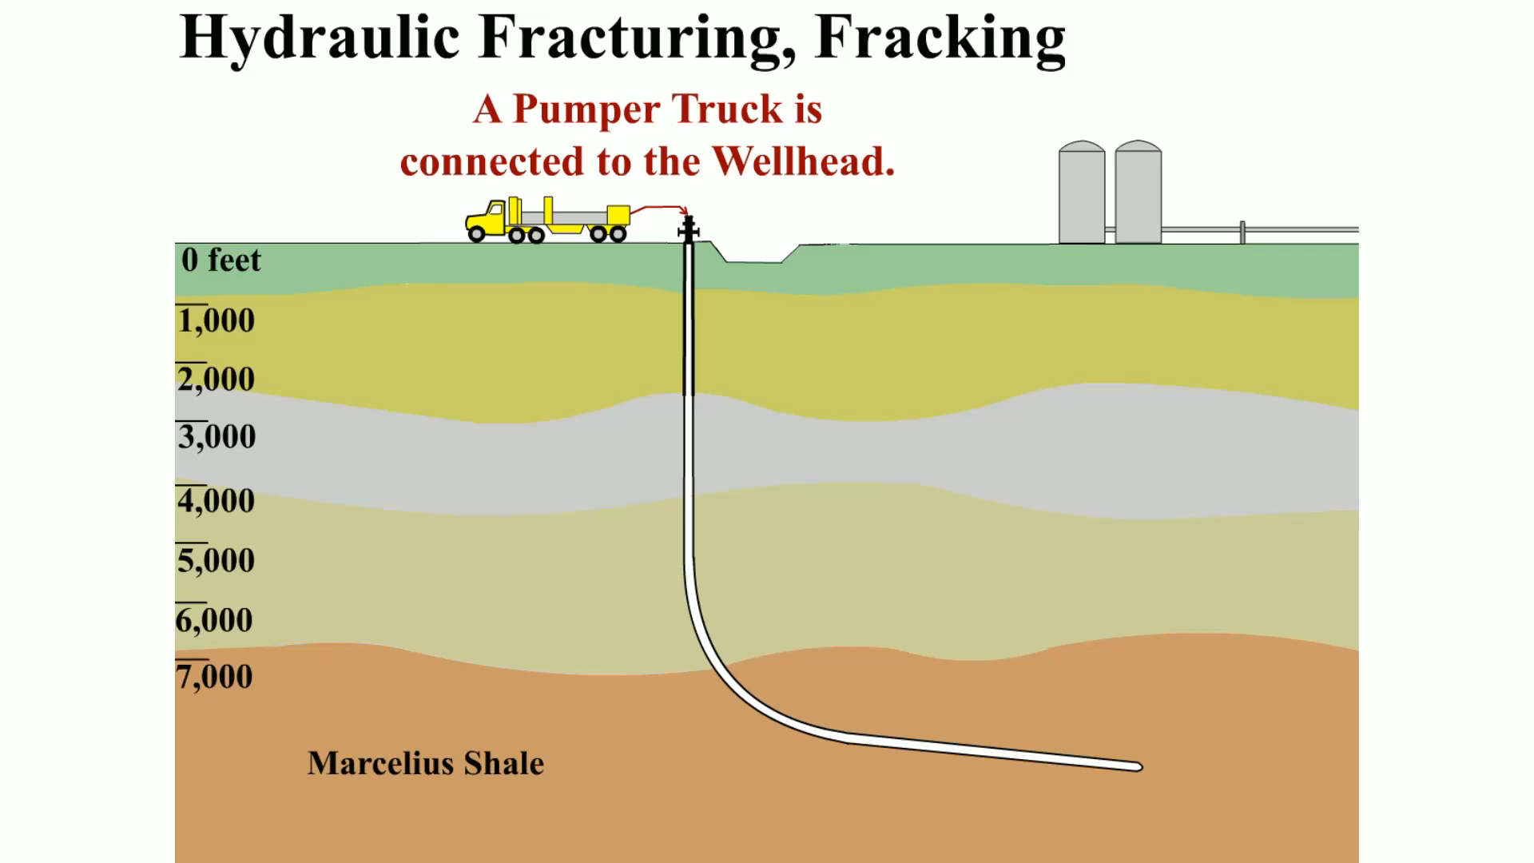
ANIMATION

Slide 12
ETHANOL
Ethanol Production
  From grains, such as corn, wheat, or soybeans
  Majority of U.S. ethanol made from:
    Corn
    Grain
    Sorghum
    Wheat
    Barley

Slide 13

ETHANOL
Ethanol Dry Mill Process
  Starch portion of corn fermented into sugar
  Distilled into alcohol. Major steps:
    STEP 1 Milling
    STEP 2 Liquefaction
    STEP 3 Saccharification
    STEP 4 Fermentation
    STEP 5 Distillation
    STEP 6 Dehydration
    STEP 7 Denaturing
How to Make Ethanol at Home: 8:21

Slide 14
CELLULOSE ETHANOL
Terminology
  From wide variety of cellulose biomass feedstock:
    Agricultural plant wastes (corn stalks, cereal straws)
    Plant wastes from industrial processes (paper pulp)
    Energy crops grown specifically for fuel production

Slide 15
CELLULOSE ETHANOL
Refining Cellulose Biomass
  Must extract fermentable sugars from feedstock
  Sugars in cellulose locked in
  Complex carbohydrates (polysaccharides)

Slide 16

CELLULOSE ETHANOL
Two Processing Options
    Separate these complex structures into
    Fermentable sugars
      Acid hydrolysis
      Enzymes
Process of Converting Biomass to Cellulosic Ethanol: 4:36

Slide 17
FREQUENTLY ASKED QUESTION?
What Is Switchgrass?
  Switchgrass used to make ethanol, summer perennial grass, native to North America. It is a natural component of the tall-grass prairie, which covered most of Great Plains. Switchgrass is resistant to many pests and plant diseases and is capable of producing high yields with very low applications of fertilizer. This means that the need for agricultural chemicals to grow switchgrass is relatively low. Switchgrass is also very tolerant of poor soils, flooding, and drought, which are widespread agricultural problems in the southeast. There are two main types of switchgrass:
    Upland types—usually grow 5 to 6 feet tall
    Lowland types—grow up to 12 feet tall
  Using switchgrass to produce ethanol results in better energy SEE FIGURE 6-3

Slide 18
FIGURE 6–3 Switchgrass is a summer perennial grass that is native to North America.

Slide 19
CELLULOSE ETHANOL
E10 is 10% ethanol and 90% gasoline
  Results in fuel with 3.5% 02 by weight
    Adding 10% ethanol increases (R + M)/2 octane rating by 3 points
    Alcohol added to base gasoline, raises
    Volatility of fuel about 0.5 PSI
    Most manufacturers permit up to 10% ethanol
    If drivability problems are not experienced. SEE FIGURE 6–4.

Slide 20
FIGURE 6–4 E10 is 10% ethanol and 90% gasoline.

Slide 21
CELLULOSE ETHANOL
E15 Definition
  E15 is 15% ethanol and 85% gasoline
  EPA recommends use of E15 only in
  Flexible fuel vehicles and those built in 2007 or later
  Precautions
    E15 requires separate fuel pump and in-ground tank
    Keep E15 separated from E10 or gasoline
    Do not use E15 unless vehicle designated flexible fuel vehicle
    Reduced fuel economy: 2% compared to conventional gasoline

Slide 22
ETHANOL BLENDING
Adding Ethanol To Gasoline
  Gasoline additives, such as ethanol & dyes
  Added to fuel at distributor
  Adding ethanol to gasoline is a way to add oxygen
  3 basic methods used to create oxygenated fuel:
    In-line blending—Figure 6-5
    Sequential blending—Figure 6-6
    Splash blending—Figure 6-7

Slide 23
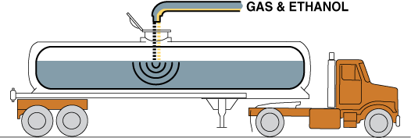
FIGURE 6-5 In-line blending is most accurate method for blending ethanol with gasoline because computers are used to calculate correct ratio.

Slide 24
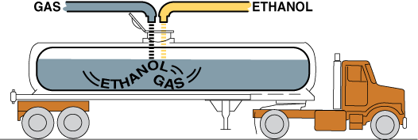
FIGURE 6-6 Sequential blending uses a computer to calculate the correct ratio as well as the prescribed order in which the products are loaded.

Slide 25
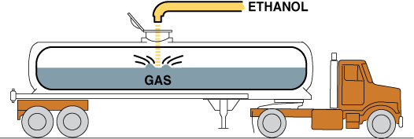
FIGURE 6-7 Splash blending occurs when ethanol is added to a tanker with gasoline and is mixed as the truck travels to the retail outlet.

Slide 26
ETHANOL BLENDING
What is E85?
  Combination 85% ethanol, 15% gasoline
  Octane rating 100–105

Slide 27
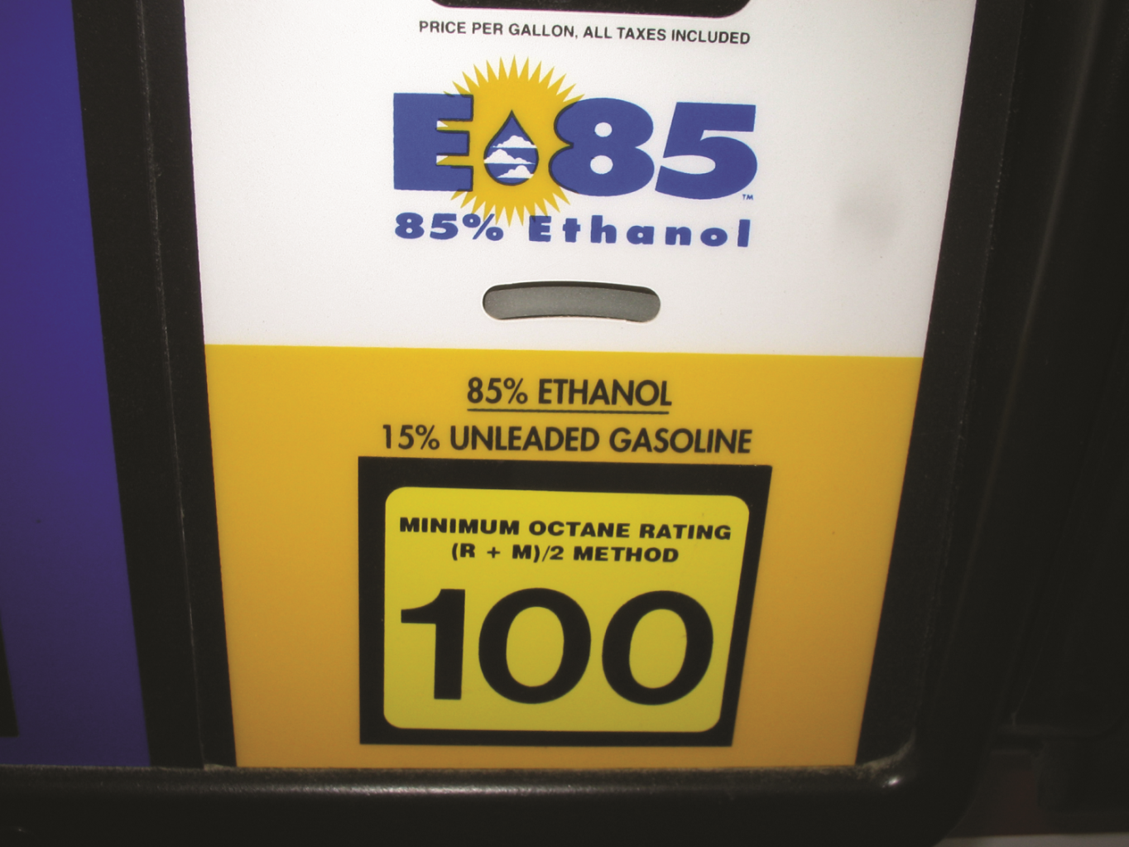
FIGURE 6–8 E85 (85% ethanol and 15% gasoline), has a high octane rating but contains less heat energy compared to gasoline or E10.

Slide 28
ETHANOL BLENDING
Heat Energy of E85
  Less heat energy than gasoline
    Gasoline = 114,000 BTUs per gallon
    E85 = 87,000 BTUs per gallon
    Fuel economy 20%–30% less with E85 instead of gasoline

Slide 29
ETHANOL BLENDING
Winter Blend E85
  E85 test as containing less than 85% ethanol
  Tested in cold climates because
  Often blended according to outside temperature
  Lower percentage of ethanol with a slightly
  Higher percentage of gasoline
  Helps engines start in cold climates
  Percentage of

Slide 30
ETHANOL BLENDING
Alternative Fuel Vehicles
  Vehicles able to run and operate correctly on
  E85 commonly referred to as:
    Alternative-fuel vehicle (AFV)
    Flexible fuel vehicle (FFV)
    Using E85 in a flex-fuel vehicle
    Result in a power increase of about 5%

Slide 31

ETHANOL BLENDING
Variable Fuel Sensor
  Flexible fuel vehicles, before 2006
  Use electronic sensor in the fuel supply line
  Detects presence and percentage of ethanol
  PCM adjusts fuel injector on-time & ignition timing
  Match needs of fuel being used
  Also called a variable fuel sensor
    SEE FIGURES 6–9 & 6–10, NEXT SLIDE

Slide 32
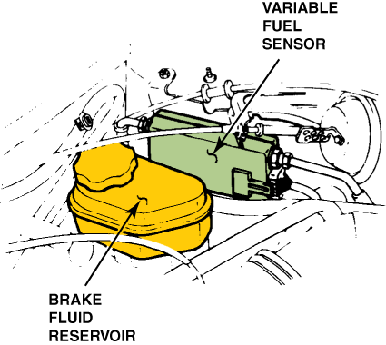
Figure 6-9 The location of the variable fuel sensor can vary, depending on the make and model of vehicle, but it is always in the fuel line between the fuel tank and the fuel injectors.

Slide 33
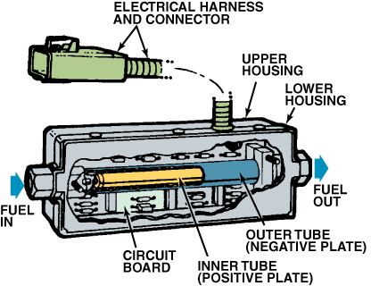
FIGURE 6-10 A cutaway view of a typical variable fuel sensor.

Slide 34
ETHANOL BLENDING
Ethanol-Fueled Vehicles
  Generally produce same pollutants as gasoline
  Produce less CO and CO2 emissions

Slide 35
FREQUENTLY ASKED QUESTION?
How Does Alcohol Content in Gasoline Affect Engine Operation?
  Use of gasoline containing 10% or less of ethanol (ethyl alcohol) has little or no effect on engine operation. However, because addition of 10% ethanol raises the volatility of the fuel slightly, occasional rough idle or stalling may be noticed, especially during warm weather. The rough idle and stalling may also be noticeable after the engine is started, driven, then stopped for a short time. Engine heat can vaporize the alcohol enhanced fuel causing bubbles to form in the fuel system. These bubbles in the fuel prevent the proper operation of the fuel-injection system and result in a hesitation during acceleration, rough idle, or in severe cases repeated stalling until all the bubbles have been forced through the fuel system, replaced by cooler fuel from the fuel tank.

Slide 36
ETHANOL BLENDING
Flex-Fuel Vehicle Identification
  Flexible fuel vehicles (FFVs) can be identified by:
    Emblems on the side, front, and/or rear of vehicle
    Yellow fuel cap showing E85/gasoline
      SEE FIGURE 6–11, NEXT SLIDE
      Vehicle Emission Control Information (VECI) Label
      SEE FIGURE 6–12, NEXT SLIDE

Slide 37
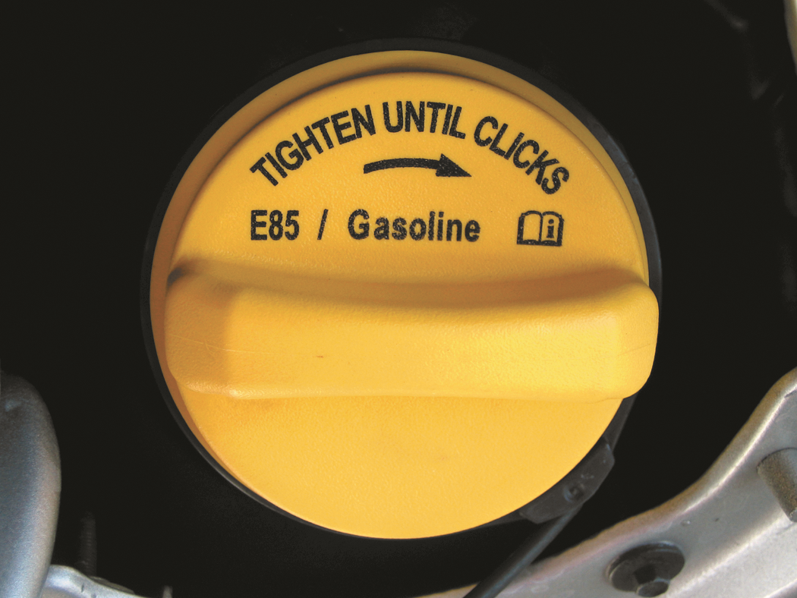
FIGURE 6-11 A flex-fuel vehicle often has a yellow gas cap, which is labelled E85/gasoline.

Slide 38
FIGURE 6-12 The letters “FFV” included on the vehicle emission control information (VECI) sticker located under the hood indicates that the vehicle is designed to operate using E85, E15, E10, or gasoline.

Slide 39
TIP TO REMEMBER
Purchase a Flex-Fuel Vehicle
  If purchasing a new or used vehicle, try to find a flexfuel vehicle. Flex-fuel vehicle has a more robust fuel system than a conventional fuel system designed for gasoline or E10. The enhanced fuel system usually includes:
    Stainless steel fuel rail
    Graphite commutator bars instead of copper in the fuel pump motor (ethanol can oxidize into acetic acid, which can corrode copper)
    Diamond-like carbon (DLC) corrosion-resistant fuel injectors
    Alcohol-resistant O-rings and hoses

Slide 40
QUESTION 1:
E85 means that the fuel is made from ____________.
a. 85% gasoline, 15% ethanol
b. 85% ethanol, 15% gasoline
c. Ethanol that has 15% water
d. Pure ethyl alcohol

Slide 41
ANSWER 1:
85% ethanol, 15% gasoline

Slide 42
STUDENT ACTIVITY 1.
Download WORD file: Identify Oxygenated Fuels

Slide 43

METHANOL
Methanol Terminology
  Chemical compound including
    1 carbon atom, 4 hydrogen atoms, 1 oxygen atom
  Light, volatile, colorless, tasteless, flammable,
    Poisonous liquid with very faint odor
  Used as antifreeze, solvent, and fuel
  Also used to denature ethanol
Working Safely with Methyl Alcohol in Classroom: 3:33

Slide 44
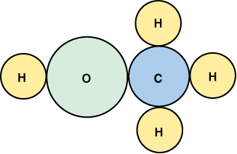
FIGURE 6–13 The molecular structure of methanol showing the one carbon atom, four hydrogen atoms, and one oxygen atom.

Slide 45
METHANOL
M85
  85% methanol and 15% gasoline
  Methanol very corrosive
  Fuel system components must be stainless steel
  Alcohol-resistant rubber and plastic components
  Heat content of about 60% of gasoline

Slide 46
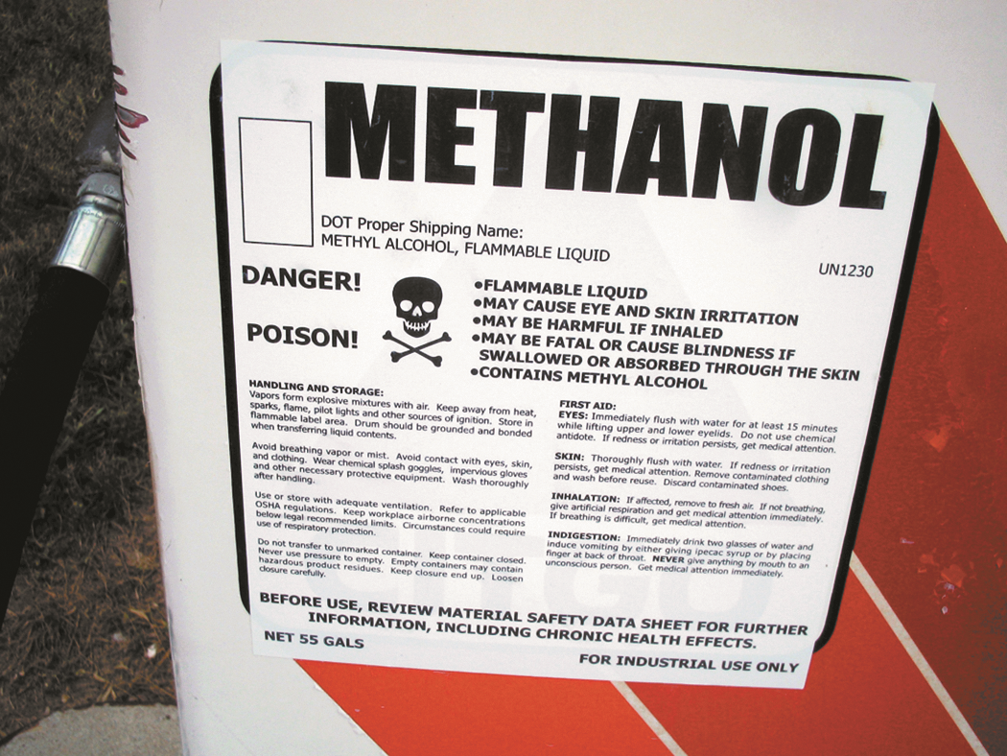
FIGURE 6–14 Sign on methanol pump shows that methyl alcohol is a poison and can cause skin irritation and other personal injury.

Slide 47
PROPANE
Most Widely Used of All Alternative Fuels
  Gas, but easily compressed into liquid
  Stored in inexpensive containers
  Also sold as liquefied petroleum gas (LPG) or LP-gas
  Mixed with about 10% other gases

Slide 48

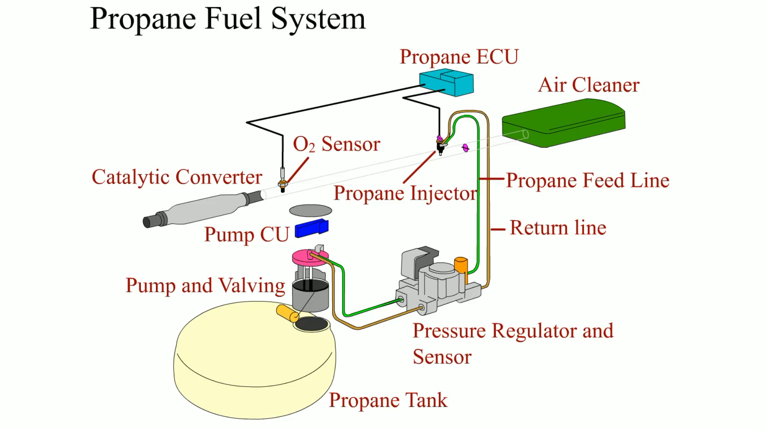
ANIMATION

Slide 49
Figure 6-15 The molecule of propane includes three carbon atoms and eight hydrogen atoms. Propane has a high octane rating but produces less heat energy than gasoline.

Slide 50
PROPANE
Nontoxic, But If Inhaled Can Cause
  Asphyxiation through lack of oxygen
  Used in forklifts inside warehouses and factories
  Heating value less than that of gasoline

Slide 51
Chart 6-1 A comparison of the heat value of commonly used fuel to propane.

Slide 52

PROPANE
Propane is Safe
  Because of following reasons:
    Air/propane ratio must be between 2.2:1 and 9.6:1 to ignite.
    Ignition point is high—940°F (500°C)
      Compared to 430°F (220°C) for gasoline.
    Safe to use because pressure is low (50 to 250 PSI).
    If propane was released into the air
      Dissipate unlike gasoline or diesel, making it harder to ignite
    Propane burns with a visible flame.
    SEE FIGURE 6–16, NEXT SLIDE
Advantages of Converting to Propane: 4:09

Slide 53
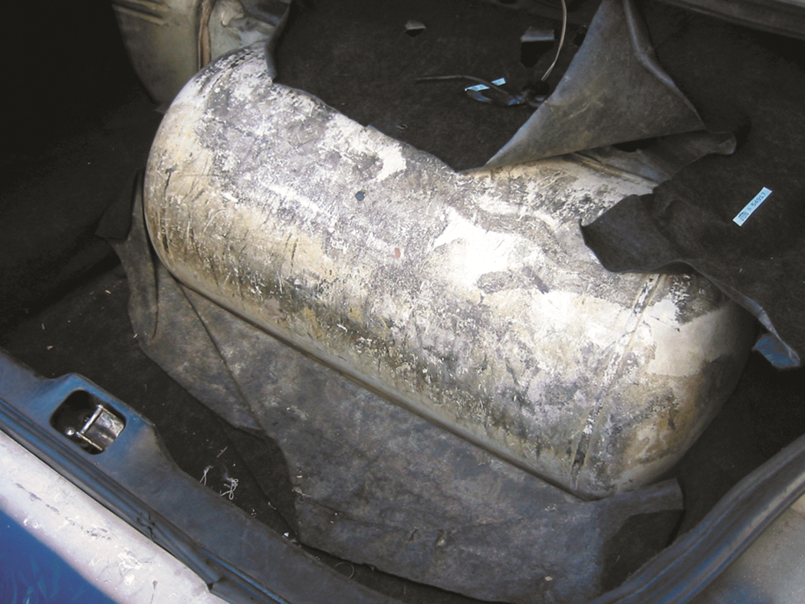
FIGURE 6–16 Propane fuel storage tank in trunk of a Ford taxi.

Slide 54
PROPANE
Advantages of Propane
  Low maintenance costs
  Cold-start problems associated reduced.
  Cost of propane is lower than gasoline
  Lower amounts of CO, CO2, & NOx emissions

Slide 55
PROPANE
Disadvantages
  Requires a storage tank FIGURE 6–16.
  Produces fewer BTUs of heat per gallon
  Original factory-delivered, light-duty propane vehicles
    Can cost more than comparable gasoline vehicles
  Propane is widely available in US
  BUT Public vehicle fueling stations are limited

Slide 56
FREQUENTLY ASKED QUESTION?
What is HD-5 Propane?
  Propane is available in 3 grades depending on amount of undesirable ingredients such as propene (propylene) which could cause valve sticking in an engine due to gum formation. The three grades include:
    HD-5—This grade of propane is suitable for use in an engine or power equipment and has a maximum concentration of 5% propene in the propane. SEE FIGURE 6–17, NEXT SLIDE
    HD-10—Propane containing too much propene (10%) is not suited for most vehicle fuels.
    Commercial grade—Similar to HD-10 and it is not suitable for use in motor vehicles, and instead is used in commercial applications such as to fuel power plants.

Slide 57
FIGURE 6–17 The sticker on this converted truck states to use HD-5 propane only. HD-5 is currently being used in all propane applications including for use with gas grills.

Slide 58
PROPANE TANKS
Propane Tanks Standards
  Many different sizes
  Tank manufacturers required to adhere to
  ASME (American Society of Mechanical Engineers) rules
  For construction intended for use in US
  Propane tanks are required to be painted
    Reflective color Indicates
    Level of propane is at or above 80% capacity

Slide 59
PROPANE TANKS
Propane Tanks Standards
  Since 1984, all new propane tanks required
    Device that shuts off filling process when tank reaches 80%
    Allows for changes in fuel volume from temperature variation
      Called an Over-Fill Protection Device (OPD)
    Constructed from carbon steel under code from
      American Society of Mechanical Engineers
      SEE FIGURE 6–18, NEXT SLIDE
    Cylinder valve will have either
      CGA 791 (ACME threads)
      CGA 810 (push–pull, quick disconnect) connection device

Slide 60
FIGURE 6–18 The storage tank under a Ford truck that was converted to operate on propane.

Slide 61
QUESTION 2:
Which is the most widely used alternative fuel?
a. E85
b. Propane
c. CNG
d. M85

Slide 62
ANSWER 2:
Propane

Slide 63
STUDENT ACTIVITY 3.
Download WORD file: Converting a Gasoline Fueled Vehicle to Propane

Slide 64

COMPRESSED NATURAL GAS (CNG)
Made By Compressing Natural Gas
  to < 1% of its volume, mostly methane
      Odorless
      Colorless
      Tasteless
    Drawn from domestically drilled wells
    Made from crude oil production
      12,000 CNG fueling stations around the world
      Only about 500 are open to public in US
      Costs 50% less than gasoline or diesel
      Emits up to 90% fewer emissions
CNG Cars Pros and Cons: 5:03

Slide 65
COMPRESSED NATURAL GAS (CNG)
CNG Composition
  CNG a blend of:
    Methane
    Propane
    Ethane
    N-butane
    Carbon dioxide
    Nitrogen

Slide 66
COMPRESSED NATURAL GAS (CNG)
Once it is processed
  Least 93% methane. Because
  Natural gas is odorless, it is odorized during processing
  Using ethyl mercaptan (“skunk”), to allow
  Easy leak detection, SEE FIGURE 6-19, NEXT SLIDE

Slide 67
FIGURE 6–19 Sign at CNG station that states the fuel is at least 90% methane

Slide 68
COMPRESSED NATURAL GAS (CNG)
CNG Vehicle Design
  Vehicles using CNG
  Referred to as natural gas vehicles (NGVs)
  Look for blue CNG label on vehicles designed
  Operate on compressed natural gas.
  SEE FIGURE 6–20, NEXT SLIDE

Slide 69
FIGURE 6–20 blue sticker on rear of this vehicle indicates that it is designed to use compressed natural gas. In California, a CNG vehicle can also use the high-occupancy lane (HOV) lane even though there is only a driver instead of a minimum of two people in vehicle.

Slide 70
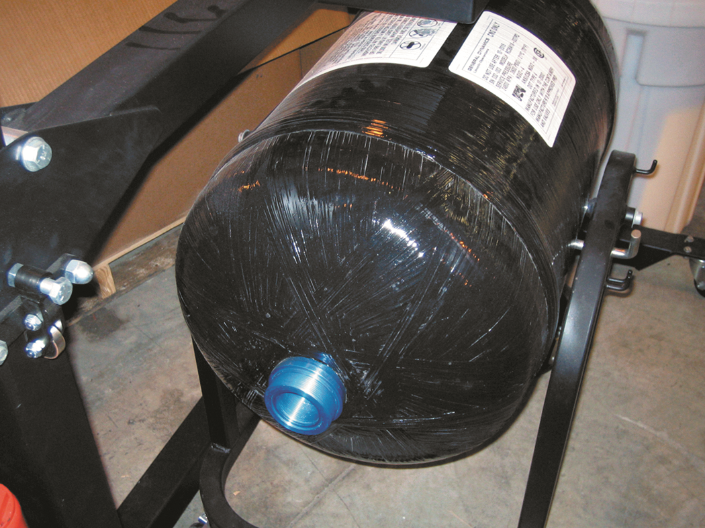
FIGURE 6–21 A CNG storage tank from a Honda Civic GX shown with the fixture used to support it while it is being removed or installed in the vehicle.

Slide 71
COMPRESSED NATURAL GAS (CNG)
Refueling Stations
  Safety valves installed between gas storage tank
  And vehicle refueling filling nozzle including:
    Each CNG storage tank has quick-action isolation
    Master shut-off valve is installed in outlet pipe
      Outside Fencing
    Quick-action emergency and isolation shut-off valve
    Near dispensing tank and kept closed refueling not performed
    SEE FIGURE 6-22, NEXT SLIDE

Slide 72
Figure 6-22 A typical CNG station which shows compressors, and all of the equipment needed are behind a secured area.

Slide 73
COMPRESSED NATURAL GAS (CNG)
Refueling with CNG
  3 commonly used CNG refilling station pressures:
    P24—2,400 PSI
    P30—3,000 PSI
    P36—3,600 PSI
      Find station with the highest refilling pressure.
      Filling at lower pressures results in less CNG
      SEE CHART 6–2 in the text
      For comparison of most frequently used alternative fuels
      SEE FIGURE 6–23, NEXT SLIDE

Slide 74
Figure 6-23 The fill handle on a CNG station.

Slide 75
QUESTION 3:
When refueling a CNG vehicle, why is it recommended that the tank be filled to a high pressure?
a. The range of the vehicle is increased
b. The cost of the fuel is lower
c. Less of the fuel is lost to evaporation
d. Both a and c

Slide 76
ANSWER 3:
The range of the vehicle is increased

Slide 77
STUDENT ACTIVITY 4.
Download WORD file: CNG – Is it Cleaner than Gasoline?

Slide 78
SYNTHETIC FUELS
Fischer-Tropsch
  Synthetic fuels were first developed
    Using Fischer-Tropsch method
  Have been in use since 1920s
  Convert coal, natural gas, other fossil fuels
  Into high-quality, clean-burning fuel
  Fischer-Tropsch fuels combust with no soot or odors
  SEE FIGURE 6-24, NEXT SLIDE

Slide 79
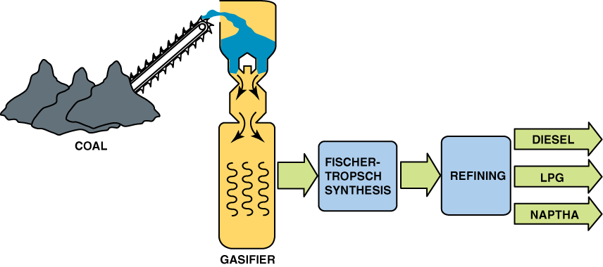
FIGURE 6–24 A Fischer-Tropsch processing plant is able to produce a variety of fuels from coal.

Slide 80
SYNTHETIC FUELS
Synthetic Fuels
  Emit only low levels of toxins
  Can be blended with traditional fuels
  With little equipment modification
  Contain very low sulfur and aromatic content
  Emit virtually no particulates
  Do not differ in fuel performance
  Expensive to produce on large scale

Slide 81
SYNTHETIC FUELS
Coal to Liquid (CTL)
  Coal can be converted to liquid fuel
  Through coal to liquid (CTL) process
  Huge cost main obstacle to these plants
  Environmental dangers as well

Slide 82
SYNTHETIC FUELS
Methanol to Gasoline
  Exxon Mobil developed
  Methanol-to-Gasoline (MTG) Process

Slide 83
SAFETY PRECAUTIONS WORKING WITH
ALTERNATIVE FUELS
All Fuels are Flammable
  Whenever working around compressed gases of any kind
  Always wear personal protective equipment (PPE):
      Safety glasses and/or face shield
      Protective gloves
      Long-sleeved shirt and pants
        If any fuel gets on the skin, the area washed Immediately
        Fuel spills on clothing, change into clean clothing
        Fuel spills on a painted surface, flush the surface
        Always vent exhaust to the outside.
        Methanol fuel, exhaust contains formaldehyde
        Cause severe burning of the eyes, nose, and throat

Slide 84

SAFETY PRECAUTIONS WORKING WITH
ALTERNATIVE FUELS
WARNING: Do not smoke or have an open flame in the area when working around or refueling any vehicle.

Slide 85
QUESTION 4: ?
Producing liquid fuel from coal or natural gas usually uses which process?
a. Syncrude
b. Underground coal gasification (UCG).
c. Fischer-Tropsch
d. Methanol-to-gasoline (MTG)

Slide 86
ANSWER 4:
Fischer-Tropsch

Slide 87
SUMMARY (1 of 2)
Flexible fuel vehicles (FFVs) are designed to operate on gasoline or gasoline–ethanol blends up to 85% ethanol (E85).
Ethanol can be made from grain, such as corn, or from cellulosic biomass, such as switchgrass.
E85 has fewer BTUs of energy per gallon compared with gasoline and will therefore provide lower fuel economy.
Methanol is also called methyl alcohol or wood alcohol and, while it can be made from wood, it is mostly made from natural gas.

Slide 88
SUMMARY (2of 2)
Propane is the most widely used alternative fuel. Propane is also called liquefied petroleum gas (LPG).
Compressed natural gas (CNG) is available for refilling in several pressures, including 2,400, 3,000, and 3,600 PSI.
Synthetic fuels are usually made using the Fischer-Tropsch method to convert coal or natural gas into gasoline and diesel fuel.
Safety procedures when working around alternative fuel include wearing the necessary personal protective equipment (PPE), including safety glasses and protective gloves.

