Slide 1

Sustainability- Principles and Practices
Chapter 7
Hybrid and Electric Vehicles

Slide 2
LEARNING OBJECTIVES
Describe the different types of hybrid electric vehicles.
Explain how a hybrid vehicle is able to achieve an improvement in fuel economy compared to a conventional vehicle design.
Discuss the advantages and disadvantages of the various hybrid designs.
Describe HEV components, including motors, energy sources, and motor controllers.
Discuss the operation of a typical hybrid electric vehicle.
Identify a plug-in hybrid electric vehicle (PHEV)

Slide 3
LEARNING OBJECTIVES (2 of 2)
Explain how the high-voltage batteries are recharged in a PHEV and EV vehicle
Discuss range anxiety
Discuss the battery capacity and range correlation of an EV
Describe the levels of chargers used to charge a PHEV or an EV

Slide 4

BACKGROUND 1.
Early Electric Vehicles
  Also called battery electric vehicles (BEV)
  First used in the late 1800s
  Not until early 1900s electric vehicles were practical
    Using rechargeable lead–acid batteries
    First was 1903 Baker Electric Car
    Detroit Electric Car Company (1907–1939)
Hybrid Cars Explained: 3:43
Difference Between Hybrid and Electric: 1:02

Slide 5
BACKGROUND 2.
Electric Vehicle Mechanical Controller
  Able to switch all 6 batteries in various combinations
    Series & parallel configurations to achieve
    Lower voltage for slow speeds/Higher voltages for higher speeds
      Did not have a long range
      Batteries charged regularly
      Only be used for short distances
      More popular than steam power in 1900
      Steam had 40% of the sales and electric had 38% of sales
      Gasoline-powered cars represented only 22% of vehicles sold

Slide 6
BACKGROUND 3.
Electric Vehicles
  Did not have a long range
  Batteries charged regularly
  Only be used for short distances
  More popular than steam power in 1900
  Steam had 40% of the sales and electric had 38% of sales
  Gasoline cars represented only 22% of vehicles sold

Slide 7
EARLY HYBRID ELECTRIC VEHICLES 1.
Hybrid Electric Vehicle (HEV)
  2 Different methods to propel vehicle
  Internal combustion engine & electric motor
    In 1901, Ferdinand Porsche developed
    Lohner-Porsche Mixte Hybrid
    First gasoline-electric hybrid automobile in world
    Originally electric powered vehicle
    Gasoline engine was added to recharge battery
    Failed because fuel economy was same as conventional engine

Slide 8
EARLY HYBRID ELECTRIC VEHICLES 2.
Newer Electric Vehicles
  Due to oil embargo of 1973, increased demand
  For alternative energy sources
  Congress enacted Public Law 94-413
  Electric and Hybrid Vehicle Research, Development, and Demonstration Act of 1976
  Designed to promote new technologies

Slide 9
EARLY HYBRID ELECTRIC VEHICLES 3.
Late 1990s, several OEMS Produced
  Electric Vehicles
  Using electronic controllers to meet demands
  For zero emission vehicles
  Specified by law in California at the time.
  Electric vehicles were produced by
    Ford, Toyota, Nissan, and General Motors.

Slide 10
EARLY HYBRID ELECTRIC VEHICLES 4.
GM EV1
  Legislation passed in California
    Zero Emissions Vehicle (ZEV) mandate
    Originally calling for 10% ZEV, GM developed
    Electric Vehicle 1 or EV1
    Leased to customers in CA & AZ, SEE FIGURE 7–1.

Slide 11
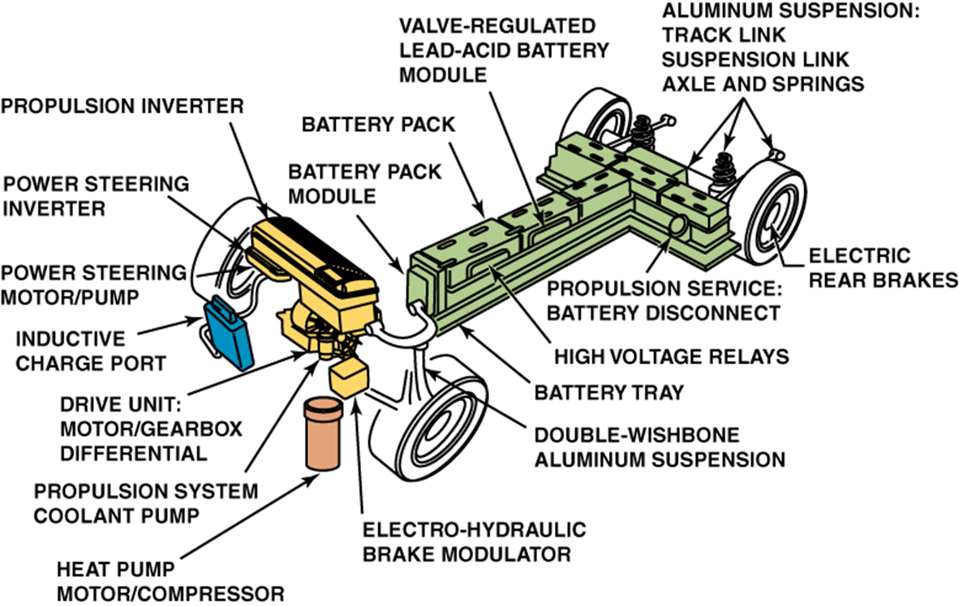
FIGURE 7-1 View of components of GM electric vehicle (EV1). Many of features of this vehicle, such as regenerative braking, currently used on HEVs were first put into production on this vehicle.

Slide 12
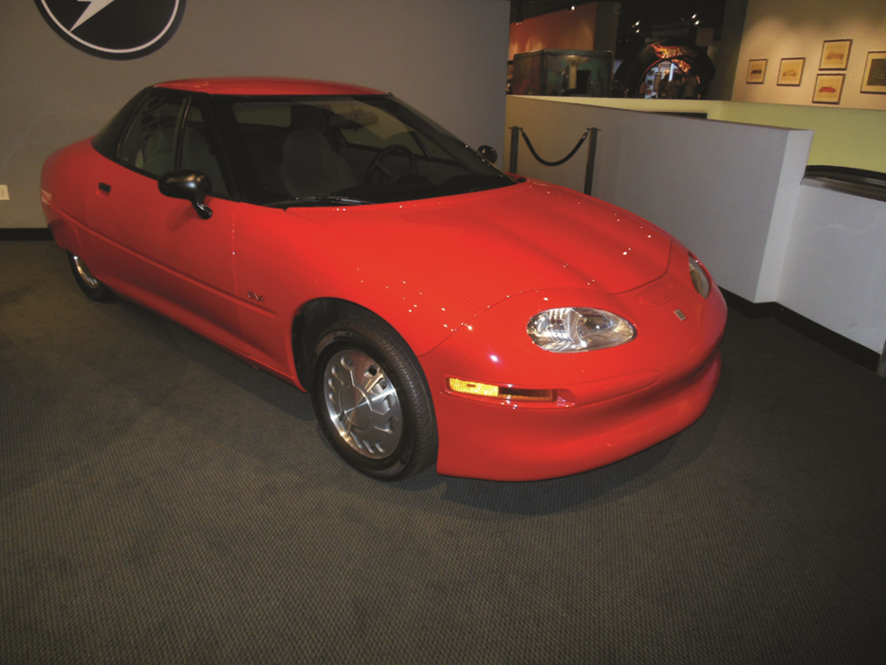
FIGURE 7-1a View of the General Motors electric vehicle (EV1)

Slide 13


STUDENT ACTIVITY 1.
Download WORD file: Chart the history of electric and hybrid electric vehicles?

Slide 14
HYBRID ELECTRIC VEHICLES 1.
Definition of Terms
  Most hybrid vehicles use high-voltage battery pack
  Combination electric motor & generator to assist ICE engine
  ICE in hybrid can be either gasoline or diesel
  Only gasoline-powered engines currently used
  Electric motor is used to help propel vehicle
  In some designs, it is capable of propelling vehicle
  Alone without having to start internal combustion engine

Slide 15

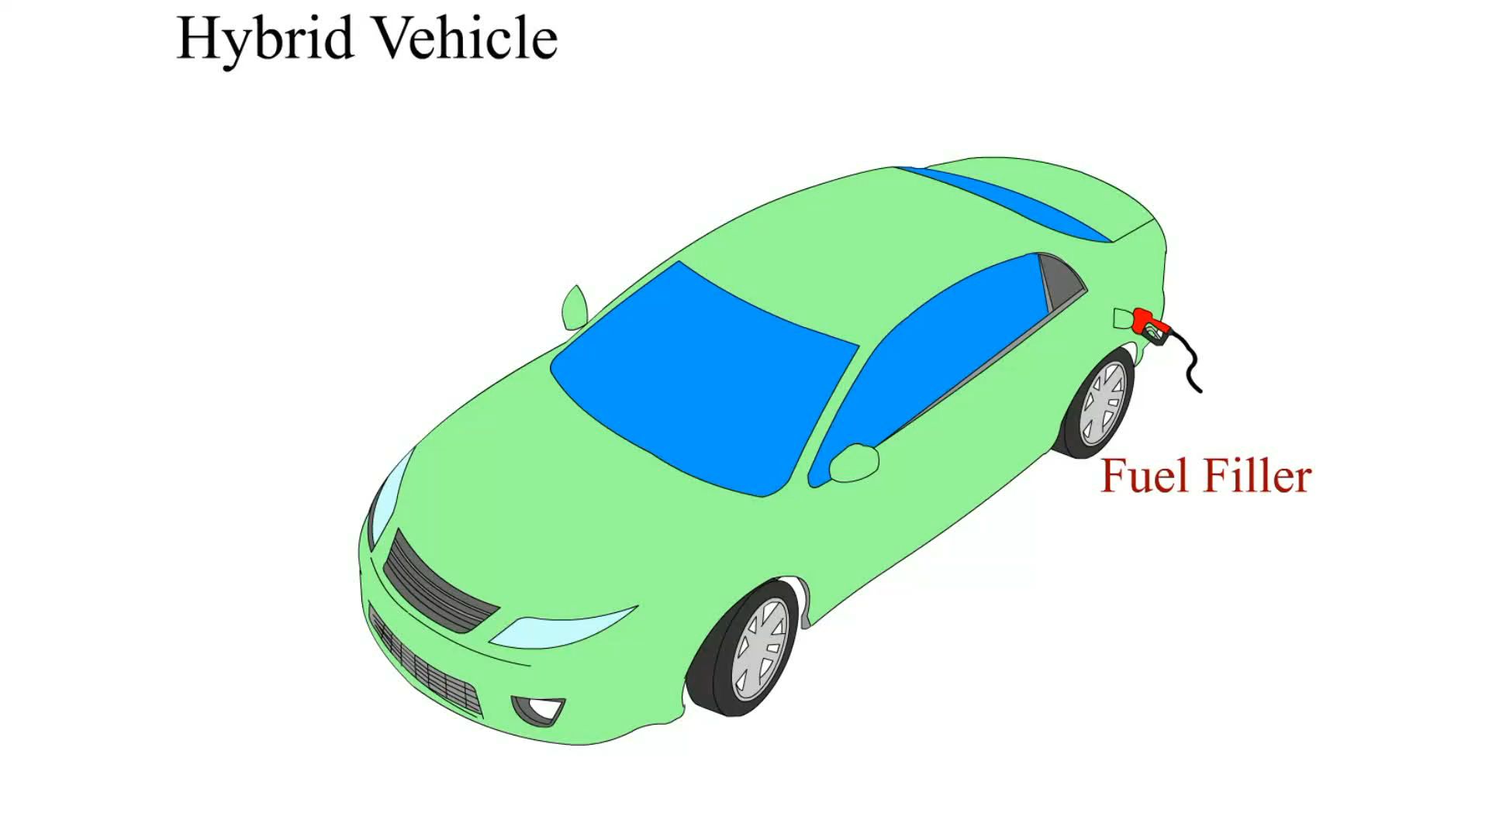
Hybrid Vehicle

Slide 16
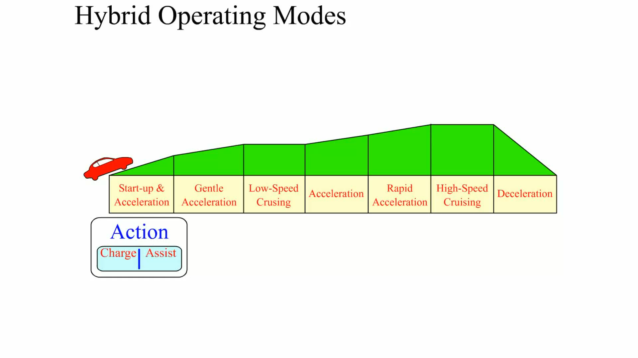
Hybrid Operating Modes

Slide 17
HYBRID ELECTRIC VEHICLES 2.
First Widely Produced Hybrids
  HEVS not available until release of Toyota Prius in Japan 1997
  Followed by Honda Insight sold in US starting in 1999
  2001, first Toyota Prius was introduced in the US
  2010, Several electric vehicles for sale in limited parts of US
  Electric vehicles include
    Tesla, Nissan Leaf, and Chevrolet Volt in FIGURE 7–2

Slide 18
FIGURE 7-2 Chevrolet Volt is charged through a port located at the left front.

Slide 19

HYBRID ELECTRIC VEHICLES 3.
Levels of Hybrid Vehicles
  Hybrid refers to a type of vehicle
  Different levels of “hybridization” among hybrids on
  Different OEMS use various hybrid technologies
Difference Between Hybrid and Electric: 1:02
Car Tech 101: 6:20
Hybrid Car Facts: 1:40
How a Hybrid System Works: 1:24

Slide 20
HYBRID ELECTRIC VEHICLES 4.
Mild Hybrid
  Uses idle stop & regenerative braking
  Electric motor cannot propel vehicle on its own
    Without help from ICE
    Costs less, saves less fuel compared to full hybrid
    42-volt electrical motor/battery package
      (36-volt batteries, 42-volt charging), EXAMPLES:
        GM Silverado pickup truck
        Saturn VUE
        Chevrolet Malibu
  Fuel savings for a mild hybrid is about 8% to 15%

Slide 21
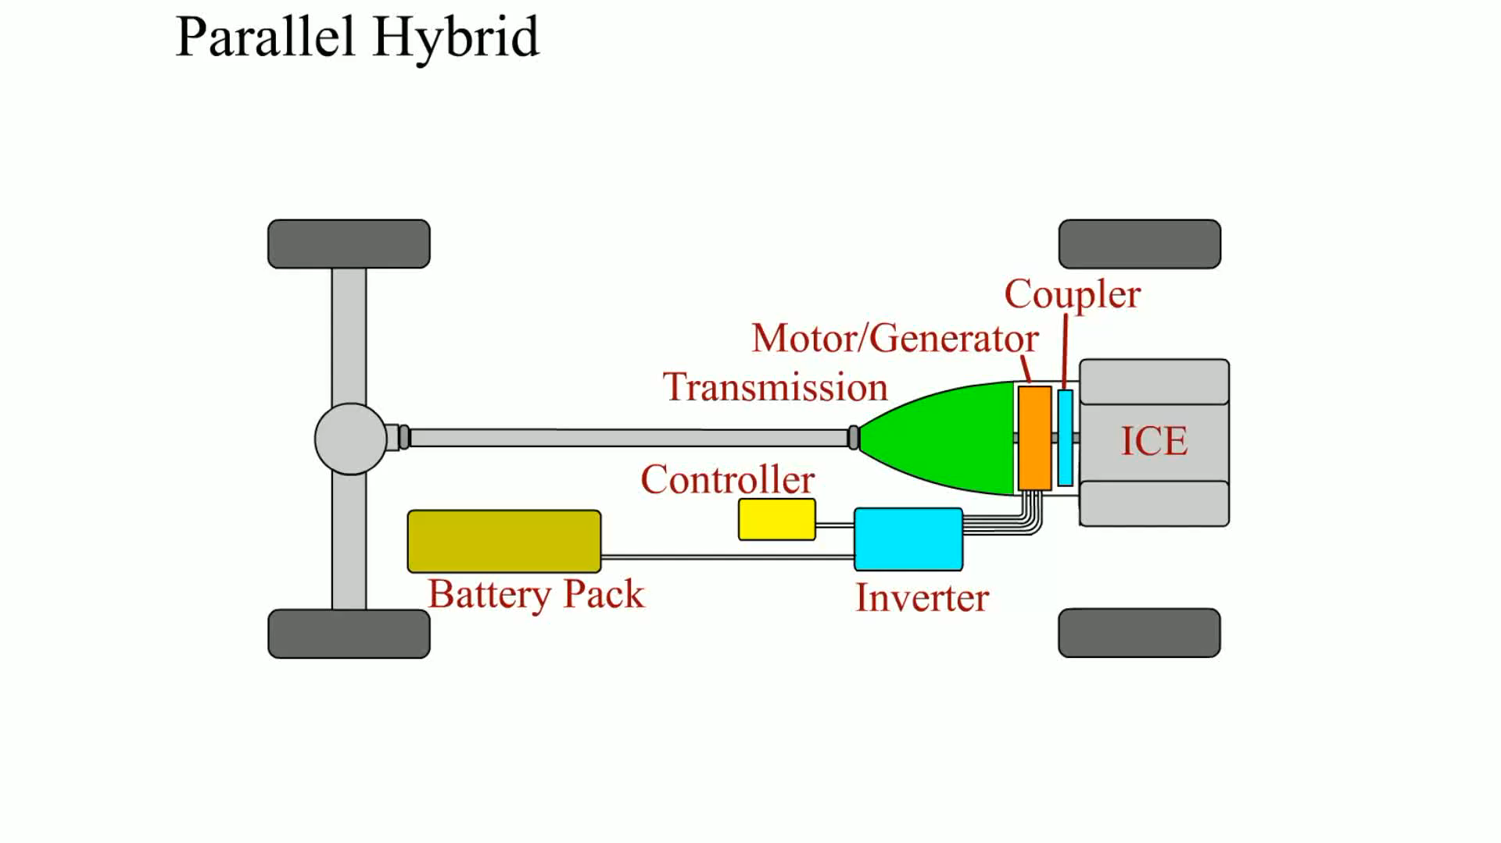
Parallel Hybrid

Slide 22
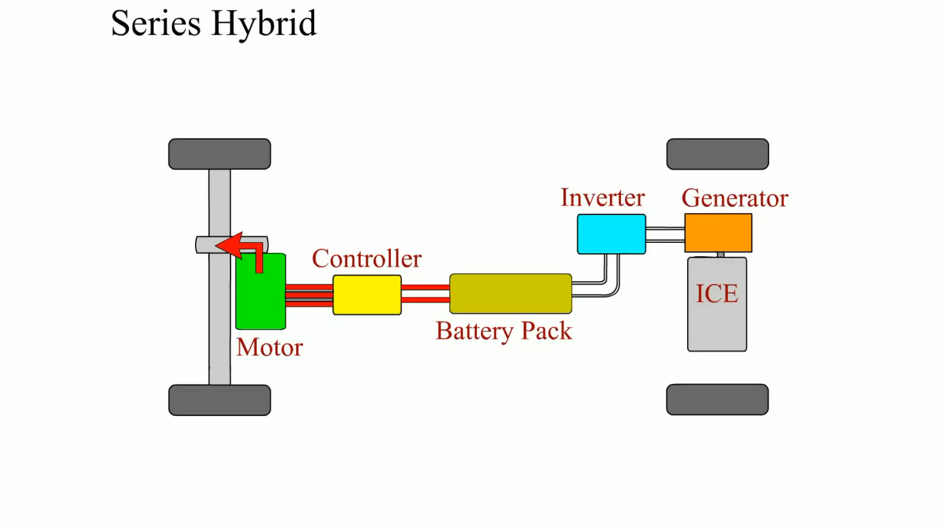
Series Hybrid

Slide 23
HYBRID ELECTRIC VEHICLES 5.
Medium Hybrid
  Uses 144- to 157-volt batteries that provide for:
    Engine stop/start, regenerative braking, and power assist
  Not capable of propelling vehicle from a stop using battery power
  Examples: Honda Insight, Civic, and Accord
  Fuel economy savings about 20% to 25%

Slide 24
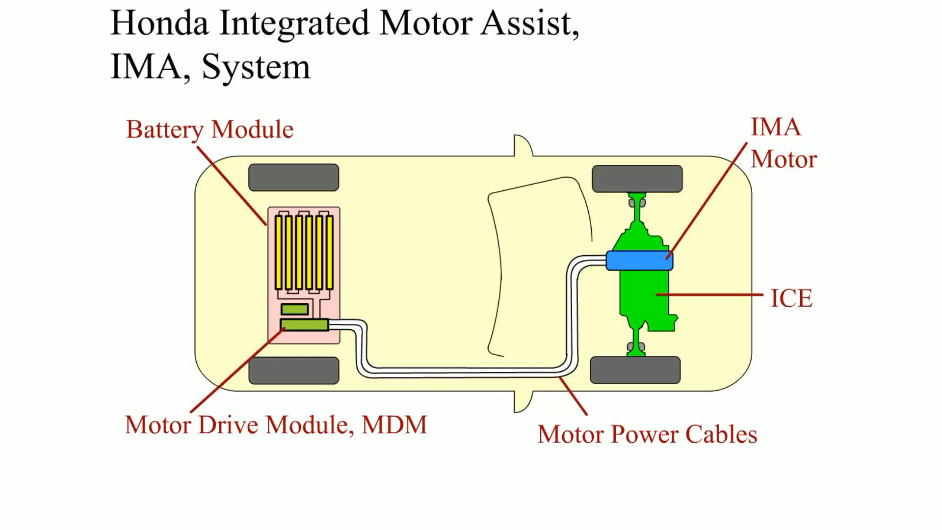
Honda Integrated Motor Assist (IMA) System

Slide 25
HYBRID ELECTRIC VEHICLES 6.
Full Hybrid
  Also called strong hybrid
  Uses idle stop & regenerative braking
  Can propel vehicle using electric motor (s) alone
  Each manufacturer has made its decision on which hybrid type
  To implement based on market
    Examples of full hybrid include:
      Ford Escape SUV, Toyota Highlander, Lexus RX400h
      Lexus GS450h, Toyota Prius, and Toyota Camry
  Full HEV Fuel economy about 30% to 50%

Slide 26
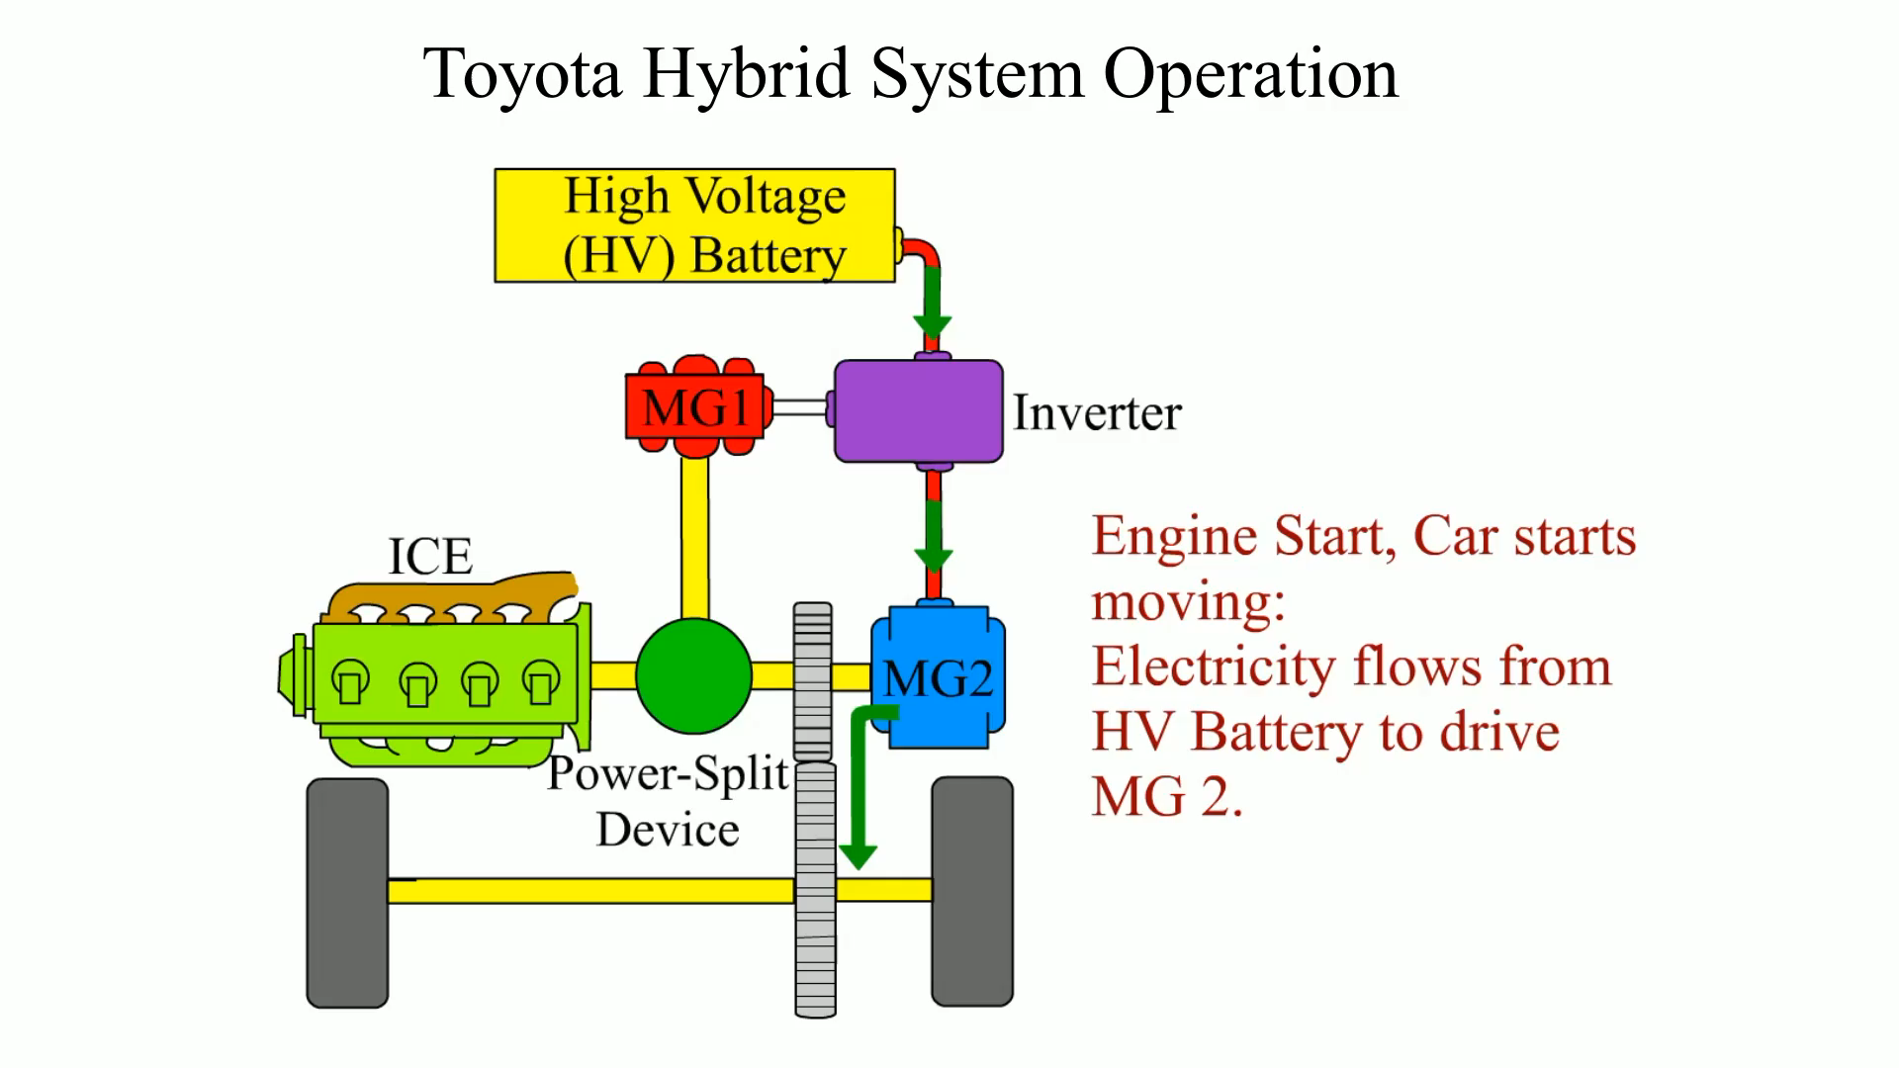
Toyota Hybrid Operating System

Slide 27
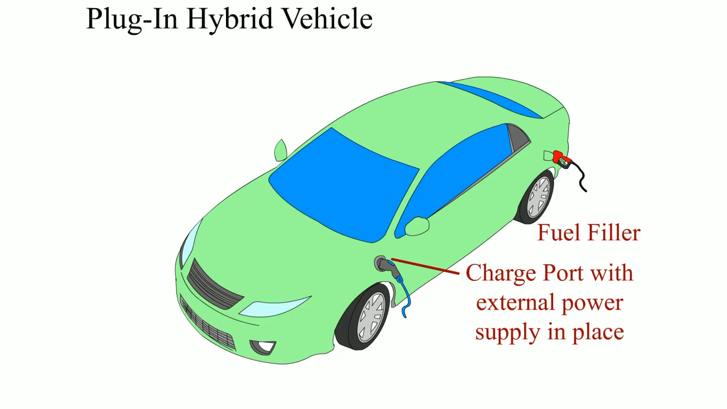
Plug In Hybrid

Slide 28
STUDENT ACTIVITY 2.
Download WORD file: Classification & Levels of HEVs

Slide 29
ONE, TWO, AND THREE
MOTOR SYSTEMS 1.
One-Motor Hybrids
  HEVs that use one electric motor include
    VW, Nissan, Honda, and GM
  Electric motor is attached to ICE crankshaft
  Perform 2 functions:
    Start ICE engine
    Act as generator to charge high-voltage batteries

Slide 30
ONE, TWO, AND THREE
MOTOR SYSTEMS 2.
One-Motor Hybrids
  GM uses a belt alternator starter (BAS) system
  Uses a belt-driven motor/generator attached
    Hybrids that use one motor are often called mild hybrids
    Usually not able to power vehicle using electric power alone

Slide 31
ONE, TWO, AND THREE
MOTOR SYSTEMS 3.
Two-Motor Hybrids
  2 motors are most commonly used HEVs
    Toyota, Ford, & GM in full-size 2-mode trucks
  Each electric motor serves 2 purposes:
    Motor/generator attached to engine, M/G1
      Start engine and charge high-voltage batteries.
    Motor/generator connected to drive wheels, M/G2
      Propel vehicle, recharge high-voltage battery
      During deceleration (regenerative braking)

Slide 32
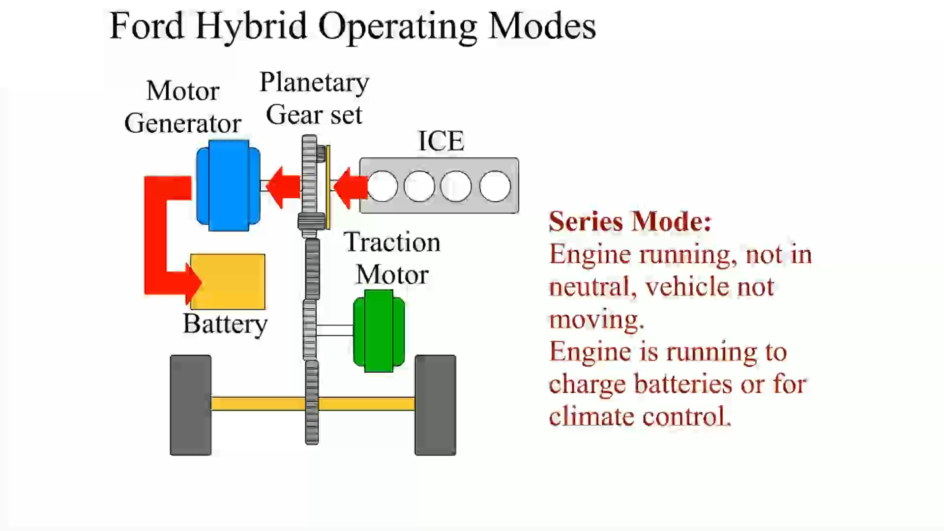
Ford Hybrid Operating Modes

Slide 33
ONE, TWO, AND THREE
MOTOR SYSTEMS 4.
Three-Motor Hybrids
  Usually two-motor HEVs with additional electric motor
  Propel rear wheels for all-wheel-drive capability
    Toyota Highlander & and Lexus RX400h/450h SUVs

Slide 34
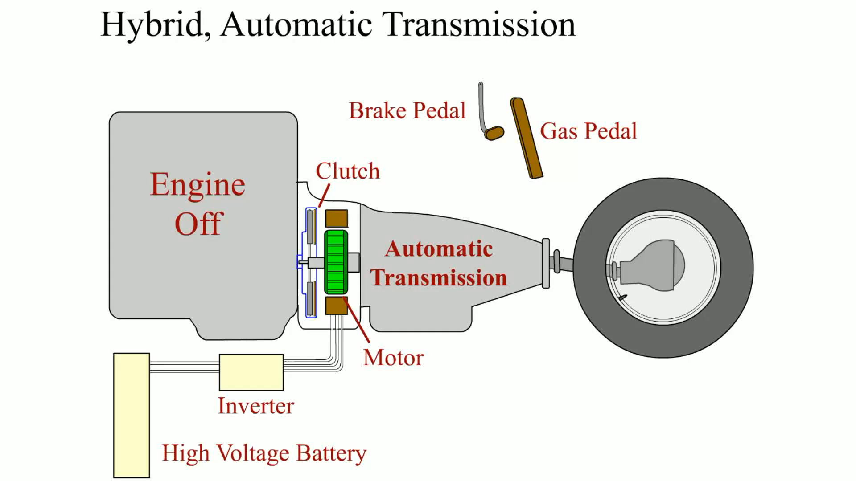
Hybrid Auto Transmission

Slide 35
ONE, TWO, AND THREE
MOTOR SYSTEMS 5.
Features of Hybrids
  Most common features of hybrids:
    Idle stop: turns off the engine when stopped
    Regenerative braking. Braking system captures energy
      Converts it to electrical energy
    Power assist. electric motor provides extra power to batteries
    Engine-off drive-electric vehicle mode
      Electric motor propels vehicle at lower speeds
      Called the motoring mode

Slide 36
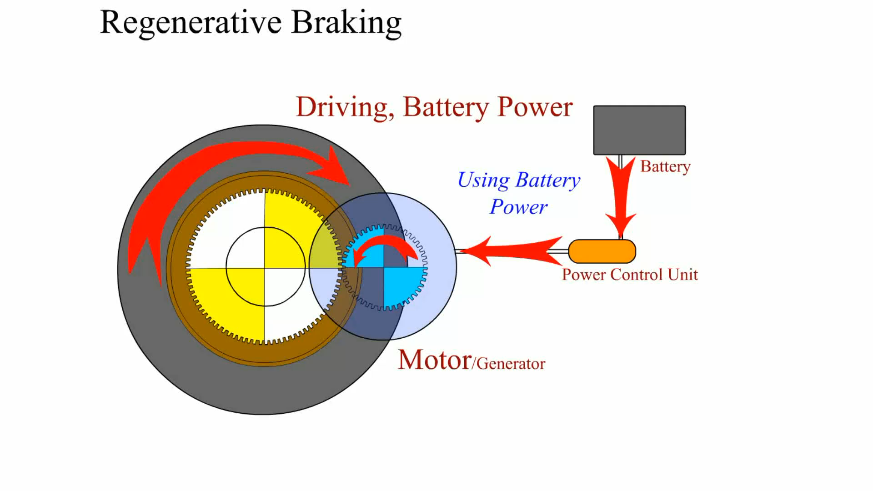
Regenerative Brakes

Slide 37
QUESTION 1:
Which type of hybrid uses 36 to 42 volts?
a. Mild hybrid
b. Medium hybrid
c. Full hybrid
d. Strong hybrid

Slide 38
ANSWER 1:
Mild hybrid

Slide 39
GAS VS ELECTRIC EFFICIENCIES 1.
Electric Motor
  Can have efficiency (including controller) of over 90%
  Gasoline engine only has efficiency of 35%
  ICE does not have overload capability of electric motor
    Rated power of ICE is higher than required for cruising
    Produces a much lower efficiency than at higher speeds

Slide 40
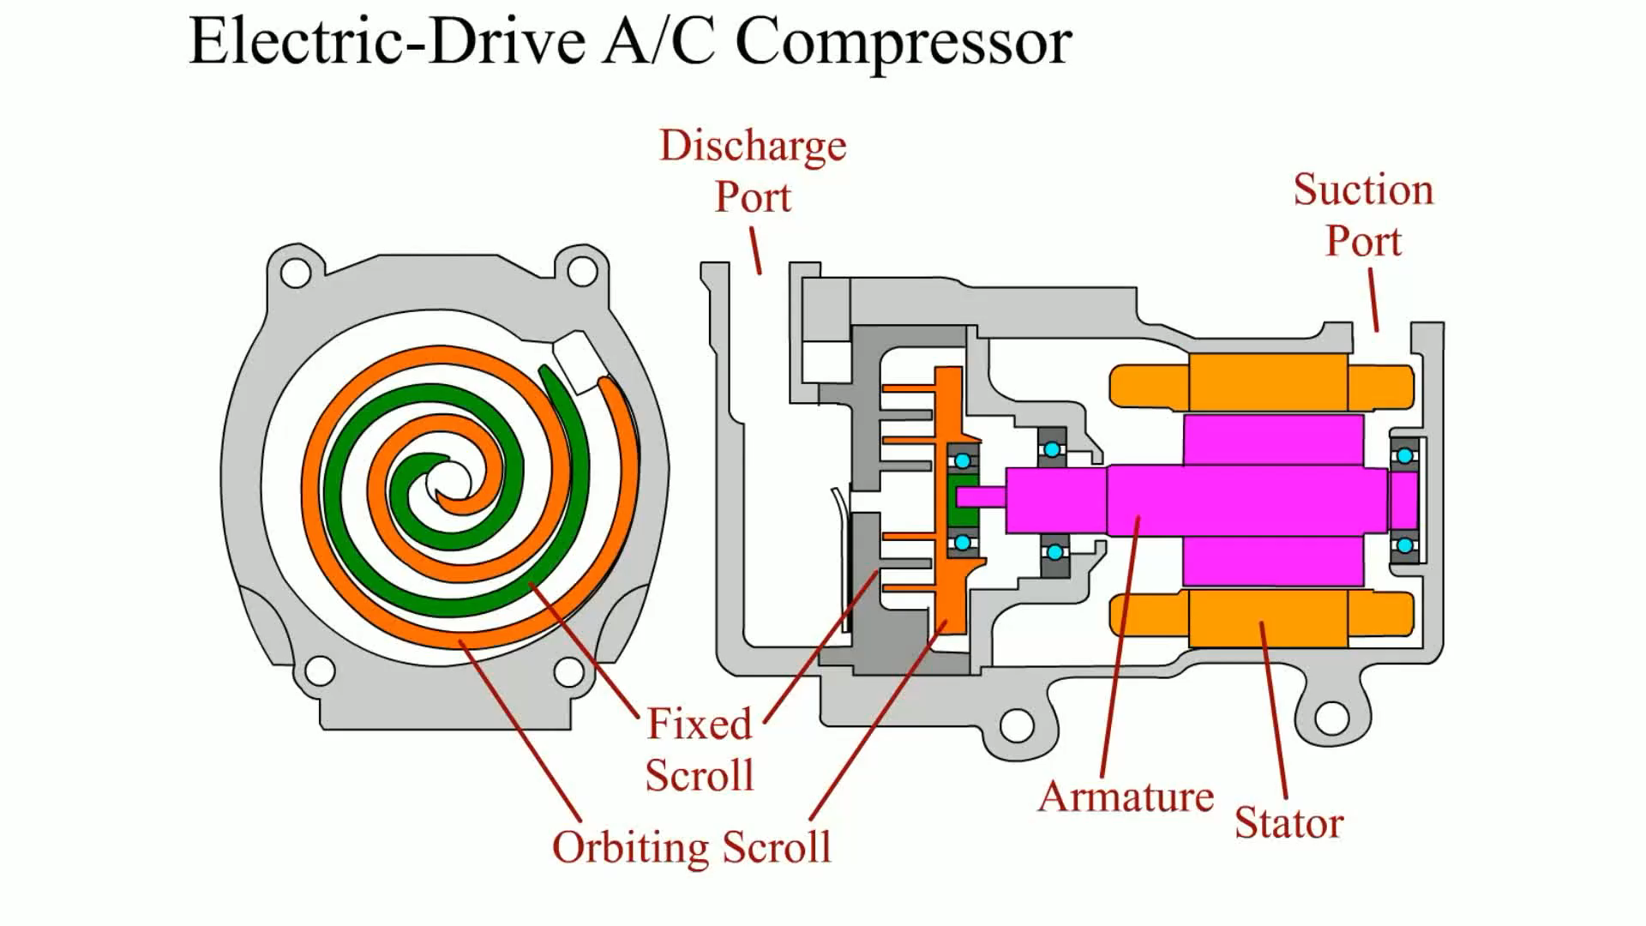
Electric Driven Compressor

Slide 41
GAS VS ELECTRIC EFFICIENCIES 2.
Electric Motor vs. ICE
  Maximum torque of ICE reached at intermediate speed
  Torque declines as speed increases further
  Maximum fuel efficiency point in speed range for ICE
  Speed is optimized by many HEV OEMs by using
  Transmission keeps engine speed within efficient range

Slide 42
GAS VS ELECTRIC EFFICIENCIES 3.
Electric Motors
  Ideal characteristics for use in a vehicle:
    Constant power over all speed ranges
    Constant torque at low speeds needed for acceleration
    Constant torque below base speed
    Constant power above base speed
    Only single gear or fixed gear needed
      In electric motor transmission

Slide 43
PLUG-IN HYBRID ELECTRIC
VEHICLES 1.
Plug-in Hybrid Electric Vehicle (PHEV)
  Plugged into electrical outlet at night to charge batteries
    Operate using electric power alone (stealth mode)
    Longer time, thereby reducing use of ICE
    Less fuel consumed and lower emissions
    Some offer option to use the ICE first then switch to EV
    ICE on highway & electric in city
PHEV: 1:55

Slide 44
PLUG-IN HYBRID ELECTRIC
VEHICLES 2.
Identifying PHEV
  Many PHEV use HEV configuration
    With added battery capacity
  Some PHEV may be difficult to pick out
    Like plug-in version of Prius
  Identification of PHEV:
    Different badges stated as PHEV
    Electrical connection door and a door for fuel for ICE
      SEE FIGURE 7-3, NEXT SLIDE

Slide 45
Figure 7-3 (a) About the only way to tell a plug-in Prius from a regular Prius is from the badge on sides or (b) by charge port door on passenger side at the rear.
(a)
(b)

Slide 46
PLUG-IN HYBRID ELECTRIC
VEHICLES 3.
PHEV Battery Capacity
  Size or capacity of battery pack used
  Determines how far vehicle can travel
  Without using ICE, called Electric Vehicle or EV range
  Battery capacity is measured in kilowatt-hours, kWh
  Kilowatt is a 1,000 watts
    Watt is a volt times an ampere
    Measurement of electrical power

Slide 47
PLUG-IN HYBRID ELECTRIC
VEHICLES 4.
HIGHER kWh Rating of Battery
  More electrical energy it can store
  Lower kilowatt-hour (kWh) rated battery weighs less
    Less expensive but range is limited
  Higher kWh rating battery means
    Battery can propel vehicle for greater distance
    Before ICE is used. Reduces fuel used
    Larger battery weighs and costs more
  PHEV is compromise between cost & weight of battery

Slide 48
PLUG-IN HYBRID ELECTRIC
VEHICLES 5.
PHEV Examples
  STD Toyota Prius has a 1.3 kWh battery pack
  PHEV has larger 4.4 kWh battery
    Allowing electric only travel of 10 miles before the ICE is used
  When battery pack SOC depleted
  Vehicle operates as a standard HEV
    With ICE & electric motor both propel vehicle
EV Basics: 24:47

Slide 49
PLUG-IN HYBRID ELECTRIC
VEHICLES 6.
PHEV Examples
  Chevrolet Volt has 16 kWh battery pack
    Can travel over 30 miles on electric power alone,
    W/O using ICE until battery discharged to about 25% to 35%.
    ICE is operated to keep battery pack a level high enough
    Keep propelling vehicle SEE FIGURE 7-4, NEXT SLIDE

Slide 50
Figure 7-4 After Chevrolet Volt has been charged it uses electrical power stored in high-voltage battery to propel vehicle & provide heating and cooling for 25-50 miles. Then gasoline engine starts, maintains SOC between 25%-35%. Gasoline engine cannot fully charge high-voltage batteries, rather vehicle plugged in to provide higher SOC level.

Slide 51
Chart 7-1 higher the capacity of HV battery, further vehicle can travel using electric power only but the longer it takes to be fully charged when plugged into a charger.

Slide 52
QUESTION 2:
The storage capacity of HV batteries are rated in______.
a. Volts
b. Li-Ion
c. kWh
d. Watts

Slide 53
ANSWER 2:
kWh

Slide 54
PLUG-IN HYBRID ELECTRIC
VEHICLES 7.
Charging PHEV
  After battery pack has been discharged
  ICE used to keep battery charged
  To Propel vehicle, but does not fully recharge battery
  To fully charge high-voltage battery pack
  PHEV required to be plugged into either
    120-volt or a 240-volt outlet. FIGURE 7-5, NEXT SLIDE

Slide 55
Figure 7-5 (a) Chevrolet Volt is charged using a standard SAE 1772 connector using either 110 or 220 volts. (b) After connecting charging plug, a light on the top of the dash turns green and dash display shows the estimated time when the high-voltage battery will be fully charged and the estimated current range using battery power alone.
(a)
(b)

Slide 56
TIP to REMEMBER
Batteries like Same Temperature Range
  As Humans
    Batteries work best when they are kept within temperature range that is also most comfortable for humans between:
    68°F and 78°F (20°C and 26°C)
    Below 68°F (20°C), most people want heat
    Above 78°F (26°C), most people want cooling
    Batteries perform best when they too are exposed to same temperature range. Proper heating and cooling system must be used to keep batteries within this fairly narrow temperature

Slide 57
PLUG-IN HYBRID ELECTRIC
VEHICLES 8.
Hot-Weather Concerns
  Batteries do not function well at high temperatures
  Battery cooling system needed
    Results in a reduction of vehicle range
  Batteries also have to supply Power for A/C
  Combined electrical loads represent
    Huge battery drain and reduce vehicle range

Slide 58
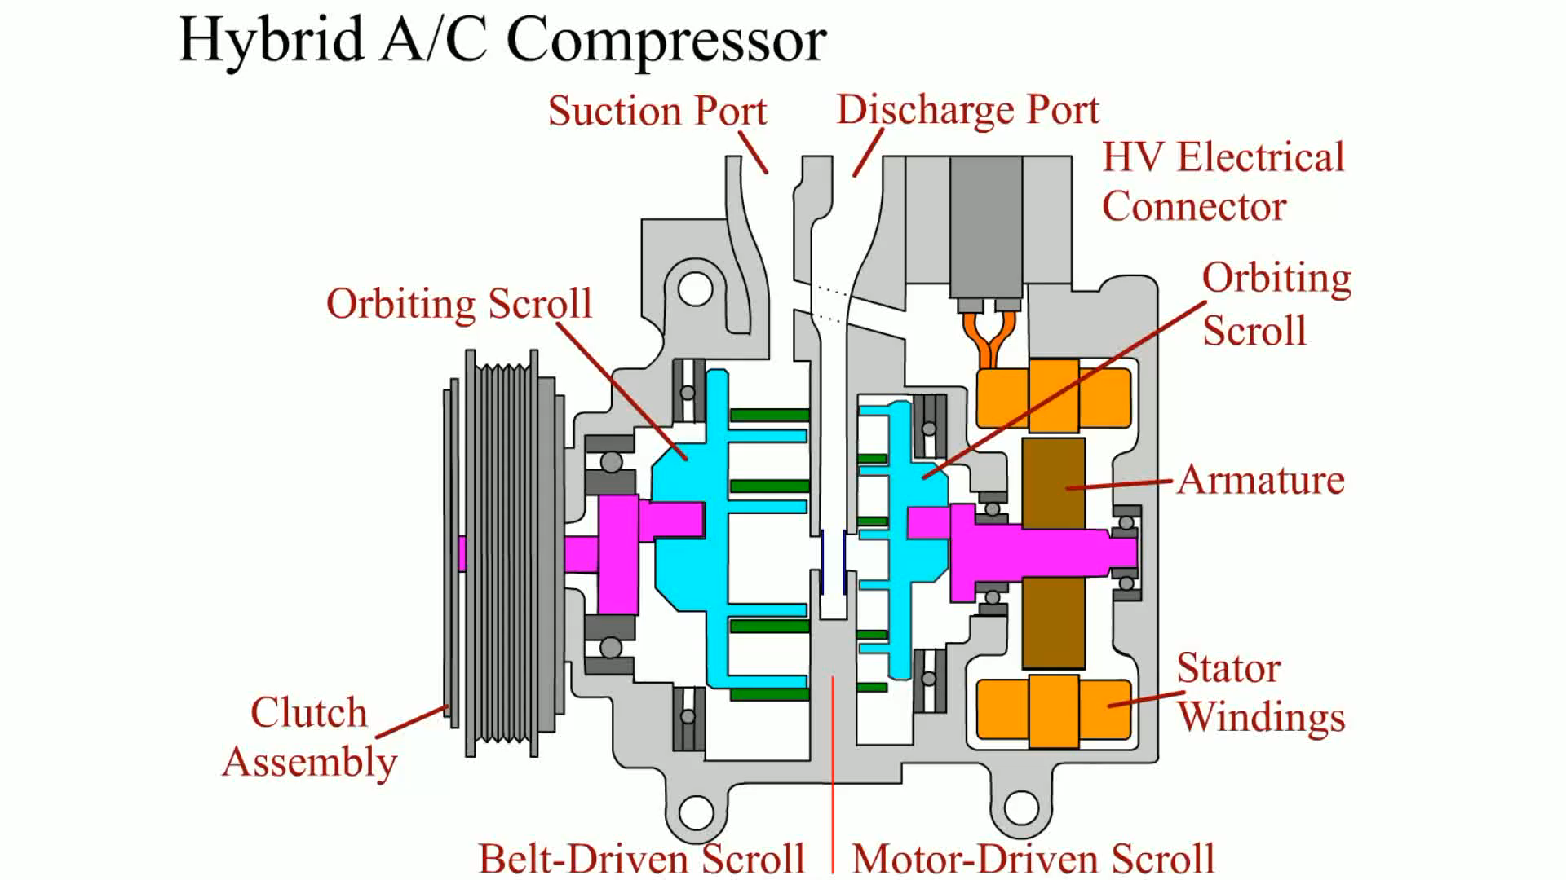
Hybrid AC Compressor

Slide 59
PLUG-IN HYBRID ELECTRIC
VEHICLES 9.
Range
  How far HEV travels on a full battery charge, its range
  Range depends on many factors, including:
    Battery energy storage capacity
    Vehicle weight
    Outside temperature
    Terrain
      (driving in hilly or mountainous areas requires more energy)
    Use of air conditioning and other electrical devices

Slide 60
TIP to REMEMBER
Rule-Of-Thumb Is 3
  Help estimate range of electric vehicle (EV),
  multiply battery capacity in kilowatt-hours (kWh) by 3
  To get a good idea as to vehicle range
  E.G. Nissan Leaf has a battery capacity of 24 kWh
  When multiplied by 3 equals 72 miles (24 x 3=72)

Slide 61
Chart 7-2 Selected electric vehicles and their battery capacity and published range.

Slide 62


FREQUENTLY ASKED QUESTION?
What is Range Anxiety?
  Range anxiety is a feeling of many drivers experience when driving an electric vehicle because they fear of running out of electric battery energy before they reach their destination. This condition is very common but, according to studies, this feeling lasts about two weeks after first getting an electric vehicle. Within those first two weeks, the driver gets experience regarding how far the vehicle can travel on a full charge and knows that their trip can be completed without any issues.
Range Anxiety and How to Get Over it: 8:04

Slide 63
PLUG-IN HYBRID ELECTRIC
VEHICLES 10.
SAE Standard Charger Plug
  Most HEVs, PHEVs, EVs
    Chevrolet Volt and Toyota Prius
    Use standard charger plug
    Meets specification SAE J1772 standard
      (updated in 2009).
  SEE FIGURE 7–6, NEXT SLIDE

Slide 64
Figure 7-6 SAE J 1772 plug is used on most electric and plug-in hybrid electric vehicles and is designed to work with Level 1(110–120 volt) and Level 2 (220–240 volt) charging.

Slide 65
QUESTION 3:
How is the high voltage (HV) battery charged in a plug-in hybrid electric vehicle (PHEV)?
a. Using the ICE to turn the motor/generator to fully
charge the HV battery
b. Using an external charging station or electrical outlet
c. Can be charged to full capacity by using a special
dealer-only high voltage charger.
d. Operating the ICE at idle after returning from a trip

Slide 66
ANSWER 3:
Using an external charging station or electrical outlet

Slide 67
STUDENT ACTIVITY 3.
Download WORD file: HEV Fuel Economy

Slide 68
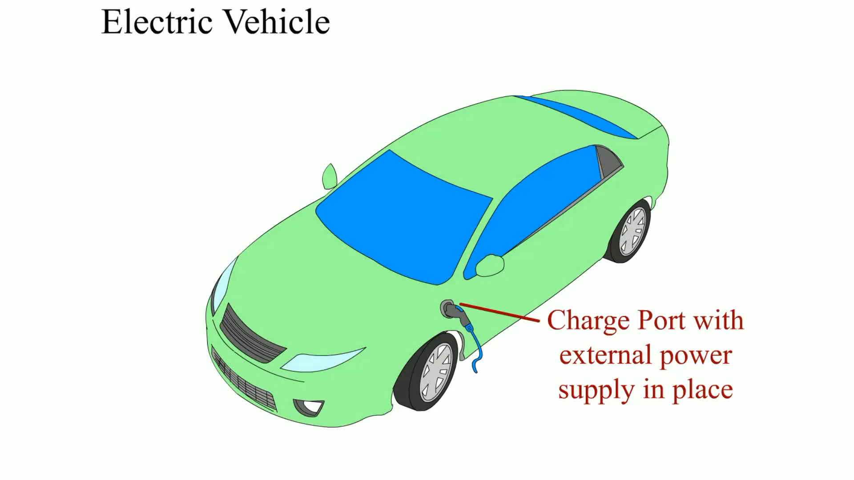
Electric Vehicle

Slide 69
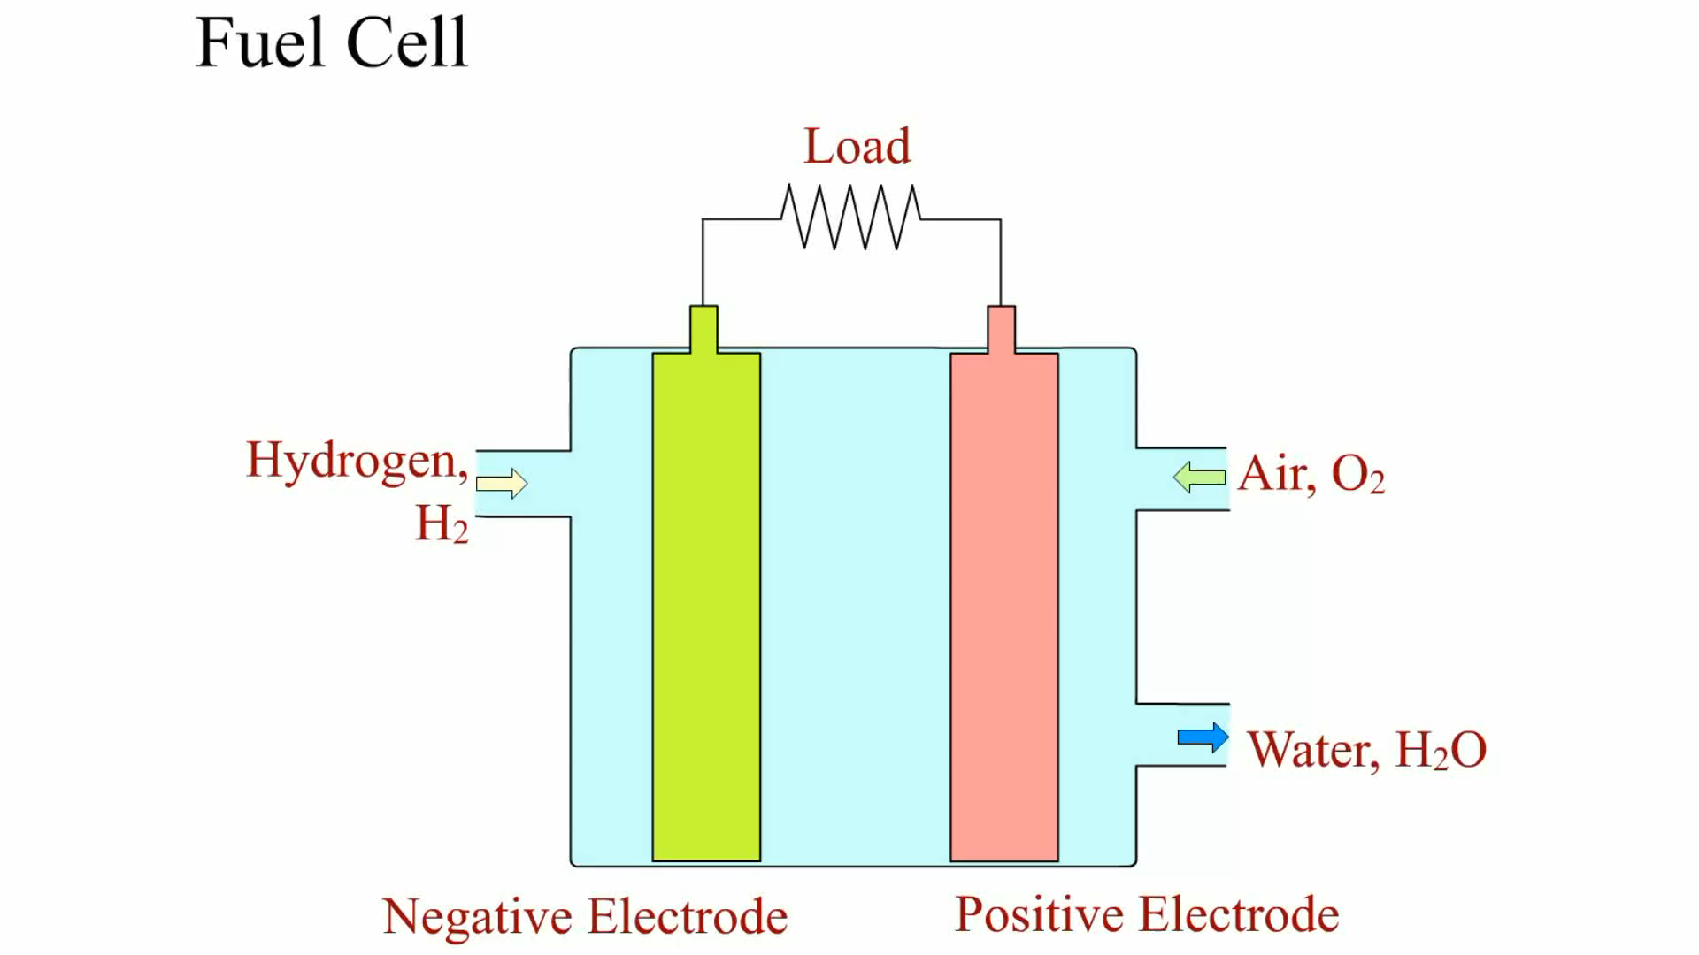
Fuel Cell

Slide 70
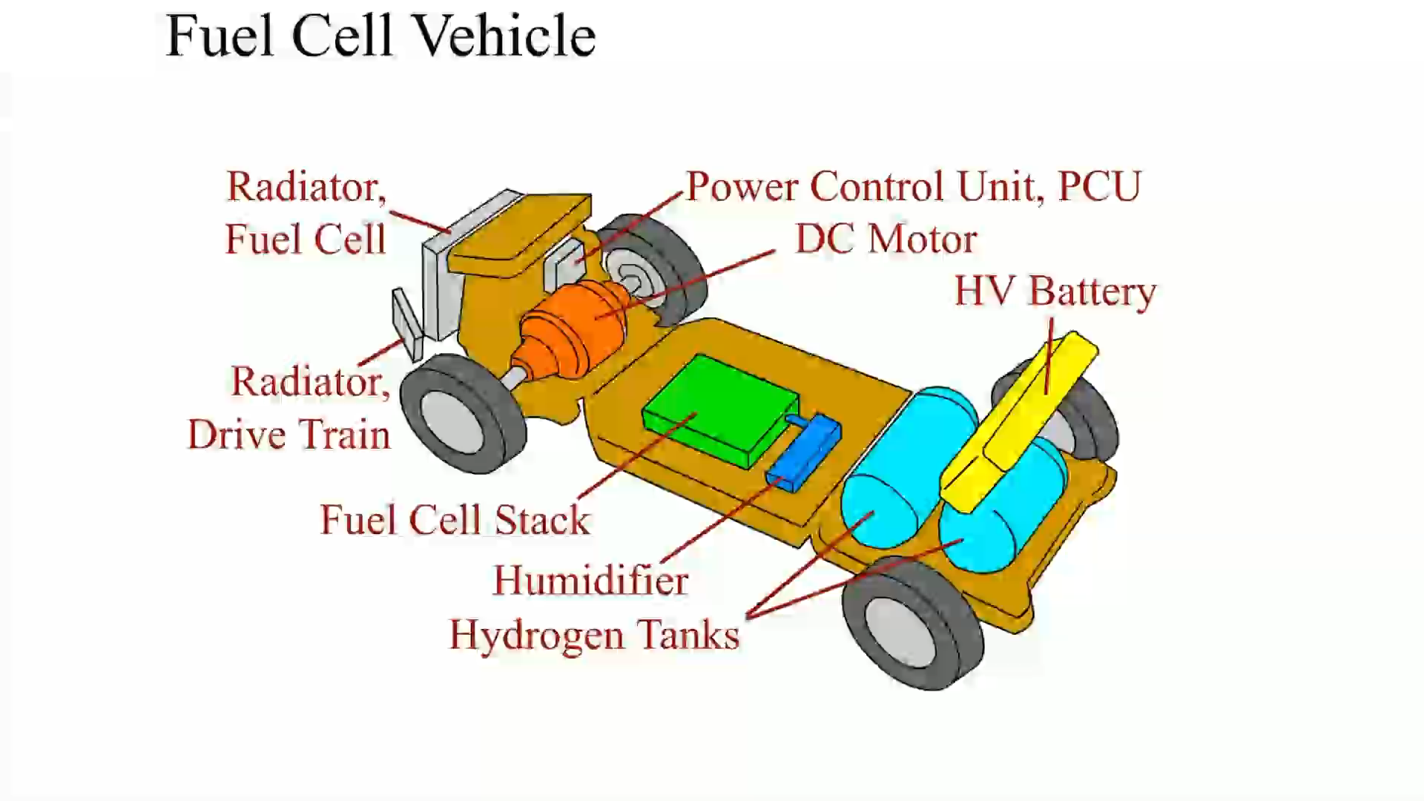
Fuel Cell Vehicle

Slide 71
CHARGING LEVELS 1.
Three Levels of Chargers
  Charge PHEV or EV
    Level 1
    Level 2
    Level 3
Prius Battery Balancing and Charging: 5:26

Slide 72
CHARGING LEVELS 2.
Level 1 Charger
  110- to 120-volt standard electric outlet (20 amps)
  Charging a Volt in 10 hours or more
  Long length of time usually means
    Best to allow overnight to charge vehicle so it is ready
    Little installation cost as most houses use 110/120 volts
    SEE FIGURE 7-7, NEXT SLIDE
Charging you EV at Home: 6:03

Slide 73
Figure 7-7 (a) Volt being charged using the supplied 100 volt charger. (b) Always lay out entire length of charging cord before plugging vehicle into outlet. If cord is not kept straight, current flow can not only create a coil but the flow of current can overheat the wires and in some cases can actually cause the insulation to melt.
(a)
(b)

Slide 74
CHARGING LEVELS 3.
Level 2 Charger
  220-240 volts to charge same vehicle in about 4 hours
  Added to house, making recharging faster (80 amps)
  Most charging stations at stores and colleges
  Adding a level 2 charging outlet cost $2,000 or more
    SEE FIGURE 7-8, NEXT SLIDE

Slide 75
Figure 7-8 Nissan Leaf plugged into a charging station at a college.

Slide 76
CHARGING LEVELS 4.
Level 3 Charger
  440 volts and can charge to 80% charge < 30 minutes.
    High-charge rate may be harmful to battery life
  Always follow owner’s manual charging instructions
  Use Direct Current (DC) up to 125 amps
  Called a DC Quick Charger (DCQC)
    Can often charge EV battery to 80% capacity in 30 minutes
    Station can cost $50,000 or more
    Most suitable where facilities will be selling rapid charging

Slide 77
CHARGING LEVELS 5.
Three Level 3 Charger Designs:
  Tesla “superchargers” are free to use by Tesla owners
    Use a unique to Tesla only connector
    Unique plug and supply adaptors
    if they are going to be connected to a
    Standard SAE J1772 charging station plug or 110 volt outlet
    SEE FIGURE 7-9, NEXT SLIDE

Slide 78
Figure 7-9 Tesla uses unique plug but also supplies adapter so vehicle owner can plug into a SAE J1772 station or a 220 volt conventional outlet (right) or even to a conventional 110 volt outlet (left).

Slide 79
CHARGING LEVELS 6.
Three Level 3 Charger Designs:
  CHAdeMO: Japanese trade name of a quick charging
    Method for level 3 charging using DC at high rate
  “CHAdeMO” is abbreviation of “CHArge de Move,”
    Translated to mean “charge for moving”
    SEE FIGURE 7-10, NEXT SLIDE

Slide 80
Figure 7-10 A Nissan Leaf electric vehicle charging ports located at front of vehicle under a hinged door for easy access.

Slide 81
CHARGING LEVELS 7.
Three Level 3 Charger Designs:
  SAE Combo Plug- SAE version under J1772
    Combined Charging System (CCS)
    Used by VW, BMW and some other EVs since 2012
    SEE FIGURE 7-11, NEXT SLIDE

Slide 82
Figure 7-11 Level 3 SAE Compatible Charging System (CCS) station located at the Great Smokey Mountains National park ranger station. There is a charge to use this charger.

Slide 83
STUDENT ACTIVITY 4.
Download WORD file: Charging an EV, HEV, or PHEV

Slide 84
QUESTION 4:
Which type (level) of charger may be harmful to the battery?
a. Level 1
b. Level 2
c. Level 3
d. J1772

Slide 85
ANSWER 4:
Level 3

Slide 86
Summary (1 of 3)
Common features of hybrid electric vehicles (HEVs) include:
  Idle stop
  Regenerative braking
  Power assist
Levels of hybrid include mild, medium and full (strong) hybrids
A plug-in hybrid electric vehicle (PHEV) is a vehicle that is designed to be plugged into an electrical outlet at night to charge the batteries.
The size or capacity of the battery pack used determines how far that the vehicle can travel without using the ICE, commonly called the electric vehicle or EV range.

Slide 87
Summary (2 of 3)
A lower kilowatt-hour (kWh) rated battery weighs less and is less expensive but the range that the vehicle can travel on battery power alone is limited
A higher kWh rating battery means that the battery is capable of propelling the vehicle for a greater distance before the ICE is used. This reduces the fuel used but the larger battery weighs and costs more.
Electric vehicles (EV) use high-voltage battery pack to supply electrical energy to electric motor(s) to propel vehicle under all driving conditions. The capacity of battery pack in kilowatt-hours (kWh) determines range of vehicle and then has to be plugged in to recharge battery before it can be driven further.

Slide 88
Summary (3 of 3)
Most electric vehicles and plug-in hybrid electric vehicles, such as the Chevrolet Volt and Toyota Prius, use a standard charger plug. The standard charger plug meets the specification as designated by SAE standard J1772 .
Range anxiety is the fear of running out of battery power before you reach your destination and a place to recharge the HV battery.
There are three levels of chargers that can be used to charge a plug-in hybrid electric vehicle (PHEV) or electric vehicle (EV).

