Slide 1
Sustainability- Principles and Practices
Chapter 8
Solar Electric Generation

Slide 2
LEARNING OBJECTIVES
Explain how photovoltaics (PV) create electricity from the sun.
Explain the difference in cost vs benefits of a PV system compared to a CSP system.
Discuss the Energy payback time (EPBT) of solar electric generation.
Describe energy returned on energy invested (EROEI) of solar.
Explain levelized cost of electricity (LCOE).
Describe grid parity.
Discuss grid integration.

Slide 3
INTRODUCTION 1.
Solar Energy
Promising form of renewable energy
Without sun earth would not exist
2 forms of solar electric generation
PV (photovoltaics)
Direct conversion of light into electricity, solar panels
Used at private residences & large installations.
CSP (Concentrated Solar Power)
Uses focused sunlight and generates electric power
Using mirrors to concentrate (focus) sun's energy
Convert it into heat to power a steam generator

Slide 4
PHOTOVOLTAICS (PV) 2.
Photovoltaics (PV)
Production of electric current at interface
Using 2 semiconductor materials
Causes them to absorb photons of light
Release electrons to produce electricity
Conversion of light into electricity using semiconductors
Photovoltaic effect as electrical current being produced
Junction of light and semiconductors
Explained: Photovoltaics: 4:28

Slide 5
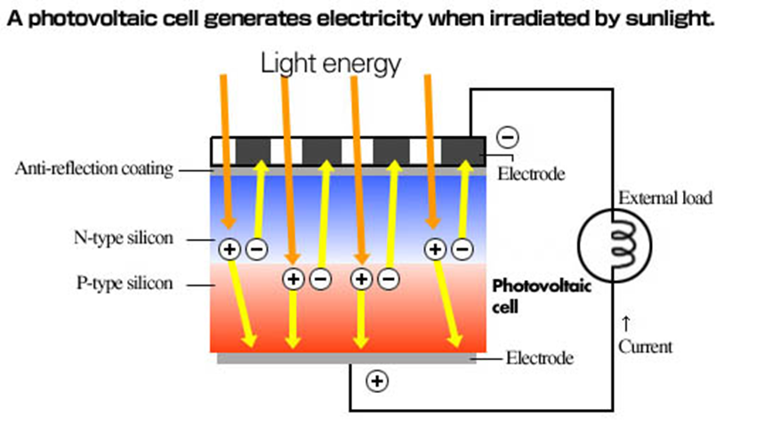
Figure 8-1 Photovoltaic Solar Cell: Photovoltaics is direct conversion of light into electricity at atomic level. Certain materials exhibit a property known as photoelectric effect that causes them to absorb photons of light and release electrons. When free electrons are captured, electric current results that can be used as electricity

Slide 6
PHOTOVOLTAIC PV CELL

Slide 7
FREQUENTLY ASKED QUESTION?
Who Invented Photovoltaics?
The photoelectric effect was first listed by a French physicist, Edmund Bequerel, in 1839, who discovered that certain materials would produce small amounts of electric current when exposed to sunlight. Albert Einstein described nature of light and photoelectric effect on which photovoltaic technology is based, for which he won a Nobel Prize in physics in 1905. The first photovoltaic module was developed by Bell Laboratories in 1954. It was promoted as a solar battery and was too costly for common use. NASA (National Aeronautics & Space Administration) began first serious use of the technology to provide power aboard spacecraft in sixties. Through the efforts of NASA and advanced technology, dependability of photovoltaics was established, and costs began to go down. Photovoltaic technology has gained recognition as a source of power during the oil embargo of the seventies.

Slide 8
PHOTOVOLTAICS (PV) 3.
Photovoltaic (Photoelectric Cell) Operation
In a solar cell, a thin semiconductor wafer
Forms an electric field
Positive on one side & negative on the other
Light strikes cell, electrons are loosened from atoms
In semiconductor material N-type and P-type wafers
Electrical circuit formed so electrons can develop
Current to turn on light bulb

Slide 9
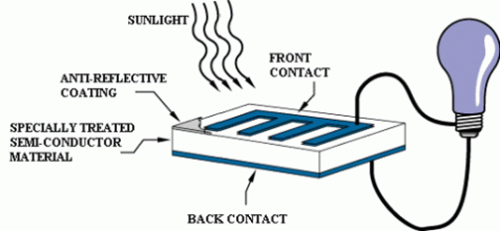
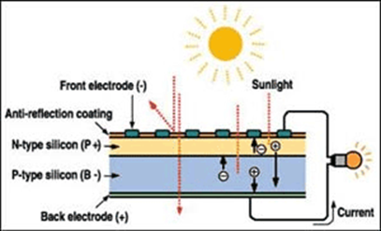
FIGURE 8-2 shows the operation of a basic photovoltaic cell, which is also called a solar cell. Solar cells are made from semiconductor materials, such as silicon that has been used in the electronics industry for decades with the invention of the transistor in 1946.

Slide 10
FIGURE 8- 3 photovoltaic device single junction, which creates an electric field within a PV cell semiconductor. PV cell single-junction only produces photons whose energy is equal to or greater than 0 voltage section of cell (band gap) that can free an electron for circuit to flow. The photovoltaic reply of single-junction cell is limited to portion of sun's spectrum whose energy is above bandgap of absorbing material.

Slide 11
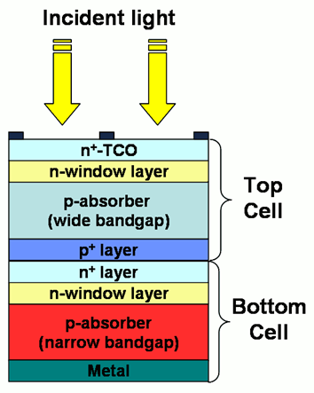
FIGURE 8-4 The multi-junction device is a stack of individual single-junction cells in descending order of bandgap.

Slide 12
QUESTION 1:
Which of these is defined as the production of electric current at the interface of two semiconductor materials?
a. Grid parity
b. Photovoltaics
c. Grid integration
d. Concentrating Solar Power

Slide 13
ANSWER 1:
Photovoltaics

Slide 14
PV (PHOTOVOLTAIC) SYSTEM 1.
Photovoltaic System Uses Solar Panels
Number of solar cells that generate electrical current
Pushed by voltage to become electrical power
1st Step photoelectric effect
Followed by an electrochemical process
Crystallized atoms, ionized in a series
Generate an electric current
Ground-mounted, rooftop mounted or wall mounted
Residential Solar PV Economics: 49:20

Slide 15
Figure 8-5 Solar Panel Array

Slide 16
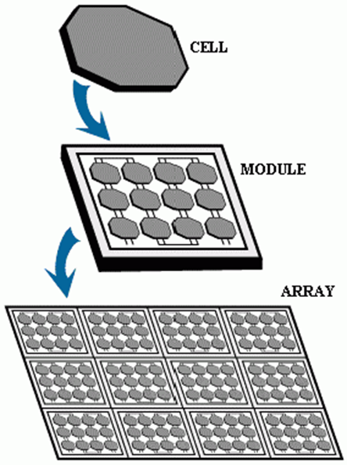
FIGURE 8-6 Solar cells in a frame called a photovoltaic module. These modules are designed to supply electricity. The current produced by module is dependent on how much light strikes it. Multiple modules are wired together to form an array. The larger the area of a module or array, the more electricity will be produced.

Slide 17
PV (PHOTOVOLTAIC) SYSTEM 2.
DC Electricity
Photovoltaic modules and arrays produce
DC (direct-current) electricity
Inverter is used to change the DC to AC
Connected in both series and parallel arrangements
Produce any required voltage & current combination
Payback for a Solar Panel System: 3:03

Slide 18
PV (PHOTOVOLTAIC) SYSTEM 3.
Concentrator Photovoltaics (CPV)
Use solar trackers and cooling system
Increase their efficiency
HCPV (high concentrator photovoltaics)
Highest efficiency of all existing PV technologies
Smaller array also reduces the balance of costs
CPV not used in PV rooftop segment
Areas with high direct normal irradiance of
2000 khrs per square meter or more
Electricity cost in range of $0.08–$0.15 per kilowatt-hour

Slide 19
STUDENT ACTIVITY 3.
Download WORD file: EROEI (Energy Returned on Energy Invested) of Activity 1

Slide 20
CSP (CONCENTRATING SOLAR POWER) SYSTEM 1.
Solar Power
Transformation of sunlight into electricity
Directly using PV (photovoltaics)
Indirectly using concentrated solar power
Concentrated Solar Power Systems
Use lenses or mirrors and a tracking system
Focus a large area of sunlight into a small beam

Slide 21
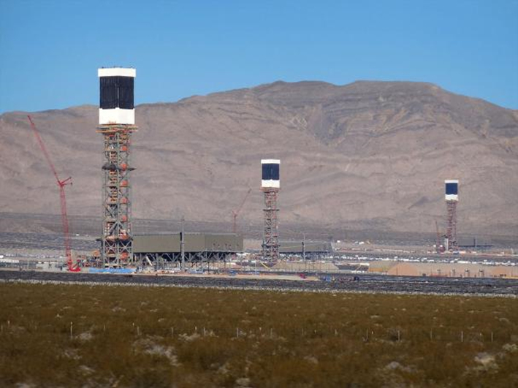
FIGURE 8-7 All CSP technological approaches require large areas for solar radiation collection when used to produce electricity at commercial scale. The 392 MW (Megawatt) plant Ivanpah in California. 392 Megawatt plant is a power tower system is the largest concentrating solar power plant in the world,

Slide 22
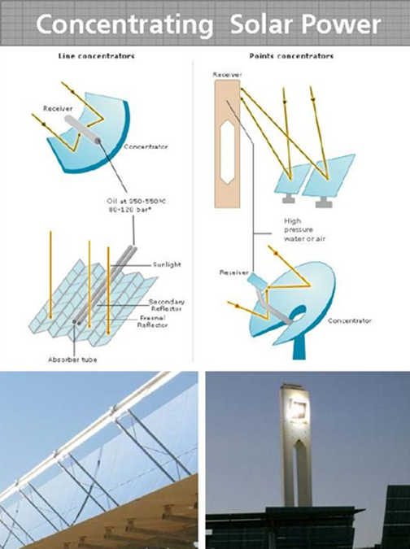
FIGURE 8-8 Concentrating Solar Power (CSP): trough system Power Tower System and dish/engine system
CSP
3 different approaches to solar energy:
Power Tower Systems
Trough Systems,
Dish/Engine Systems

Slide 23
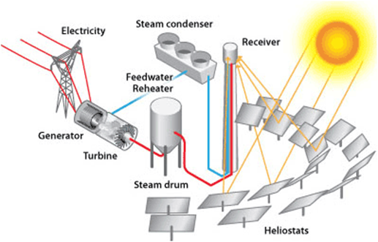
CSP (CONCENTRATING SOLAR POWER) SYSTEM 2.
Solar Power Tower
Dual-axis tracking reflectors (heliostats/Fresnel reflectors)
Concentrate sunlight on central receiver tower
Uses sea water heated to 932–1,832 ° F
Stored in steam drum as heat source for power generator turbine
Figure 8-9 Solar Power Tower

Slide 24
FREQUENTLY ASKED QUESTION?
What is some of the History of Solar Energy?
A legend has it that Archimedes used a "burning glass" to concentrate sunlight on invading Roman fleet and repel them from Syracuse. Dr. Ioannis Sakkas, a Greek scientist performed an experiment in 1973 to see if Archimedes could have destroyed Roman fleet in 212 BC. He lined up 60 Greek sailors, each holding an oblong mirror tipped to catch the sun's rays and direct them at a tar-covered plywood silhouette 160 feet away. Ship caught fire after a few minutes. Auguste Mouchout in 1866 used a parabolic trough to produce steam for the first solar steam engine. The first solar-power system using a mirror dish was built by Dr. R.H. Goddard.

Slide 25
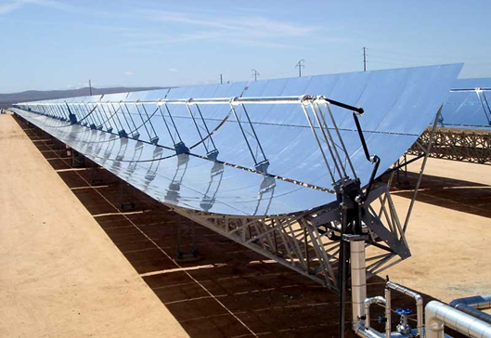
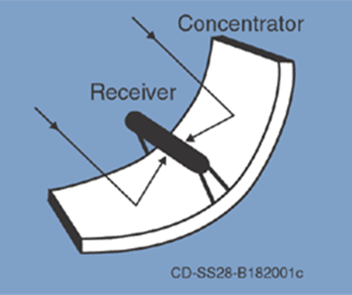
FIGURE 8-10 The CSP parabolic trough consists of a linear or straight line parabolic (Parabola Shape) reflector that concentrates light onto a receiver positioned along the reflector's focal line

Slide 26
CSP (CONCENTRATING SOLAR POWER) SYSTEM 3.
Parabolic Trough
Receiver is a tube directly above middle
Parabolic mirror and filled with sea water
Reflector tracks along a single axis to follow
Sun during daylight hours
Sea water heated to between 300–660 °F
Flows through receiver and becomes
Heat source for power generator turbine engine.

Slide 27
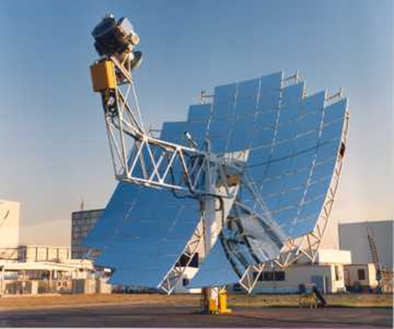
CSP (CONCENTRATING SOLAR POWER) SYSTEM 4.
Dish/Engine Systems
Stand-alone parabolic reflector
Concentrates light on receiver
Positioned at reflector's focal point
Reflector tracks sun
Receiver working fluid is heated to 480–1,300 °F
Used by Stirling engine to generate power
Figure 8-11 Dish Engine Systems

Slide 28
FIGURE 8-12 Sterling engine is a heat engine that operates by cycled compression & expansion of a permanent gaseous fluid at different temperatures, so there is a conversion of heat energy to mechanical work. It is a closed-cycle regenerative heat engine with a permanently gaseous working fluid.

Slide 29
COST BENEFITS OF PV SYSTEM COMPARED TO CSP SYSTEM 1.
CSP (Concentrating Solar Power)
Old fashioned technology borrowed from coal plants
Produce gas to drive a turbine
2010 PV: global installed capacity of about 35 Gigawatts
CSP had 1.5 Gigawatts.

Slide 30
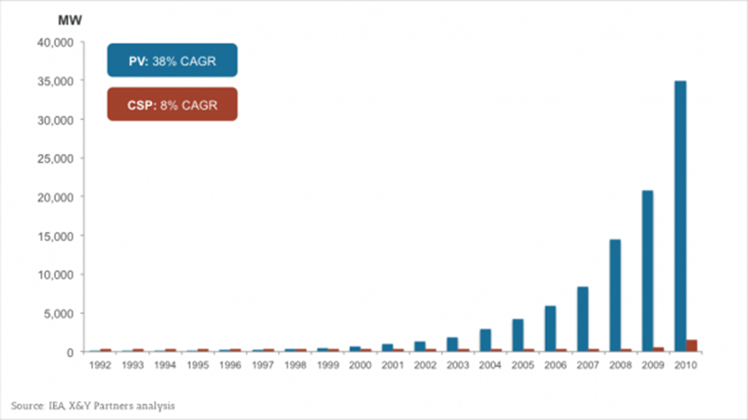
FIGURE 8-13 Megawatt Analysis of PV vs. CSP

Slide 31
COST BENEFITS OF PV SYSTEM COMPARED TO CSP SYSTEM 2.
Two Reasons for Ascendency of
Photovoltaics over Concentrating Solar Power:
Market Size
Technology

Slide 32
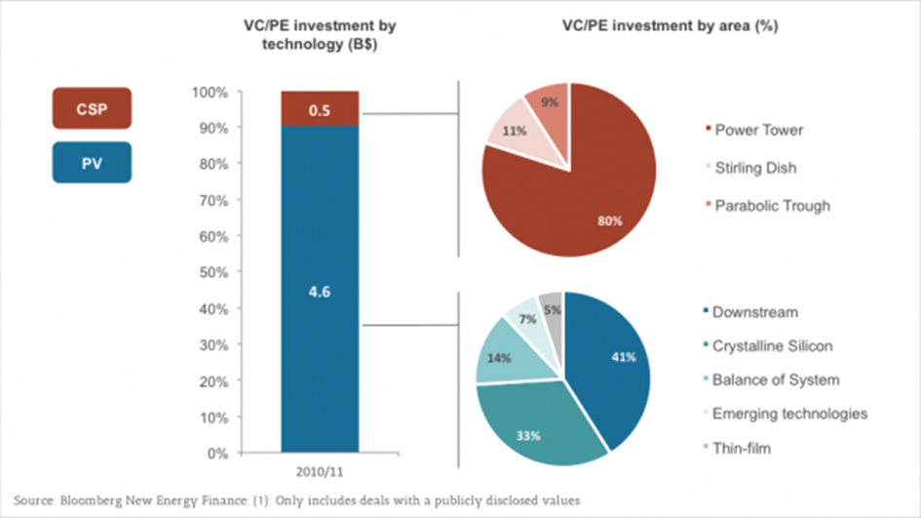
FIGURE 8-14 Venture Capital and Private Equity investment in PV and CSP (2010/2011)

Slide 33
CSP (CONCENTRATING SOLAR POWER) SYSTEM 3.
PV vs. CSP
Photovoltaics (PV) installed almost everywhere
CSP can be installed, reverse is not true
CSP technology needs higher levels of irradiance
Large-scale distributions like 20 Megawatts
PV (Photovoltaics) centers on solar cell
CSP is collection of sophisticated components

Slide 34
CSP (CONCENTRATING SOLAR POWER) SYSTEM 4.
EPBT (Energy Payback Time)
Time required to generate as much energy
As is consumed during production/lifetime of system
Payback time has been decreasing
2000, PV energy payback time for PV 8 to 11 years
2006 1.5 to 3.5 years for crystalline silicon PV systems
2013 dropped to 0.75–3.5 years.
Energy Return on Investment: 2:04

Slide 35
QUESTION 2:
Which of these uses three different approaches to solar energy: power tower systems, trough systems, and dish/engine systems ?
a. Grid parity
b. Concentrating Solar Power
c. Grid integration
d. Photovoltaics

Slide 36
ANSWER 2:
Concentrating Solar Power

Slide 37
STUDENT ACTIVITY 2.
Download WORD file: EPBT (Energy Payback Time) of Activity 1

Slide 38
CSP (CONCENTRATING SOLAR POWER) SYSTEM 5.
EROEI (Energy Returned on Energy Invested)
Ratio of electricity generated divided by
Energy required to build and maintain equipment
EROEI uses the following formula:
$EROEI= \frac{Electricity Generated }{Energy required to build and maintain the equipment}$

Slide 39
QUESTION 3:
Which of these solar systems offers higher efficiency and better energy storage capability?
a. Dish/engine
b. Photovoltaics
c. Trough
d. Power tower

Slide 40
ANSWER 3:
Power tower

Slide 41
STUDENT ACTIVITY 1.
Download WORD file: Cost Benefits PV (Photovoltaics) System vs. CSP (Concentrating Solar Power) System

Slide 42
GRID PARITY 1.
Grid Parity
Alternative energy source that can generate power
At LCOE (Levelized Cost of Electricity)
< or equal to price of buying power from local utility grid
LCOE is generally used when discussing
Renewable energy sources, like solar and wind power
Grid parity depends upon whether you calculate
From view of a consumer or power utility

Slide 43
STUDENT ACTIVITY 4 .
Download WORD file: Grid Parity

Slide 44
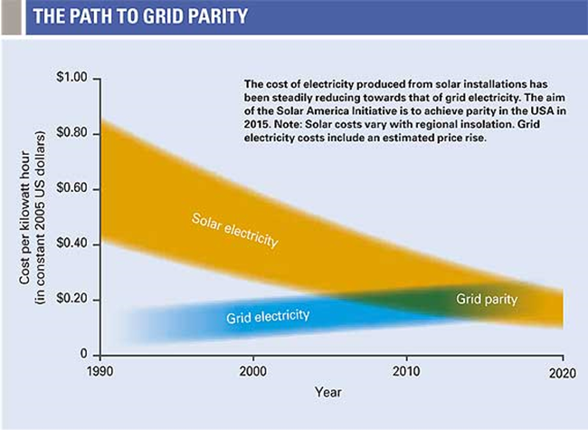
FIGURE 8-15 path to grid parity

Slide 45
GRID PARITY 2.
Reaching Grid Parity
Point at which an energy source becomes
Competitor for widespread development
Pricing of electricity from the grid is very complex
Utility providing power
Utility delivering power
Often separate bodies who enter into an agreement
Sets fixed rate for all of the power delivered
Grid Parity: 4:01

Slide 46
GRID INTEGRATION 1.
Grid-Integrated Photovoltaic Power System
Electricity generating solar PV power system
Connected to utility grid
Consists of solar panels, inverters, a power conditioning unit
Grid connection equipment
Small residential and commercial rooftop systems to
Large utility-scale solar power stations
Grid-connected photovoltaic system supplies excess power
Redefining What’s Possible: Grid Integration: 3:21

Slide 47
FIGURE 16 PV Grid Integration with Utility Grid

Slide 48
Electrical Energy Distribution

Slide 49
GRID INTEGRATION 2.
Typical System
Systems with more than a10 kilowatt capacity
Meet load of most customers
Supply excess power to the grid
Consumed by other users
Meter is used to monitor power transferred
If PV wattage exceeds average consumption
Produce revenue by selling the power back to utility

Slide 50
QUESTION 4: ?
Which of these is the time requisite to generate as much energy as is consumed during the production and lifetime operation of the energy system?
a. EPBT (energy payback time)
b. EROEI (Energy Returned on Energy Invested)
c. LCOE (Levelized Cost of Electricity)
d. LEC (Levelized Energy Cost)

Slide 51
ANSWER 4:
EPBT (energy payback time)

Slide 52
LCOE (LEVELIZED COST OF ELECTRICITY) 1.
The LCOE (Levelized Cost of Electricity)
Measure of a power source
Compare different methods of electricity generation

Slide 53
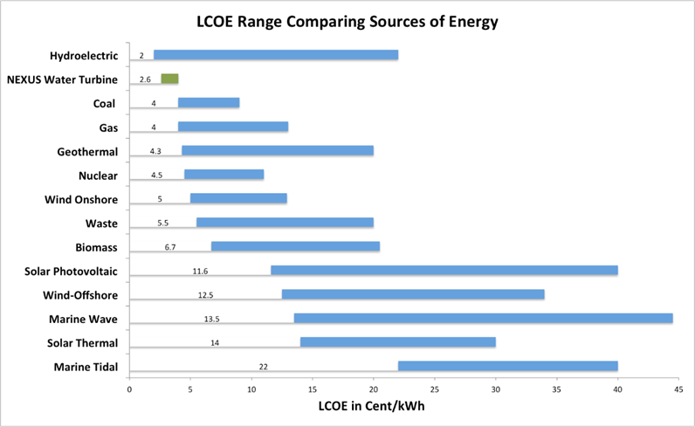
FIGURE 8-17 shows a comparison of LCOE across energy sectors. LCOE is an economic assessment of average total cost to build & operate a power-generating asset over its lifetime divided by total energy output of asset over that lifetime.

Slide 54
LCOE (LEVELIZED COST OF ELECTRICITY) 2.
LCOE Cost Factors:
Capital costs (waste disposal) -low for fossil fuel power stations; high for wind turbines, solar PV; very high for waste to energy, wave and tidal, solar thermal, and nuclear
Fuel costs - high for fossil fuel and biomass sources, low for nuclear, and zero for many renewables
Factors such as costs of waste and different insurance costs are not included in works power or parasitic load or portion of generated power actually used to run station's pumps and fans.

Slide 55
LCOE (LEVELIZED COST OF ELECTRICITY) 3.
Formula for LCOE is listed below:
$LCOE= \frac{Sum of Costs over Lifetime}{Sum of Electrical Energy produced over Lifetime}$
Solar: LCOE: 12:49

Slide 56
LCOE (LEVELIZED COST OF ELECTRICITY) 4.
Factors Affecting LCOE
Electricity price
Adjusting for inflation
Process improvements
Average retail price of equipment

Slide 57
QUESTION 5:
Which of these is a measure of a power source which tries to compare different methods of electricity generation on an equivalent basis?
a. EPBT (energy payback time)
b. EROEI (Energy Returned on Energy Invested)
c. LCOE (Levelized Cost of Electricity)
d. LEC (Levelized Energy Cost)

Slide 58
ANSWER 5:
LCOE (Levelized Cost of Electricity)

Slide 59
Summary (1 of 4)
Photovoltaics or just PV is defined as the production of electric current at the interface of two semiconductor materials, which causes them to absorb photons of light and release electrons to produce electricity and is a form of renewable energy
PV concerns the conversion of light into electricity using semiconducting materials that exhibit the photovoltaic effect as electrical current being produced at the junction of light and a semiconductor or the use of solar (sun based) energy.
In a solar cell, a thin semiconductor wafer is used to form an electric field, positive on one side and negative on the other. When light strikes the solar cell, electrons are loosened from the atoms in the semiconductor material N-type and P-type silicon wafers. With electrical conductors attached to the positive and negative sides, an electrical circuit is formed so the electrons can develop an electric current.

Slide 60
Summary (2 of 4)
Solar cells are electrically connected to each other and mounted in a frame is called a photovoltaic module. The current produced by a module is directly dependent on how much light strikes the module. Multiple modules can be wired together to form an array.
Multiple solar modules are wired together to form an array. The larger the area of a module or array, the more electricity will be produced. Photovoltaic modules and arrays produce DC electricity. Inverters used to change the DC to AC.
PV Installations may be ground-mounted, rooftop mounted or wall mounted.
Concentrating Solar Power (CSP) technology uses three alternative technological approaches: power tower systems, trough systems, and dish/engine systems.

Slide 61
Summary (3 of 4)
The high efficiency of PV systems reduces the balance of system costs. For areas with a high annual direct normal irradiance of 2000 kilowatt-hours per square meter or more, the cost of electricity is in the range of $0.08–$0.15 per kilowatt hour and installation cost for a 10-megawatt CPV power plant is about $1.50-$2.30 per watt peak.
In 2010 PV had a global installed capacity of approximately 35 Gigawatts, compared with CSP’s 1.5 Gigawatts. There are two reasons for the ascendency of Photovoltaics over Concentrating Solar Power:
Photovoltaics (PV) can be installed almost everywhere that Concentrating Solar Power (CSP) can be installed, but the reverse is not true. CSP technology needs higher levels of irradiance, access to water, and large-scale distributions like 20 Megawatts or more compared the small amount of kilowatts in a residential PV system.

Slide 62
Summary (4 of 4)
The energy payback time (EPBT) of a power generating system is the time required to generate as much energy as is consumed during production and lifetime operation of the system.
EROEI (energy returned on energy invested) is the ratio of electricity generated divided by the energy required to build and maintain the equipment.
Grid parity is an alternative energy source that can generate power at a LCOE (Levelized Cost of Electricity) that is less than or equal to the price of purchasing power from the electricity grid.
A grid-integrated photovoltaic power system is an electricity generating solar PV power system that is connected to the utility grid.
LCOE (Levelized Cost of Electricity) is a measure of a power source which attempts to compare different methods of electricity generation on a comparable basis.

